Slide 1


Promoting College Readiness for Individuals with Intellectual & Developmental Disabilities (IDD) and Autism Spectrum Disorder (ASD)
Stacie Rulison, M.S., M.Ed., BCBA, LBA
February 22, 2024
Balance MI-Skills, Inc.

Slide 2
Session Information
Session Specific:
PowerPoint
Participant Guide (with session specific information and resources)
Guided Notes
Resources
Student Guide: Thinking About College or Higher Education: Considerations, Skills, and Supports for Students with Intellectual and Developmental Disabilities (IDD) and Autism Spectrum Disorder (ASD) Considerations for Students with Intellectual and Developmental Disabilities (IDD) and Autism Spectrum Disorder (ASD)
Self-Assessment: Considerations for Students with Intellectual and Developmental Disabilities (IDD) and Autism Spectrum Disorder (ASD) Planning to Attend College or Higher Education
For Reference and Information
Interventions Commonly Used to Support ASD and IDD-Descriptions
Notes:
SR

Slide 3
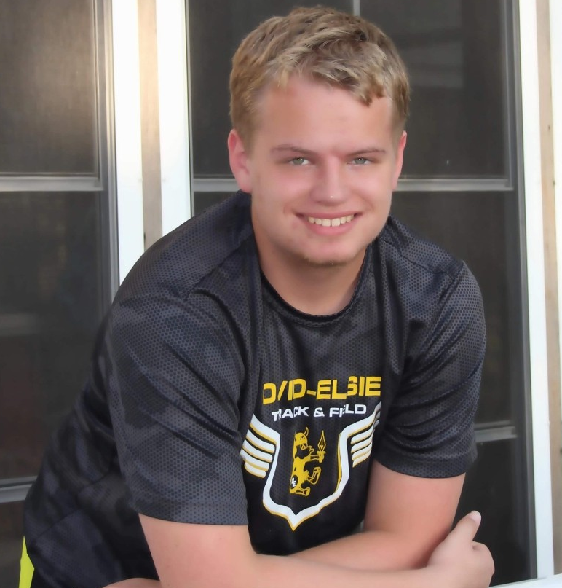
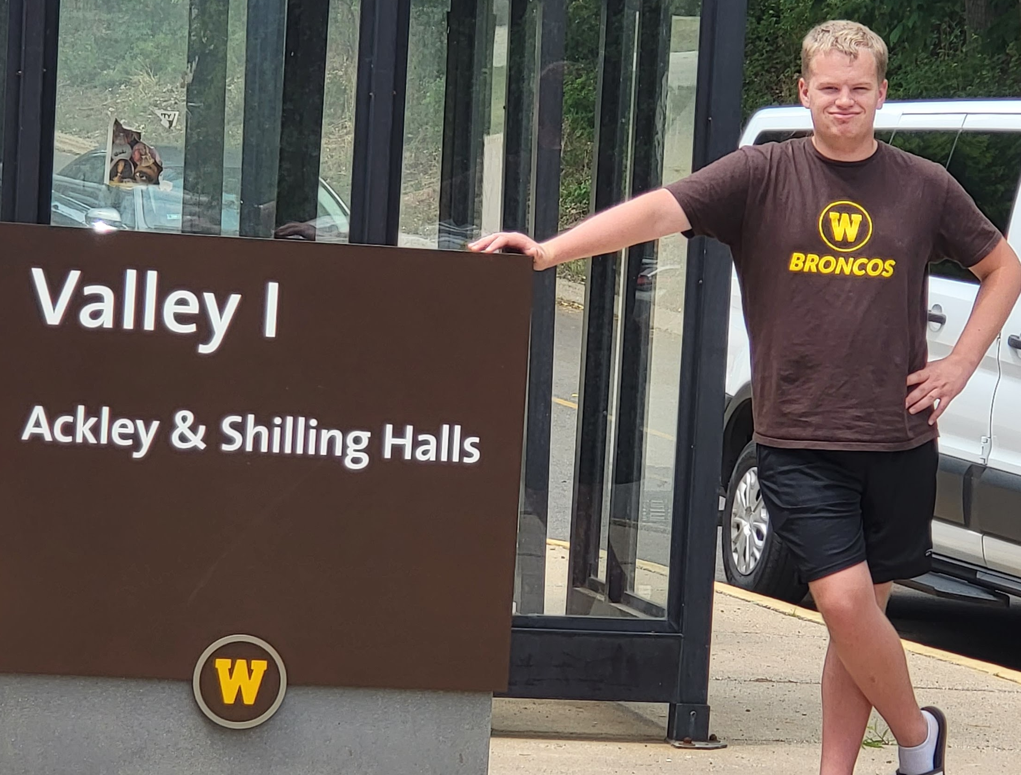
Background
Stacie Rulison, MS, M.Ed, BCBA, LBA
Consultant with MI Dept of Education (MDE), Office of Spec Education (OSE), Michigan Alliance for Families, Statewide Autism Resources and Training Project (START)
MI Autism Council 8 years; development team for the MI ASD State Plan; numerous state level committees; state and national and presentations on autism, disabilities, behavioral intervention, other
Clinical practitioner working with disabilities since 2008; UCLA PEERS® Certified
Co-owner of Balance MI-Skills, Inc.
Parent of 19-year-old autistic adult
Notes:
SR/LE

Slide 4

Objectives
Gain knowledge and information related to IDD and ASD pertaining to college and higher education readiness:
Impact of IDD and ASD characteristics
Data and research on entry, completion, challenges and barriers, intervention and supports
Essential skills for improved outcomes
Impact and opportunities of transition programming
Increased support needs in college and higher education
Tools and resources

Slide 5

Participants
Self-advocates
Parents
Educators (general or special education, transition coordinators, administrators)
Vocational rehabilitation
Professional services or therapists (Counselors, SLPs, OTs, Psychologists, BCBAs, other)

Slide 6

True or False
Most individuals with intellectual disabilities are severely impacted.
False
About 85% of people affected with IDD are mildly impacted
American Psychiatric Association

Slide 7
True or False
Many transition programs are adequately preparing young adults with IDDs and ASD for college.
False
Many do not focus on skills needed to be successful in college

Slide 8
True or False
When the majority of students with ASD leave high school with high academic achievement, they are likely to have academic and other challenges in college.
True
Research supports several factors which contribute to reduced academic performance in college.

Slide 9
True or False
Disability service supports at most colleges are adequate for students with ASD.
False
Research supports the benefits of supplemental support from professionals who understand autism and its features in addition to interventions, strategies, and supports for ASD

Slide 10
True or False
About 36% of young autistic adults ever attended postsecondary education of any kind between high school and their early 20s, including 2-year or 4-year colleges or vocational education
True
A National Autism Indicators report issued by Drexel University indicates this is in fact true.
Roux et al., 2015; Drexel National Autism Indicators Report, 2015

Slide 11

IDD & ASD

Slide 12
Impact and Disabilities
IDDs and ASD share a number of features and challenges
Autistic individuals may need additional supports to improve outcomes
Heterogeneity, increased prevalence, and impact of autistic characteristics
High rate of comorbidity: 60% of youth have at least two health or mental health (co-existing) in addition to ASD
19% of young adults with autism ever lived independently after high school compared to 60% of peers with speech and language or emotional disabilities and 80% of peers with learning disabilities
Autistic young adults worked for pay in the community between high school and their early 20’s at significantly lower rates than peers with other disabilities
Higher rate of “disconnecting” after high school than peers with other disabilities
Lower higher education completion rate than other IDDs
Roux et al., 2015

Slide 13
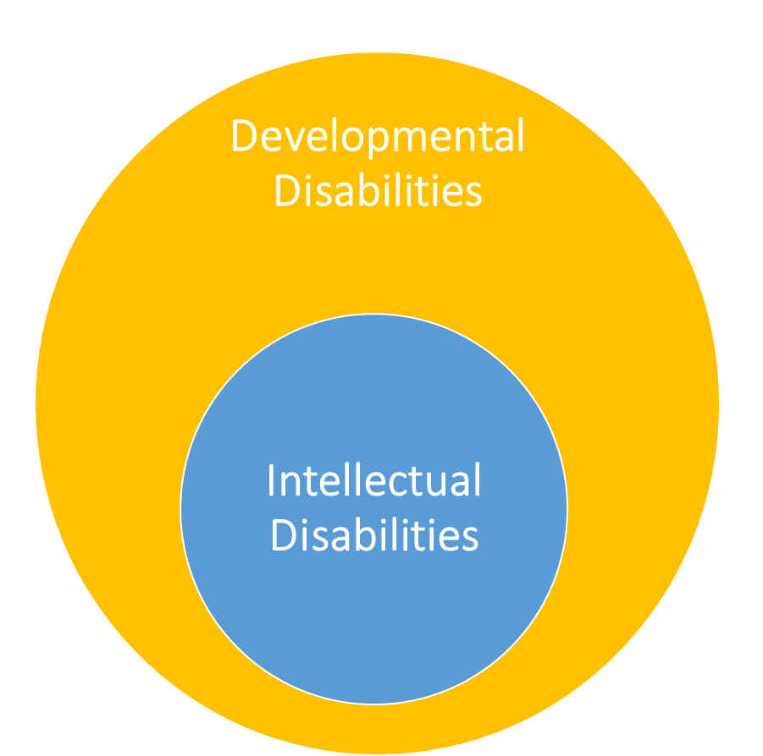
IDD
Group of conditions: neurodevelopmental, genetic, communication disorders
IDs, ASD, ADHD, cerebral palsy, vision loss, others
Physical, learning, language, behavior, cognitive
Self-care, socializing, communicating, reasoning, problem solving, planning and organizing, thinking, comprehending complex ideas, experiential learning
Lifelong with onset before 22 years
Increasing with 8.6% of children 3-17y (CDC, 2021)
Significant rate of co-morbidity 30-50% (up to 18y)
Autism is the fastest growing developmental disability in the US (1:36)
CDC, 2021 (IDD); CDC 2023 (ASD)

Slide 14

Intellectual Disabilities (ID)
Cognitive impairment (CI)-eligibility in special education
More significant impact intellectually (thought processes)
Conditions: injury, disease, problem with the brain (infections)
Preventable IDD: environmental (fetal alcohol syndrome)
Unpreventable IDD: chromosomal cause (Down’s Syndrome)
Examples: epilepsy, cerebral palsy, birth issues, stroke, TBI
CDC, 2021 (IDD)
Notes:
LE

Slide 15
Misconceptions about Learning & IDD
Facts:
Majority have mild IDD
70% develop functional reading
Learning process slower
Underestimated in cognitive abilities (receptive vs. expressive)
Can learn new skills/gain knowledge
Brain forms new connections throughout the lifespan
Uneven cognitive profile (splintered skills)
Learning outcomes cannot be improved through education
Cannot learn anything complex such as reading
(Centre for Educational Neuroscience; Hughes et al., 2022)
Notes:
LE

Slide 16
ASD Prevalence Data
1994
1:2,000
(DSM-IV)
2023
1:36
(CDC)
2013
16,730
(MDE-Office of Special Education)
2023
25,147
(MDE, Office of Special Education)
DSM-IV, CDC, MDE

Slide 17

Comorbidity and ASD
Overall comorbidity (75%-80%)
ASD-mental illness/psychiatric diagnosis= up to 75% (Buck et al., 2014; Hofvander et al., 2009; Joshi et al., 2013; Vohra et al., 2016)
ASD common comorbidities (World Journal of Pediatrics, 2021)
ADHD=50-70%
Depression=26% (versus 10% general population)
Anxiety=30% (versus 10% of general population)
Bi-Polar=11% (versus 2% of general population)
Schizophrenia=7% (versus .5% of general population)
Down’s Syndrome=40% (versus .125% of general population)
Epilepsy=30% (versus 6-7% of general population)
Sleep disorders=50%-80%
Gastrointestinal and feeding disorders=46%-84%
Immune deficiency=25%
Cardiovascular issues=37% (versus 23% of general population
Obesity 30% (versus 13% of general population)
Others: skin conditions, asthma, allergies, frequent ear infections, pica, pain

Slide 18
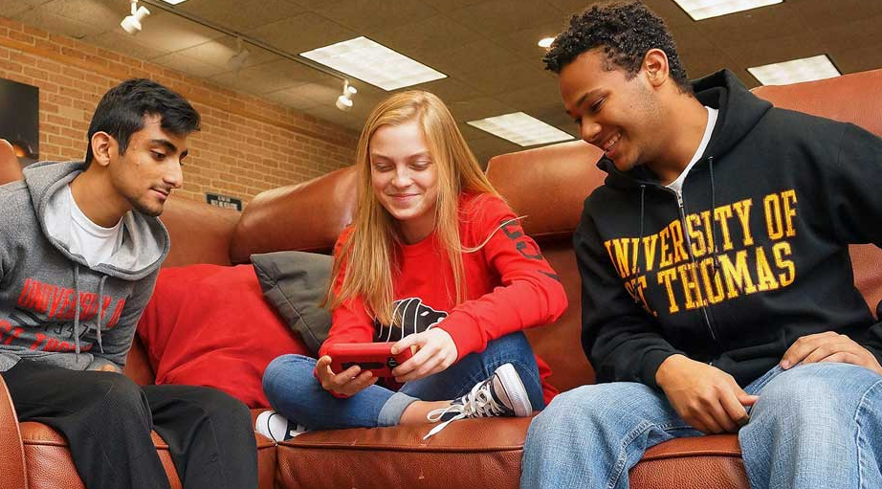
IDDs and ASD
Cognitive features across IDDs
Intellectual and Developmental Disabilities (IDD)
Autism Spectrum Disorder (ASD)

Slide 19

IDD Features and Impact
Initiation, planning, organization
Receptive-expressive language
Adaptive and daily living skills
Social cognition
Eye contact, volume control, body boundaries
Learning and processing
Hyperactivity, impulsive, focus
Self-regulation and over-emotional reactions
Self-advocacy
Executive function
Sensory
CDC; Pagni et al., 2020

Slide 20

ASD: IDD Features Plus…
Detail-oriented versus big picture
Perspective taking
Intense interests/hyper-focus
Repetitive, restricted behaviors or verbalizations
Eating and sleeping habits vary
Sensory – across systems
CDC; Pagni et al., 2020

Slide 21

ASD Impact
Sensory Behaviors
Hyposensitivity
Hypersensitivity
Self-regulation
Self-stimulatory behavior (stimming)
Not a medical diagnosis (at this time), but symptom of ASD
Considered a “feature” of ASD
DSM-5; Kojovic et al., 2019; UCLA Health
Notes:
CHAT: Can they name some stims they may have seen?

Slide 22
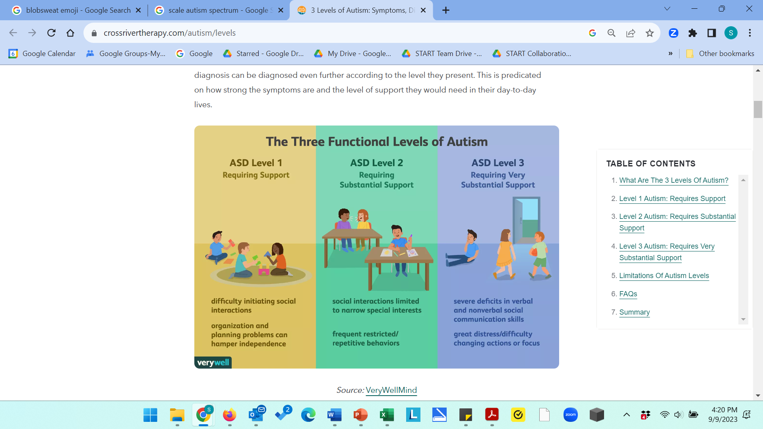
Autism Spectrum Disorder (ASD) Core Symptoms
DSM-5 Diagnostic Criteria, Centers for Disease Control (CDC); graphic from Very Well

Slide 23

ASD Impact
Strengths
Visual processing
Memory
Analytical and refined skills
Knowledge about specific topics
Straightforward
Authentic
Curious
Loyal

Slide 24

ASD Impact
Females
Presents differently – delays diagnosis
More advanced vocabulary
Imitate peers more often
More control of behavior
High motor skills early in life
Internalizing behaviors vs. externalizing
Emotional vs. physical behaviors
Quiet-so noticed less
Mask symptoms
PsychCentral

Slide 25

ASD Impact
Gender Preferences
Gender identity and sexuality more varied in ASD than general population
Gender is a spectrum like ASD
Research:
30% of individuals of autistic people identified as heterosexual compared to 70% of neurotypical peers
6.5% autistic adolescents and 11.4% of autistic adults wish they were the gender opposite of birth gender compared to 3% and 5% of the general population, respectively
Less influenced by social norms
Hormone differences may exist
George & Stokes, 2018

Slide 26

IDD & ASD Intervention & Supports
Applied behavior analysis (ABA)
Speech therapy-expressive and receptive skills
Occupational therapy-sensory supports
Social work interventions
CBT-therapist familiar with ASD
Visual supports; routine and structure
Functional communication training
Self- awareness, management, monitoring
Emotional self-regulation
Social skills training
Parent training

Slide 27

ASD Learning
Skills are splintered across domains
Prerequisite skills
Incremental learning (stepwise)
Maintenance and generalization
Support needed:
Reciprocal interactions
Imitation
Receptive/expressive skills

Slide 28

ASD & Cognition
Symptoms:
Thinking, concentrating, remembering, making decisions, learning, paying attention, speaking, motor coordination, confusion, judgement, regulation, expressive-receptive language and processing….
Effects:
Exhaustion, overwhelmed, anger, anxiety, stressed, depression, sadness
Impacts:
School and academics, social relationships, higher education, employment, community integration
CDC; Pagni et al., 2020
Notes:
1-14

Slide 29

Research & Data: Outcomes

Slide 30
IDD Students Leaving High School
Leaving Secondary Education
Diploma
Work
Post High School Education
(college, tech, military, etc.)
No Diploma
Post High School Transition Program (ISD)
Work
Inclusive Postsecondary Experience
Focus today

Slide 31

IDD-Students Finishing without a Diploma
Inclusive Postsecondary Education for Students with Intellectual Disability (IPSE): attending college with peers and receive the same benefits of peers on campus including social activities, internships, recreation, living, classes for credit or audit; as of May 2023, there were 310 IPSE programs in the US
ThinkCollege is a national technical assistance center and clearinghouse for individuals with ID and their families

Slide 32
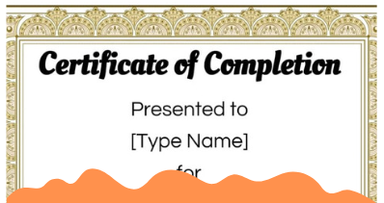
IDD-Students Finishing without a Diploma
College programs offer certificates and inclusive college experience who did not attain high school diploma
Varied requirements for class completion with certificates or credit
Higher education opportunities for individuals with ID show improved employment outcomes and increased community participation (Kleinert, 2012)
Postsecondary programs nationwide through authorized funding from the Higher Education Opportunities Act of 2008 (HEOA) in the form of Transition Programs for Students with Intellectual Disabilities (TPSID)
Typically, full tuition required with some grants or financial supports available, depending on location

Slide 33
Disability Postsecondary Education Data
21%
U.S. Disability Areas of Difficulty Categories
Ages 18-64 Years (2022)
28.6%
36.8%
Postsecondary National Policy Institute, 2023; US BLS Census, 2022
Notes:
Total US Disabilities: 44.1M
Total Aged 18-64 with a Disability: 22.0M

Slide 34
True or False
The number of students with IDD and ASD graduating from college are close to the number of students graduating without disabilities.
False
There is a significant difference in education attainment for those with and without disabilities.

Slide 35
Disability Postsecondary Education Data
US Population Educational Levels
Ages 25-64 (2019)
Numbers represented in Millions
21%
28.6%
52.8%
36.8%
US BLS Census, 2022

Slide 36
True or False
Of the number of students with a disability who start college working toward a bachelor’s degree, less than 20% get a bachelor’s degree.
True
According to the BLS, about 18% get a bachelor’s degree.
Petcu et al., 2021

Slide 37
Disability Postsecondary Education Data
US Population with a disability who attended college and report attaining a Bachelor’s Degree
25 Years & Older (2019)
18%
28.6%
52.8%
82%
Postsecondary National Policy Institute, 2023; US BLS Census, 2022

Slide 38
True or False
Students with ASD are more likely than peers with other disabilities to enroll in a 2-year versus 4-year college program.
True
About 32% of autistic students enroll in 2-year colleges compared to a 4-year college (17%).
Petcu et al., 2021

Slide 39
Postsecondary Completion Rates
Completion rates of postsecondary education of students with no disabilities, all disabilities, and ASD
28.6%
Newman et al., 2015

Slide 40
True or False
The numbers of individuals with IDD not in the workforce is consistent with the general population not in the workforce.
False
There is a large disparity for people with and without disabilities who are employed, unemployed, and not in the workforce.

Slide 41
U.S. Employment Data
US Civilian Population
Employment Data
Ages 16 Years and Older
(2022)
28.6%
US BLS Census

Slide 42


ASD Prevalence
Between 2011 and 2019, autism prevalence more than doubled among those over age 18 enrolled in Medicaid with over 403,000 autistic Medicaid beneficiaries (often working under-paid jobs, no jobs, or unemployed)
Journal of the American Medical Association (JAMA) Psychiatry, Oct 4, 2023
This Photo by Unknown Author is licensed under CC BY-NC
Notes:
he study findings suggest that despite difficulties in identifying autism in adults, there is a considerable and growing population of autistic adults enrolled in Medicaid. As children on the autism spectrum become autistic adults, Medicaid is an important insurance provider for an increasing number of autistic adults and can be a valuable resource for understanding the health of the autistic population.

Slide 43

ASD
21%
Entrance into adulthood is a vulnerable time, especially for young adults on the autism spectrum. Even as they continue to experience issues with communication, social skills, behavioral challenges, organization, decision-making, planning, and co-occurring mental health problems, these youth are expected to move into the world of adult work, continued education, and new living situations – often without adequate preparation or help.
28.6%
36.8%
36.8%
National Autism Indicators Report, 2015

Slide 44
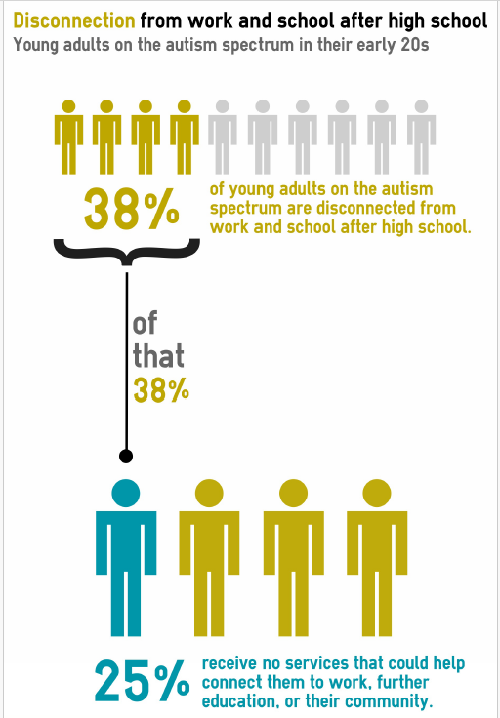
ASD
21%
Individuals with Autism
Life After High School
28.6%
36.8%
Disconnected=no job or continuing education post high school
Young autistic adults had far higher rates of disconnection than peers with other disabilities. Less than 8% of young adults with a learning disability, emotional disturbance, or speech-language impairment were disconnected, compared to 37% of those with autism.
36.8%
Roux et al., 2017

Slide 45

Reasons Students with IDD and ASD Leave Early
Lack of transition planning in high school
Student readiness, expectations, lack of disclosure
Institutional lack of knowledge and support at college/higher level education
Challenges with social engagement, self-advocacy, and executive function are interrelated and perpetuate challenges in navigating college and leaving early
Additional targeted supports are needed for improved outcomes for students with ASD

Slide 46
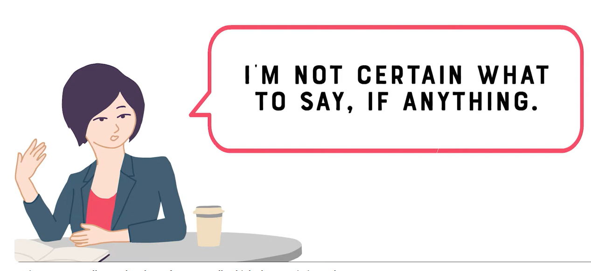
Social Communication-College
Video: Autism Goes to College, What do Professors Really Think About Autistic Students?

Slide 47

Research
Transition Planning and Readiness

Slide 48
Research Summary on College Experiences
Lack of Transition Planning and Readiness: Research Summary
Students with IDD and ASD are not adequately prepared for transition to college in high school programs
Students with IDD and ASD are not entering college with basic skills for success in college
Students with ASD are less likely than peers to enroll in 2 or 4-year colleges
Programming in high school for transition in the areas of executive function, communication, living skills, and self-advocacy could be beneficial for student with IDD
Jackson et al., 2018; White et al., 2017;White et al., 2016; Smith et al., 2012; Taylor & Seltzer, 2010;

Slide 49
ASD Research on College Experiences
Lack of Transition Planning and Readiness-Supporting Citations
Students with ASD are less likely than peers to enroll in 2 or 4-year colleges than neurotypical peers, and peers with other disabilities (White, 2017)
45% of children with ASD and becoming adults in the next 10 years are expected to seek higher level education (Jackson et al., 2018)
Programming to support a smooth transition from high school to postsecondary education may prove critical in helping students succeed in the postsecondary environment, as well as preventing a host of adverse outcomes (i.e., skill loss, symptom exacerbation, and poor quality of life, in adulthood) (White et al., 2016).
ASD features such as social communication difficulties and daily living skills tends to peak, or sometimes worsen, after adolescence (Smith, Maenner, & Seltzer, 2012; Taylor & Seltzer, 2010), so intervening during this transition timeframe may be valuable when considering longer term outcomes (White, et al., 2017)

Slide 50
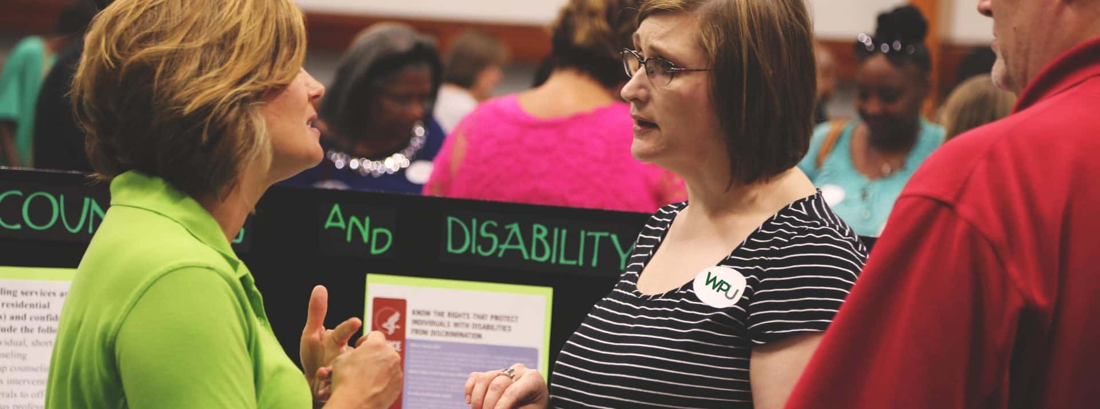
Research
Institutional Challenges

Slide 51
True or False
Students with IDDs and ASD may not disclose their disability to campus disability support offices.
True
Many try to fit in and are concerned about being stigmatized

Slide 52
True or False
Mental health concerns are a primary reason students with ASD leave college.
True
Perpetuated by lack of social, executive function, and self-advocacy skills

Slide 53
Research on College Experiences
Institutional Challenges-Summary
Lack of understanding of and knowledge by disability supports at the college about features and needs of disabilities.
Lack of staff with knowledge about autism and specific needs to promote success (social skills groups, mentors, sensory).
Traditional supports such as extended test time, quiet locations, etc. do not meet the needs of individuals with ASD.
Faculty is not trained or prepared to support individuals with ASD or IDD.
Mental health and social isolation are primary factors in dropout rates in colleges for students with disabilities.
Wood, 2022; Cox et al., 2021; Cage et al., 2020; Myrvold et al., 2021; Roux et al., 2015

Slide 54
ASD Research on College Experiences
Institutional Challenges-Supporting Citations
ASD-Autistic students indicated personal challenges and institutional barriers in lack of supports and understanding needs impeding college success (Cox et al., 2021).
ASD-Many disability support organizations do not understand the specific needs of autistic students (Myrvold et al., 2021).
ASD-Over 85% of students with ASD who attend college in the US will enroll in a 2-year college at some point after high school and over half the students solely attend a 2-year college. Gaps in college supports can hinder their opportunities to succeed in this setting. (Roux et al., 2015).
ASD-IDD-System issues of lack of understanding ASD and cognitive issues with IDD, lack of acceptance, and absence of mental health supports at universities and colleges (Cage et al., 2020).
ASD-IDD-Colleges are set up for neurotypical versus neurodivergent individuals so transitioning into college with larger classrooms, time management, and crowded spaces is not always smooth (Wood, 2022).

Slide 55

Research
Expectations, Readiness, Other

Slide 56

Research
Expectations, readiness, other information-Summary
Culture shock upon entering college: size, expectations, social demands
Preconceived notion of dropping out from the time they begin college
When students don’t make it in college, they are embarrassed and self-deprecating about not feeling successful when they drop out
Dwyer, 023; Cage et al., 2020; Raines and Talaptara, 2018; Jackson et al., 2018; White, et al., 2017; Haber et al., 2016

Slide 57
Research
Expectations, readiness, acceptance, culture, other information-Supporting Citations
Students with ASD are less likely than peers to enroll in 2 or 4-year colleges than neurotypical peers, and peers with other disabilities (White, 2017)
45% of children with ASD and becoming adults in the next 10 years are expected to seek higher level education (Jackson et al., 2018)
Upon entering college, students experience culture shock, disengage, do not initiate for support (and there is not proactive support), and there is a perceived end-result as dropping out—which appeared to be the only option (Cage, et al., 2020).
Students with IDD often lack specific tools needed to be successful in postsecondary education and it is critical to include families during transition planning (Raines and Talaptara, 2018).
After leaving college, students experience trauma from their time at college and embarrassment and shame for not being successful (Cage et al., 2020).
College and career readiness supports can assist individuals with IDD achieve greater success in postsecondary education, employment, and independent living (Raines and Talaptara, 2018).
Students with IDD are less likely to stay in college and be accepted into student-run social organizations, and often are socially isolated (Haber et al., 2016).
Students with disabilities not only have challenges with adequate accommodations at college, but also face serious barriers of stigma and prejudice toward individuals who are neurodivergent (Dwyer, 2023).

Slide 58
Research on College Readiness
Journal of Vocational Rehabilitation (Roux et al., 2019):
Study analyzed WIOA state plans with a focus on identifying how states propose to improve delivery of VR services for TAY and adults with autism
Findings:
Need to increase capacity to provide VR services for those with autism was needed due to expressed concerns about the growing population of youth with autism potentially needing vocational services and the identification of autism as an underserved group.
This overall finding is consistent with other observations that states need to focus on their development of autism-specific policies and system capacity (Turcotte, et al., 2016).
Need more robust supports for multiple or complex disabilities.
More expertise in working with autism is needed.

Slide 59

Research
Social Communication, Self-Advocacy, Executive Function Needs

Slide 60
ASD Research on College Experiences
Social Communication (SC), Self-Advocacy (SA), Executive Function(EF)-Summary
Generalization challenges from high school to college
Executive function concerns with initiation, flexibility, organization and planning, time management, and prioritization are primary issues
Self-advocacy skills needs upon entering college to navigate the daily needs of students in college, seeking supports, and communicating needs
Social communication is a primary reason for increased anxiety and disconnecting from college, often leading to dropping out of college
Executive function, social skills, and self-advocacy skills are integrated and interrelated, and continually called upon simultaneously and not isolated skills
Davis, 2021; Myrvold, et al., 2021; Gorenstein et al., 2020; Mazzotti et al., 2020; Kudor & Accardo, 2018; Paradiz et al., 2017; White et al., 2017; Jansen et al., 2017; VanHees et al., 2015

Slide 61
ASD Research on College Experiences
Social Communication, Self-Advocacy, Executive Function Needs-Supporting Citations
Students with ASD experience a number of difficulties upon entering college which impede success including social-communication, lack of structure and routine, sensory issues, co-morbid conditions such as anxiety and depression, executive function issues affecting organizing and planning, and difficulty with fine motor and writing (Kudor & Accardo, 2018; Jansen et al., 2017), doubts about disclosure and mental health issues (VanHees et al., 2015).
Students are unaware of campus disability resource office and services and a 1/3 with mental health disabilities were not self-advocating or aware of eligibility for accommodations (Davis, 2021).
Stakeholders including self-advocates (student), parents, secondary and postsecondary educators where social difficulties were identified as a central need and the need to facilitate independently initiated and facilitated age-appropriate social interactions. Specific areas include interpersonal skills, capacity for intimacy, and a lack of social supports in college environments (White et al., 2017).

Slide 62
ASD Research on College Experiences
Social Communication, Self-Advocacy, Executive Function Needs-Supporting Citations
Experiences of college students suggest challenges with executive function, sensory needs, accessing appropriate resources, social interactions and situations, feelings of isolation, inability to self-advocate (Myrvold et al., 2021)
As young adults with autism transition into adulthood, they leave educational entitlements and self-advocacy becomes crucial in communicating needs and wants; and as daily self-advocacy increases, dependency on others decreases (Paradiz, et al., 2017).
Self-determination and self-advocacy are identified as research-based predictors for students with disabilities of postsecondary success in higher level education and employment and promising predictors of independent living and self care (Mazzotti et al., 2020).
Greater self-advocacy and emotional regulation are needed for improving higher education outcomes(White et al., 2017).
Individuals with ASD have challenges with interviewing, socially inappropriate behaviors, poor hygiene, and perspective taking (theory of mind) (Gorenstein et al., 2020).

Slide 63
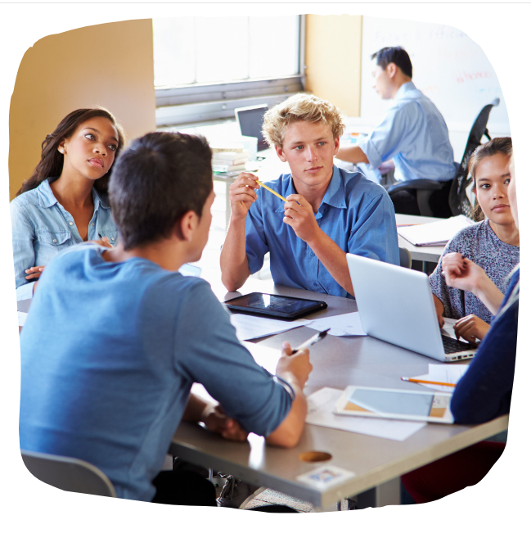
ASD Research
Most students can do the academics. It is the social landscape that is problematic; social skills are a greater predictor of postsecondary success than academics.
Nasamran et al., 2017

Slide 64

Research
ASD Specific Supports

Slide 65
ASD Research on College Experiences
Need for ASD Specific Supports
74 colleges in the U.S. have begun to explore these alternate approaches by initiating comprehensive autism-specific college support programs (McDermott & Nachman, 2020).
Autism-specific college support programs typically have fees averaging $6,525 USD annually that must be paid in addition to regular tuition (Barnhill, 2016).
As the unique needs of autistic students have become more apparent, some colleges are offering specialized programs providing practices effective for addressing academic, executive function, and social needs of students with ASD (Kuder and Accardo, 2018).
Although many students maintain acceptable or above average GPAs, many report needing executive function support for navigating academic requirements (planning assignments, time management, multi-tasking, making and following a study schedule, unclear course expectations, group work, and extensive class loads) and exhibit a need for autism-specific supports during their college experience (Myrvold et al., 2021).
Colleges and universities must reconsider supports available to autistic students. Consistent with other research (Accardo et al., 2018; Brown & Coomes, 2015; Newman et al., 2011; Roux et al., 2015; Sarrett, 2018), most of the students in this study spoke of receiving traditional academic accommodations (e.g., extended time on tests, quiet location for test taking). Recent studies argue autistic students may benefit more from non-traditional supports like customized transition programs, sensory-friendly spaces, social support groups, and faculty or peer mentors (Accardo et al., 2018; Brown & Coomes, 2015; Knott & Taylor, 2014; Roux et al., 2015; Sarrett, 2018).

Slide 66
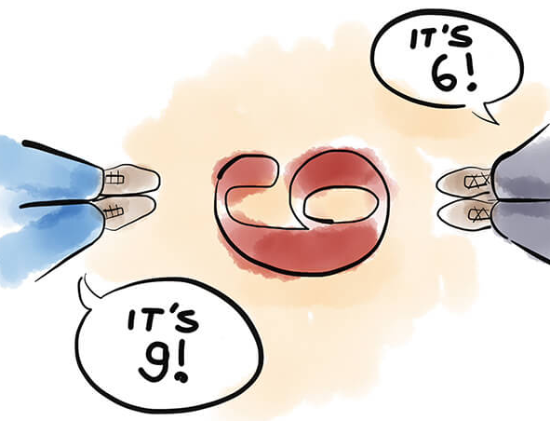
Research
Student Perspectives

Slide 67

Student Perspectives
Academic challenges or failure due to executive function issues (time management, flexibility, self-management; organizing and support for homework, studying, class expectations).
Mental health issues including social isolation, anxiety and depression exacerbated by challenges in college.
Need for greater self-advocacy in working with disability services and benefits of disclosure to getting needed supports, such as housing accommodations (low-noise).
Challenges across social contexts in communicating with peers and unsure how to start or maintain friendships, find common interests, and felt they repelled some students they wanted to be friends with; having prior social skills training in communications and developing relationships may be helpful.
The Postsecondary National Policy Institute, 2022; Myrvold, et al., 2021

Slide 68
Student Perspectives
Unaware of campus disability resource office and services and a 1/3 with mental health disabilities were not aware of eligibility for accommodations.
Navigating campus procedures and inadequate accommodations.
Classroom and instructional environment barriers including faculty unaware of disability accommodations, faculty who push back against accommodations, instructors who do not respond to requests for accommodations.
Negative interactions with fellow students, stigma of disability, and the added work of seeking support and accommodations for their disability.
Applying for accommodations for learning disabilities can be an involved process, and students who don’t receive support early face an increased risk of not graduating.
The Postsecondary National Policy Institute, 2022

Slide 69
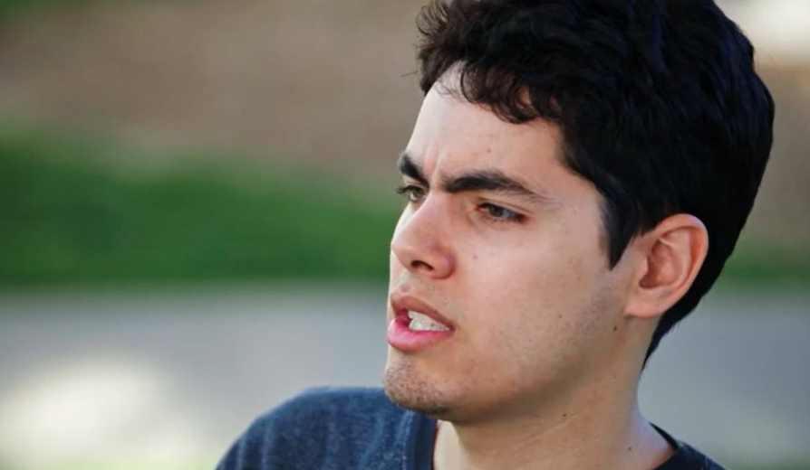
Student Perspectives of the College Experiences
Jonathon’s experience at college: Roommates (Autism Goes to College)

Slide 70

Related Activity
Brief Activity-facilitator will provide additional information related to the video

Slide 71

Keys to Increase Success

Slide 72

Focus on…
Disability Services-increased understanding of IDD and ASD features
Support models for ASD/more intensive needs
Evidence-based teaching and learning model
Expectations in high school vs. college
Match of skills and interests to college
Preparation in self-empowerment through the “Big 3” and interconnected skills (SA, SC, EF)
In high school and preparation for college
In college
Emphasis and strategies for teaching needed skills for success

Slide 73
Disability Support Services-Roles
Student
DSS
Faculty/Staff
Registers with DSS
Provides requested documentation
Reviews needs with the DSS counselor
Provides accommodation letter to faculty or professors
Communicates with faculty and professors as needed
Determines eligibility for services
Grants or authorizes academic accommodations
Assists faculty pertaining to disability specific questions or issues
Provides accommodations listed on letter
Respects student privacy
Contacts DSS if there are questions about disability or accommodations

Slide 74

Traditional College Accommodations
Self-identification required to get accommodations
Extra time on tests
Use of computer for exams
Accessible class materials
Assistive technology in class (i.e., screen readers)
Document conversion
Interpreters for deaf and hard of hearing
Readers or scribes for classes, exams, library research
Priority registration
Substituting one course for another
Allowing full-time student status for part-time schedule

Slide 75

Now…
Current model is not working for many students with ASD!

Slide 76
Disability Services-Increased Support
Student
DSS
Faculty/Staff
Additional Autism Supports (separate requirements, registration, and fees)
Registers with DSS
Provides requested documentation
Reviews needs with the DSS counselor
Provides accommodation letter to faculty or professors
Communicates with faculty and professors as needed
Determines eligibility for services
Grants or authorizes academic accommodations
Assists faculty pertaining to disability specific questions or issues
Provides accommodations listed on letter
Respects student privacy
Contacts DSS if there are questions about disability or accommodations

Slide 77

Increased Support Models
Degree seeking and accepted to university
Supports provided through the college-sub-program of disability office
Intensive individualized support with academic coach
Weekly meetings focused on executive function (time management, goal setting, problem solving), social communication skills, self-advocacy (self-management, understanding needs and requesting supports)
Observations or check-ins with professors
Social skills learning, coaching, practice weekly
Group social opportunities 1-2 times monthly
Pairing with other students (without disabilities) as mentors
Assistance navigating campus, resources, life skills
Fee based for some programs, for some no fee

Slide 78

Increased Support Models
Why do these models promote better outcomes?
Intensified supports targeting ASD features
Strong knowledge of ASD, learning style, best practice strategies (minimize dependence)
REAL TIME practice-not just conceptual
Generalization of skills already learned
Modifying learned skills to fit the context
Learn social expectations (may be new concept)
Peer supports

Slide 79
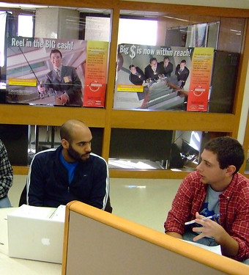
Additional ASD Support Considerations
Address areas such as:
Communication: receptive/expressive skills; conversations; verbal and non-verbal communication
Accommodation examples: notetaker, instructor notes, study guides for tests, waiting for longer response times, written communication; be concise, assure understanding
Social skills: group activities, flexibility, non-verbals
Accommodations: breaks, ensuring appropriate inclusion, written rules (visual) for rules for asking/answering questions
Adapted from Indiana Resource Center for Autism: Academic Supports for College Students with an ASD

Slide 80

Additional ASD Support Considerations
Sensory needs: hypo or hypersensitivity; overload
Accommodations: sunglasses, ear buds, seating choices, may leave abruptly due to sensory issues, plan to address sensory needs, quiet space
Motor skills: gross and fine motor skills and motor planning, awareness of body space, balancing, walking; holding pencils, turning pages, using keys and locks, utensils
Accommodations: using a computer for in-class work, notetaker, longer time to finish assignments, breaking down work into steps, alternate forms of transportation, typing versus writing notes
Adapted from Indiana Resource Center for Autism: Academic Supports for College Students with an ASD

Slide 81

Additional ASD Support Considerations
Learning style: splintered learning; sequencing, attention, may need to realize something is important or meaningful to them and be unaware they are having academic difficulty until it is too late to correct on their own
Accommodations: provide review sheets, checklists, check-ins, deadlines, hands on learning, demonstrations, peer mentors paired with student for feedback and structure for staying on task. Professors can provide positive feedback, encourage use of calendars, quiet study locations, negotiation of deadlines, extra transition time
Adapted from Indiana Resource Center for Autism: Academic Supports for College Students with an ASD

Slide 82

Additional ASD Support Considerations
Self-regulation and coping: high anxiety and stress; sensory, changes; social expectations, stims-make others uncomfortable; leave unexpectedly, rock, pace, chew on fingers/clothes, lecture on topics, other unusual behavior
Accommodations: professor and student agree on a cue when the student needs to leave, ask if something is bothering the student or if they are overwhelmed, allow for comfort objects
Adapted from Indiana Resource Center for Autism: Academic Supports for College Students with an ASD

Slide 83
Learning Model
Behavior Skills Training (BST) Model-EBP for Teaching Skills
Teach (explain what needs to be done)
Model (show them how to do it)
Practice (have them do it)
Coach (provide feedback and guidance through prompts and reinforcement)
Teach
Model
Practice
Coach
BST
Schaefer et al., 2021; Kirkpatrick et al., 2019, Ervin et al., 2018; Morgan et al., 2018; Warner-Horner et al., 2012

Slide 84
FOCUS: The Big Three!
Self-Empowerment
Executive Function
Social Communication
Self-Advocacy

Slide 85

Interconnection of Skills
EF=Executive Function
SA=Self-Advocacy
SC=Social Communication
SC
EF
SC
SC
SA
EF
EF
SC
EF
SA
EF
SC
EF
SA
SA
SC
SA
SA
SC
SA
SC
SA
EF
EF
SA
SC
SA
EF
SC
SC
SA
EF
SC
EF
SC
SC
SA
SA
EF
SA

Slide 86

College Readiness
Transition programming
Acclimation after entry to college

Slide 87

Transition Programming
Executive Function
Self-Advocacy
Social Communication

Slide 88
Transition Programming
Self-advocacy
Executive function
Social communication
High school
Transition goals include areas of challenge in key areas
Transition goals
Engagement with vocational rehabilitation
Job readiness
College readiness
Clear understanding of expectations and supports in high school versus college

Slide 89
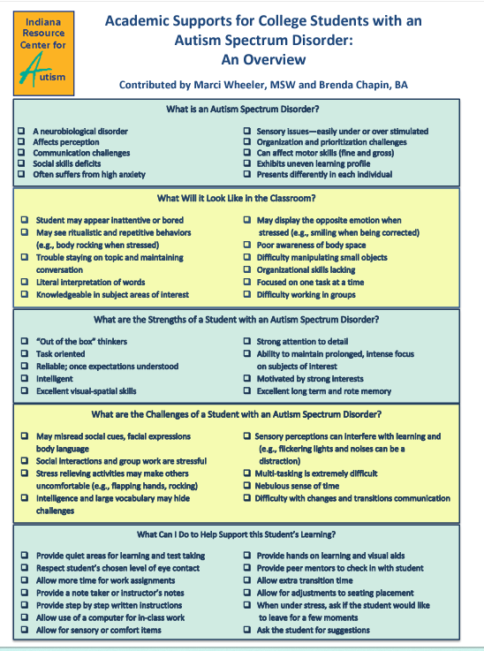
Additional (Cognition) ASD Supports
Indiana University: Academic Supports for College Students with an Autism Spectrum Disorder-Quick Overview

Slide 90
Vocational Rehabilitation
VR support:
High school-take part in IEP
College readiness skills and preparation
Identify skill needs and opportunities in executive function, self-advocacy, social communication and connect resources
High School Transition
College Acclimation
College Readiness

Slide 91
High School vs. College
IEP (K-12): Entitlement
504 Plan (K-College): Eligibility
Must have one of 13 special education eligibilities
Disability impacts ability to access general education curriculum (adverse impact)
Schools identify and evaluate
Set annual goals
IEP Team facilitates progress
Specialized instruction to access
Accommodations given to support accessing general education curriculum
Governed by US Department of Education
Students self-identify and are responsible for evaluations
Difference is getting in the way of their learning in gen education classroom-accommodations (changes to environment) in general education classroom (extra time for testing or to complete homework)
Student must initiate support and self-advocate
No specialized instruction
Accommodations must be requested by the student
Student must register with Disability Supports
Governed by US Department of Civil Rights

Slide 92

Student Actions for Connecting to Colleges
Assure the school is a good match
Distance from home, location, small or large, specific programs for autistic students, program interests, match goals (degree, classes, social opportunities, sports, etc.)
Research disability support to see what they offer for supports
Living arrangements, supports other than academic, communication with professors, how many student complete the program, are mental health needs supported
3. Planning
Complete paperwork including FERPA, assure payment, class schedules and materials, logistics of campus, secure academic supports, transportation on campus, etc.
Adapted from OAR College Central

Slide 93

Self-Empowerment Model
Skills of Focus for College Readiness
Executive Function
Social Communication
Self-Advocacy

Slide 94

Executive Function in High School
Individualize
Learn to create and follow schedules
Identify and complete tasks
Initiating and prioritizing
Problem solving and decision making
Setting goals and following through
Cognitive flexibility and impulsivity
Emotional regulation

Slide 95

Executive Function at College
Needed across domains
Planning, organizing homework, tests, demands
Coordinating time and effort across class expectations
Self-management-using strategies to control attention, remember instructions, and organize thoughts
Self-regulation and managing emotional reactions, behaviors, thoughts, anxiety

Slide 96

Executive Functioning
Flexible thinking:
Shift with changes and viewpoints
Multiple trains of thought
Changes at college are constant
Sensory overload
Anxiety increases and induces behavior (stims)
Self-regulation is critical

Slide 97
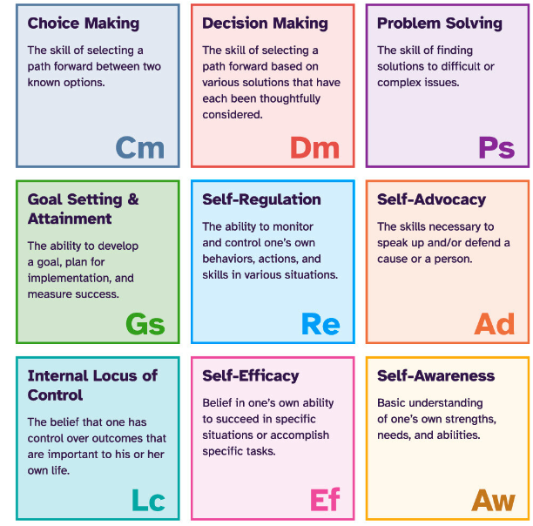
Executive Function in High School
Resources
I’m Determined: to promote self-advocacy and other required skills for self-determination and increased independence. Descriptions, tools, and resources.
IRIS (Vanderbilt): Time Management, Materials Organization
Columbia Regional Inclusive Services: Executive Function-excellent site describing executive function with strategies and resource to teach skills
Social Thinking: Free downloads and social thinking worksheets

Slide 98

Social Communication
Everyone learns and practices social communication throughout life
Societal expectations for EVERYONE
Individual decision to target skills
Best practice approaches
Breaking it down
Showing, practicing, feedback
Across contexts (for generalization)
Supports faded
Continued practice
Managing anxiety
Not perfect for anyone

Slide 99

Social Communication
Social Cognition
Theory of Mind
Perspectives of others are different
Inferring intentions and fact-fiction
Interpreting sarcasm, inuendo
How behavior affects others
Have affective empathy-can feel emotions when they see them
Struggle with cognitive empathy-describing emotions or meaning as others experience
Central Coherence
Over-focus on details and seeing big picture
Literal thinking and generalization difficulty

Slide 100
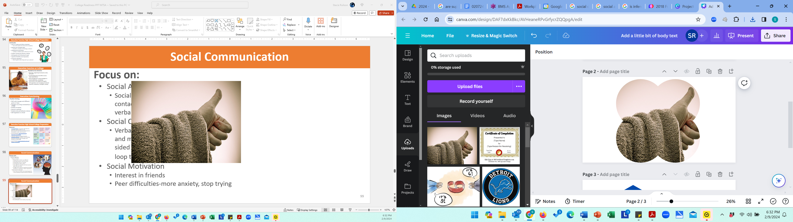
Social Communication
Social Awareness
Social landscape and gestures, e.g., eye contact, volume body boundaries, non-verbal interpretation, emotional states
Social Communication
Verbal, non-verbal, tone, listening, building and maintaining relationships, empathy, 1-sided conversations, restricted interests and loop to topics of interest
Social Motivation
Interest in friends
Peer difficulties-more anxiety, stop trying

Slide 101

Social Communication in High School
Learn and strengthen social interactions
Social skills supports and relationship building
Verbal communication
Non-verbal communication (body language, facial expression, gestures, tone)
Theory of mind (perspective taking)
Across settings (generalization to home, class, work, community)
Personal motivation must be considered

Slide 102
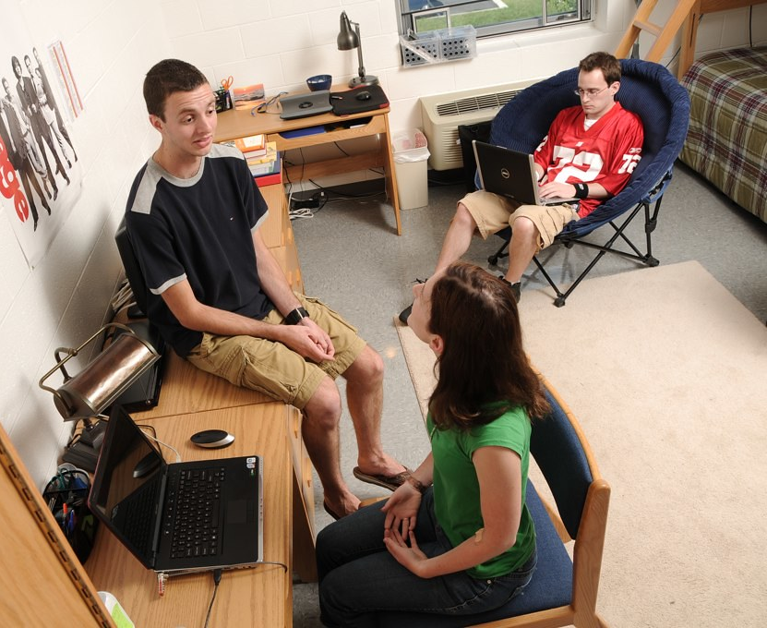
Social Communication at College
Needed across domains
Interpersonal skills with peers
Group work for assignments
Roommate and living arrangements
Instructors and understanding expectations
Disability services communication
Medical and other needs
Not knowing what isn’t known

Slide 103

Social Communication
Resources
Jill Kuzma, Conversation Skills, Perspective Taking Skills
Kansas Technical Assistance System Network (TASN): Tri-State Webinar: Social Skills: Expanding The World Through Social Development: Your “Wh” Questions Part 1 of 3; Expanding the World through Social Development: Part 2 of 3; Social Communication Part 3 of 3
Ohio Center for Autism and Low Incidence (OCALI): Overview of Social Skills and Interventions (create free account and free training)
Social Thinking: Free downloads and social thinking worksheets
UCLA PEERS® Curriculum: EBP curriculum for building relationships and social communication skills
U.S. Department of Education, Skills to Pay the Bills

Slide 104

Self-Advocacy in High School
Knowing and requesting needed supports
Knowing who, when, and how to ask for help
Understanding basic legal rights and disclosure
Participating in IEPs, goal setting, making decisions, problem solving
Negotiating on own behalf
Taking on more responsibilities for needs
Basic self-care
Active role in higher education considerations

Slide 105
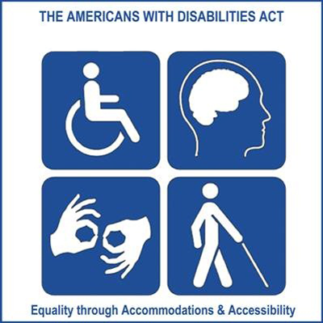
Self-Advocacy at College
High school, plus…
Navigating campus logistically
Living with roommates
Financial autonomy
Disclosing when appropriate
Communicating needs and wants
Understanding diverse course requirements
Developing relationships and social connections

Slide 106

Self-Advocacy at College
Other skills for living on campus
Meal preparation, lists, shopping, planning, cafeteria
Living and sharing space
Hygiene and self-care
Health care
Safety and risks
Transportation
Other…

Slide 107

Self-Advocacy-Resources
Resources
I’m Determined-Self-Advocacy: description, tools, resources for implementing
Ohio Center for Autism and Low Incidence (OCALI): Self-Advocacy and Self-Determination – Evidence Based Practices (includes a PowerPoint, Develop of self-determination skills handout, skill areas associated with self-determination, research, and more
Transition TN: Pathways to Self-Determination: Video for Educators by Erik Carter, Vanderbilt University

Slide 108

Resources and Wrap-Up

Slide 109
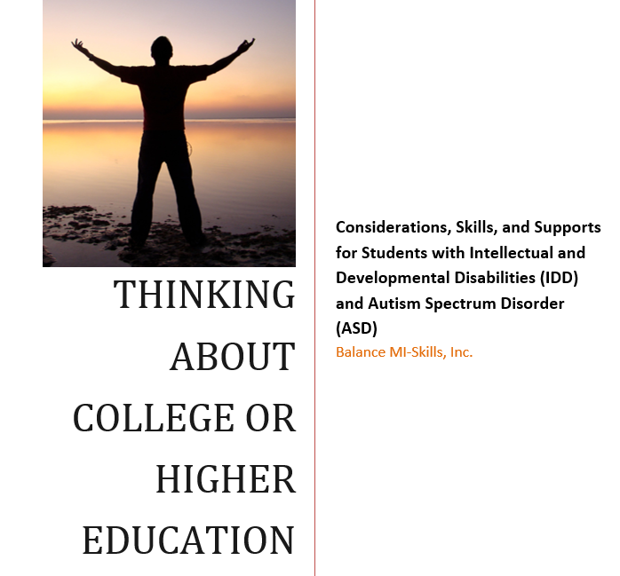
Student Guidance
Resource for student for rating executive function, self-advocacy, and social communication skills.
In addition to student, can also be used by educators, vocational rehabilitation, and families

Slide 110



ASD Support Program
Western Michigan University-Kalamazoo Autism Center, Autism Services Center (ASC)
ASD/Intensive Support Model
Expertise with ASD and best practice interventions and supports
Immersive summer experience and ongoing support opportunities
Acceptance to WMU
Communication conduit with disability supports and professors
Workshops addressing needs of students
Social opportunities connecting students with similar interests
Structured study times with support staff
Systematically fade support as skills are gained
Parent/support sessions (adhere to FERPA)

Slide 111




Key Take-Aways
Focus on skills needed to promote success in college while in high school: executive function, self-advocacy, and social communication skills.
Learn and understand core features of IDD and ASD which can help with support and intervention strategies and increasing preparedness for higher education.
Explore colleges who can support the individual and their needs, beyond academics. Offering academics and interests may not be sufficient for finishing. Many students may not fully understand the expectations or demands of attending college or higher education.
Use best practice strategies and supports in high school and college. Maintain high expectations, presume competence, and believe with necessary supports and preparation, higher education outcomes are attainable.

Slide 112
Contact Information
Stacie Rulison, MS, M.Ed., BCBA, LBA
Consultant
Balance MI-Skills, Inc.
Website: https://balancemi-skills.com
contact@balancemi-skills.com
Personal email: stacie.rulison@gmail.com
Balance MI-Skills, Inc.

Slide 113
Research
Accardo, A. L., Kuder, S. J., & Woodruff, J. (2019). Accommodations and support services preferred by college students with autism spectrum disorder. Autism, 23(3), 574–5.
Barnhill, G. P. (2016). Supporting students with Asperger syndrome on college campuses: Current practices. Focus on Autism and Other Developmental Disabilities, 31(1), 3–15.
Brown, K. R., & Coomes, M. D. (2015). A spectrum of support: Current and best practices for Community College students with autism spectrum disorder (ASD) at community colleges. Journal of Research and Practice, 40 (6), 1–15.
Cage, E., & Howes, J. (2020). Dropping out and moving on: A qualitative study of autistic people’s experiences of university. Autism, 24(7), 1664-1675.
Cox, Edelstein, J., Brogdon, B., & Roy, A. (2021). Navigating Challenges to Facilitate Success for College Students with Autism. The Journal of Higher Education (Columbus), 92(2), 252–278.
Davis, K. (2021). Supporting college students: Mental health And disability In higher education, Mental Health America. Link: https://mhanational.org/sites/default/files/MHA%20College%20Report%202021.pdf
Dreaver, Thompson, C., Girdler, S., Adolfsson, M., Black, M. H., & Falkmer, M. (2020). Success factors enabling employment for adults on the autism spectrum from employers’ perspective. Journal of Autism and Developmental Disorders, 50(5), 1657–166
Dwyer, P., Mineo, E., Mifsud, K., Lindholm, C., Gurba, A., & Waisman, T. C. (2023). Building neurodiversity-inclusive postsecondary campuses: Recommendations for leaders in higher education. Autism in adulthood : challenges and management, 5(1), 1–14.
Elksin, N. &Elksin, L. (2001). Adolescents with disabilities. The need for occupational social skills training. Exceptionality, 9(1-2), 91-105.
Ervin, T., Wilson, A. N., Maynard, B. R., & Bramblett, T. (2018). Determining the effectiveness of behavior skills training and observational learning on classroom behaviors: A case study. Social Work Research, 42(2), 106-117.

Slide 114
Research
Gerhard, Peter F., et al. (2023). Adulthood begins in preschool: Meaningful curriculum in support of increased independence for individuals with autism. International Electronic Journal of Elementary Education 15(3), 213-223.
Gorenstein, Giserman-Kiss, I., Feldman, E., Isenstein, E. L., Donnelly, L., Wang, A. T., & Foss-Feig, J. H. (2020). Brief Report: A Job-Based Social Skills Program (JOBSS) for Adults with Autism Spectrum Disorder: A Pilot Randomized Controlled Trial. Journal of Autism and Developmental Disorders, 50(12), 4527–4534.
Haber, M. G., Mazzotti, V. L., Mustian, A. L., Rowe, D. A., Bartholomew, A. L., Test, D. W., & Fowler, C. H. (2016). What works, when, for whom, and with whom: A meta-analytic review of predictors of postsecondary success for students with disabilities. Review of Educational Research, 86(1), 123-162.
Jackson, S.L.J., Hart, L. & Volkmar, F.R. (2018). Preface: Special issue—College experiences for students with autism spectrum disorder. Journal for Autism and Developmental Disorders 48, 639–642
Jansen, D., Petry, K., Ceulemans, E., Noens, I., & Baeyens, D. (2017). Functioning and participation problems of students with ASD in higher education: Which reasonable accommodations are effective? European Journal of Special Needs Education, 32(1), 71–88.
Kirkpatrick, M., Akers, J., & Rivera, G. (2019). Use of behavioral skills training with teachers: A systematic review. Journal of Behavioral Education, 28, 344-361.
Kleinert, H.L., Jones, M. M., Sheppard-Jones, K., Harb, B., Harriston, E. (2012). Students with intellectual disabilities going to college? Absolutely! TEACHING Exceptional Children, 44(5), 26-35.
Kuder, S. J., & Accardo, A. L. (2018). What works for college students with autism spectrum disorder. Journal of Autism and Developmental Disorders, 48(3), 722–731.
Knott, F., & Taylor, A. (2014). Life at university with asperger syndrome: A comparison of 18 student and staff perspectives. International Journal of Inclusive Education, (4), 411–426.

Slide 115
Research
Mazzotti, V. L., Rowe, D. A., Kwiatek, S., Voggt, A., Chang, W.-H., Fowler, C. H., Poppen, M., Sinclair, J., & Test, D. W. (2021). Secondary transition predictors of postschool success: An update to the research base. Career Development and Transition for Exceptional Individuals, 44(1), 47-64.
Petcu, S. D., Zhang, D., & Li, Y. F. (2021). Students with autism spectrum disorders and their first-year college experiences. International Journal of Environmental Research and Public Health, 18(22), 11822.
Postsecondary National Policy Institute, Students with Disabilities in Higher Education (2022) Fact Sheet
Raines, T. C., & Talapatra, D. (2019). College and career readiness consultation for high-risk youth: An introduction. Journal of Educational and Psychological Consultation, 29(3), 255-259.
McDermott, C. T., & Nachman, B. R. (2020). United states college programs for autistic college students. https://collegeautismnetwork.org/wp-content/uploads/2020/05/Autism-College-Programs-PDF-McDermott-Nachman-2020-05-14.pdf.
Morgan, C. A., & Wine, B. (2018). Evaluation of behavior skills training for teaching work skills to a student with autism spectrum disorder. Education and Treatment of Children, 41(2), 223-232.
Myrvold R, Kang-Yi C, Frederick LK, Nehilla L, Closson JS, et al. (2021) Understanding the experiences of autistic college students: An exploratory mixed-methods analysis. International Journal of Autism & Related Disabilities: IJARD-148.
Nasamran, A., Witmer, S.E., & Los, J.E. (2017). Exploring predictors of postsecondary outcomes for students with autism spectrum disorder. Education and Training in Autism and Developmental Disabilities, 52(4), 343-356.
Newman, L. A., Wagner, M., Knokey, A.-M., Marder, C., Nagle, K., Shaver, D., & Wei, X. (2011). The post-high school outcomes of young adults with disabilities up to 8 years after high school: Key findings from the National Longitudinal Transition Study-2 (NLTS2). NCSER2011–3005. US Department of Education’s National Center for Special Education Research.
Newman L.A., Madaus J.W. (2015). An analysis of factors related to receipt of accommodations and services by postsecondary students with disabilities. Remedial Special Education, 6, 208–219.
Paradiz, V., Kelso, S., Nelson, A., & Earl, A. (2018). Essential self-advocacy and transition. Pediatrics, 141(Supplement_4), S373-S377.

Slide 116
Research
Paskins, R. T., Brady, A. M., & Schultz, J. C. (2018). Applied interventions in college settings to assist adult students with autism spectrum disorder: A systematic review of the literature. Journal of Applied Rehabilitation Counseling, 49(3), 39–45.
Roach, A.T. (2018). Agents of Hope: College and career readiness consultation to support successful sransitions. Journal of Educational and Psychological Consultation, 29, 368 - 376.
Roper, L. (2023). How self-advocacy strategies help students with ‘invisible disabilities’ flourish beyond high school. Journal of Human Behavior in the Social Environment. DOI: 10.1080/10911359.2023.2251554
Roux, A. M., Rast, Jessica E., Anderson, Kristy A., Shattuck, Paul T. (2017) National Autism Indicators Report: Developmental Disability Services and Outcomes in Adulthood. Philadelphia, PA: Life Course Outcomes Program, A.J. Drexel Autism Institute, Drexel University
Roux, A., Shattuck, P. T., Rast, J. E., Rava, J. A., Edwards, A. D., Wei, X., McCracken, M., & Yu, J. W. (2015). Characteristics of two-year college students on the autism spectrum and their support services experiences. Autism Research and Treatment, 391693–10
Sarrett, J. C. (2018). Autism and accommodations in higher education: Insights from the Journal of Autism and Developmental Disorders, 48(autism community. 3), 679–693.
Schaefer, J. M., & Andzik, N. R. (2021). Evaluating behavioral skills training as an evidence-based practice when training parents to intervene with their children. Behavior Modification, 45(6), 887-910.
Solomon, C. (2020). Autism and employment: Implications for employers and adults with ASD. Journal of Autism and Developmental Disorders, 50(11), 4209–4217.
US Bureau of Labor and Statistics (BLS), US Census 2022, Disability Characteristics
U.S. Centers for Disease Control and Prevention. CDC estimates 1 in 68 children has been identified with autism spectrum disorder. 2014.
Van Hees, V., Moyson, T., and Roeyers, H. (2015). Higher education experiences of students with ASD spectrum disorder: Challenges, benefits and support needs. Journal of Autism and Developmental Disorders, 45(6), 1673–1688.
Vohra R, Madhavan S, & Sambamoorthi U (2016). Comorbidity prevalence, healthcare utilization, and expenditures of Medicaid enrolled adults with autism spectrum disorders. Autism. doi: 10.1177/1362361316665222.

Slide 117
Research
Ward‐Horner, J., & Sturmey, P. (2012). Component analysis of behavior skills training in functional analysis. Behavioral Interventions, 27(2), 75-92.
Wehman, P., Schall, C., McDonough, J., Sima, A., Brooke, A., Ham, W., Whittenburg, H., Brooke, V., Avellone, L., & Riehle, E. (2020). Competitive employment for transition-aged youth with significant impact from autism: A multi-site randomized clinical trial. Journal of Autism and Developmental Disorders, 50(6), 1882–1897.
White, Hillier, A., Frye, A., & Makrez, E. (2019). College students’ knowledge and attitudes towards students on the autism spectrum. Journal of Autism and Developmental Disorders, 49(7), 2699–2705.
White, S. W., Elias, R., Salinas, C. E., Capriola, N., Conner, C. M., Asselin, S. B., Miyazaki, Y., Mazefsky, C. A., Howlin, P., & Getzel, E. E. (2016). Students with autism spectrum disorder in college: Results from a preliminary mixed methods needs analysis. Research in Developmental Disabilities, 56, 29–40.
Wood, S. (2022). How to navigate college as a neurodivergent student. US News and World Report (online article).
World Health Organization, Mental Disorders, Key Facts.

