Slide 1
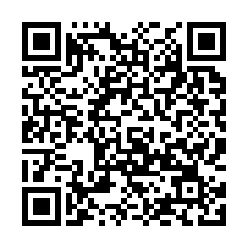
How NextUp Transition Curriculum Can Enhance Your District’s Transition Program and Services
Take our pre-session survey!
MTSA Conference 2024

Slide 2

Our Mission
Founded in 2015, NextUp was created by experienced transition educators and professionals with a passion for guiding students toward competitive employment and independent living.
Our mission: To serve educators and students by providing adaptable, comprehensive, and relevant transition curriculum to promote competitive employment, post-secondary training, and independent living success.
Here at NextUp, our success is when each student experiences success in their transition from high school to life after graduation.

Slide 3
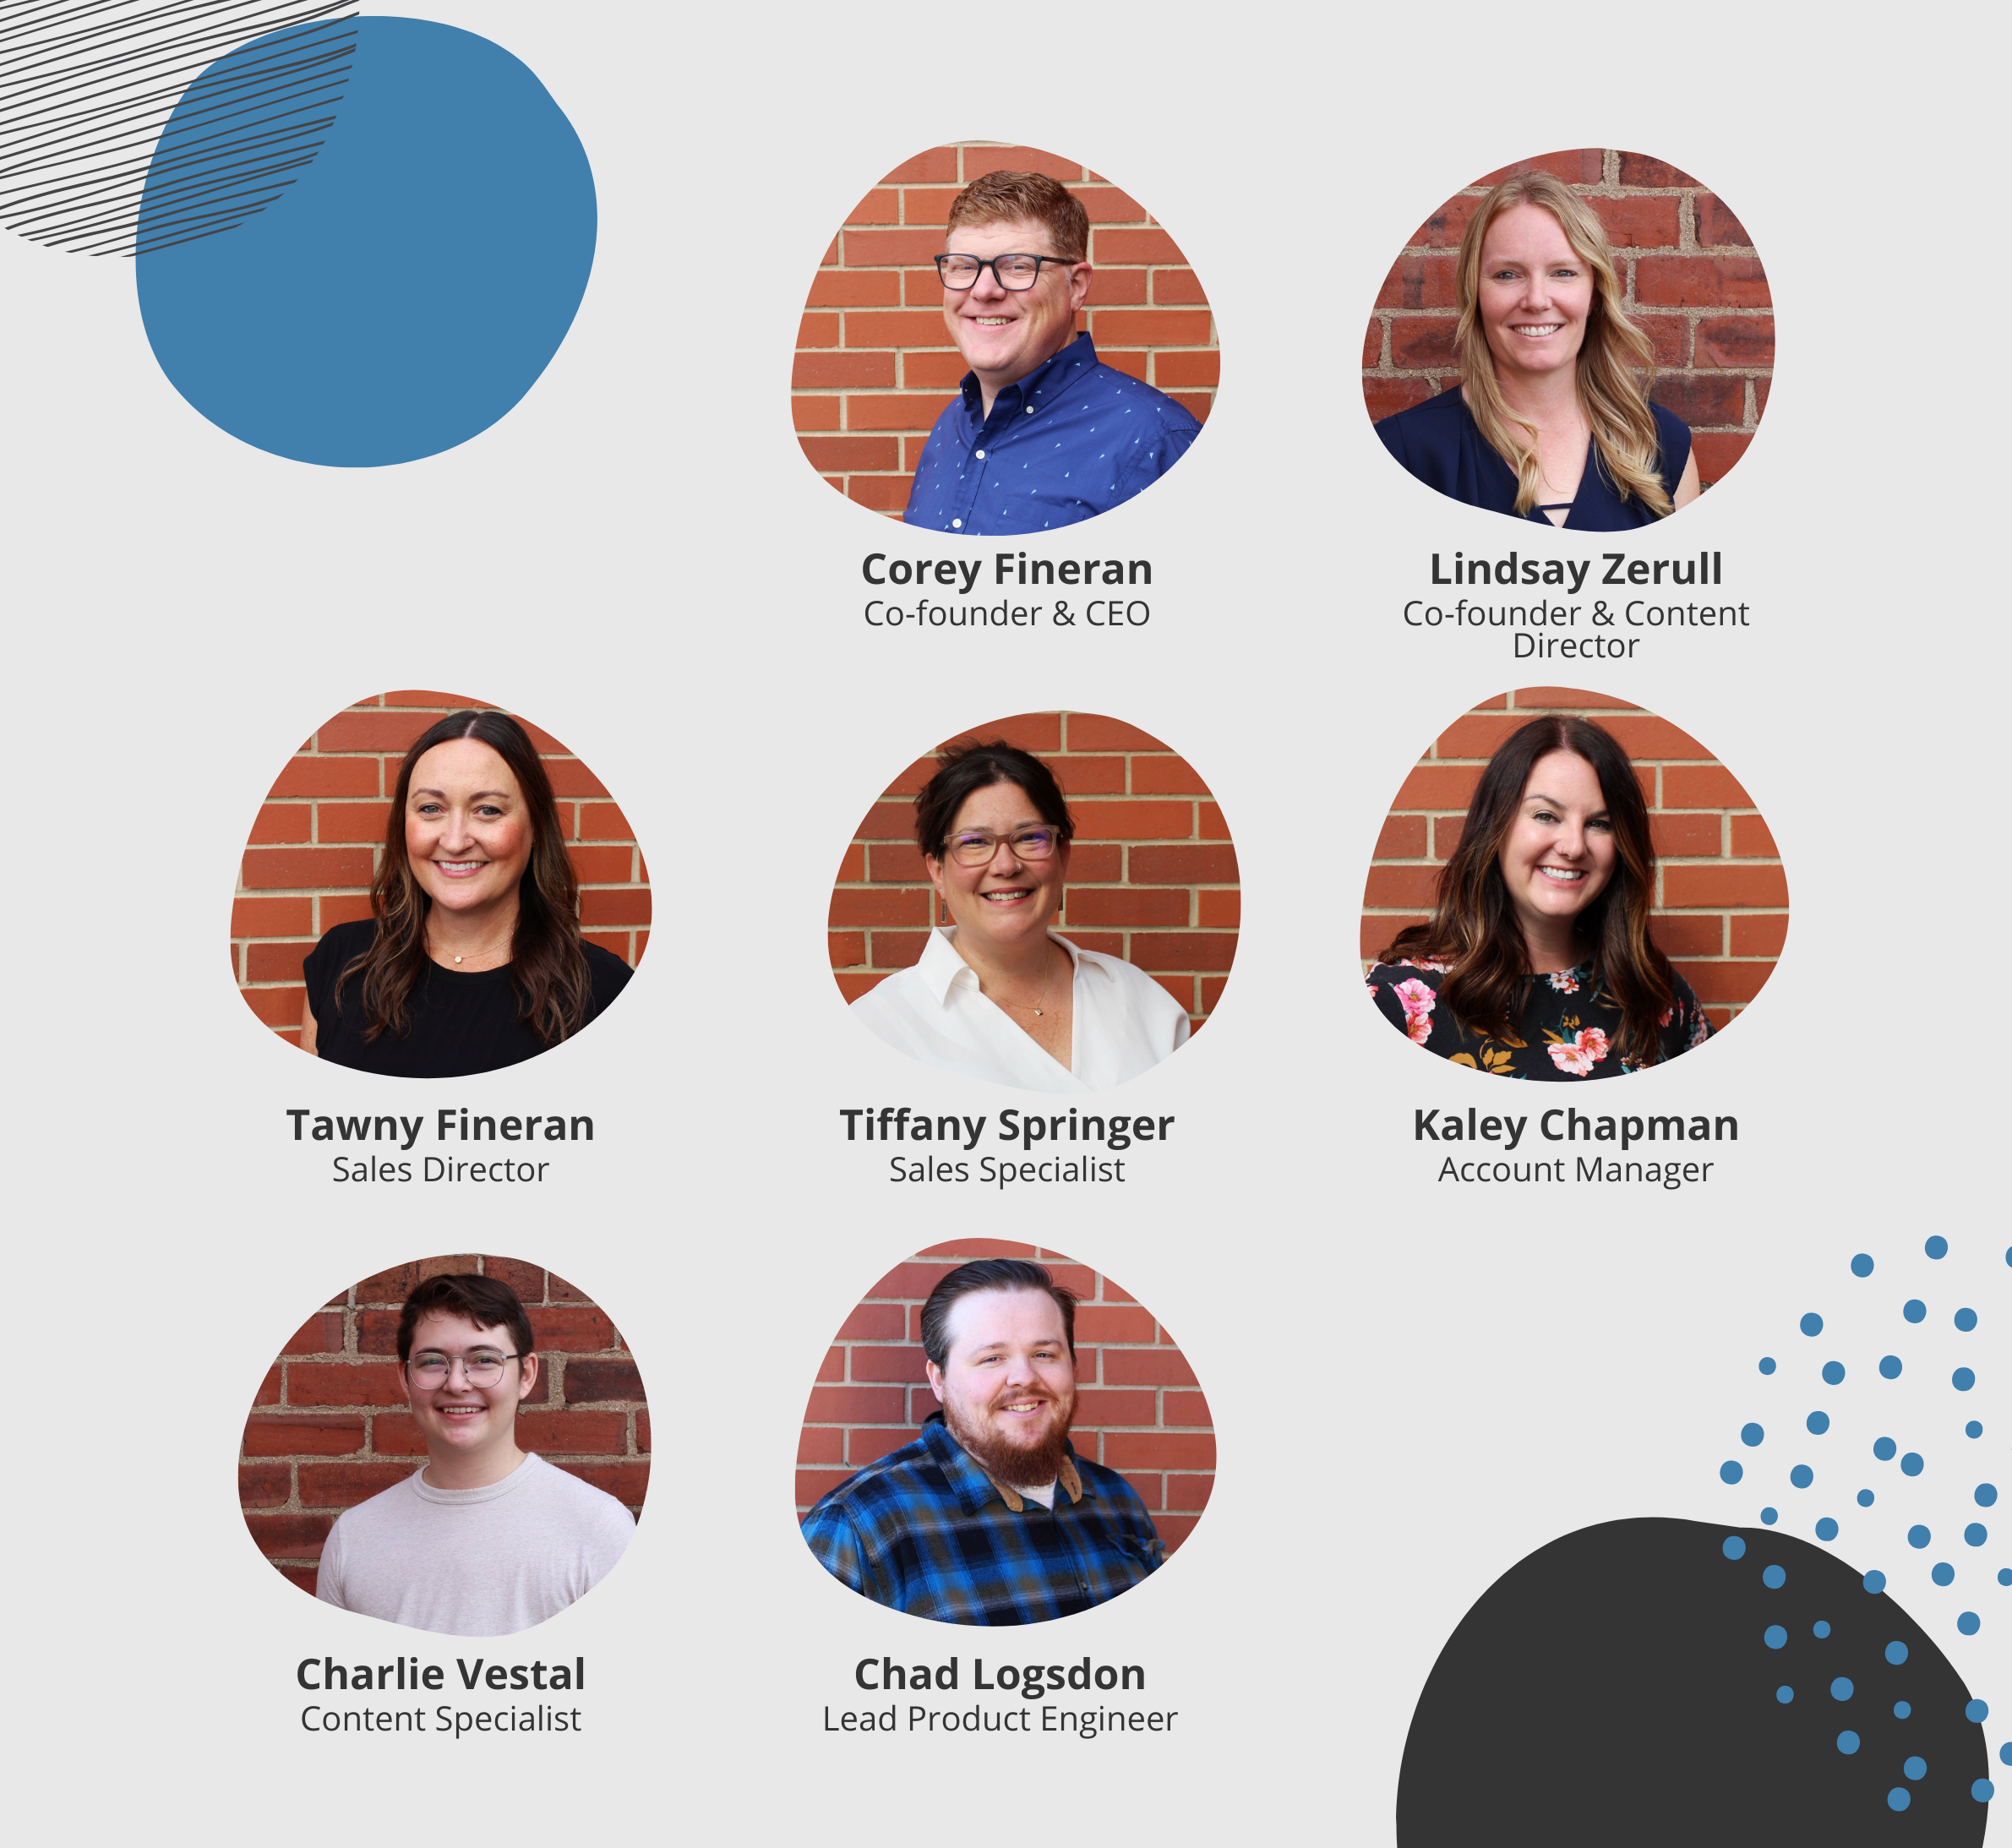
Meet Our Team

Slide 4
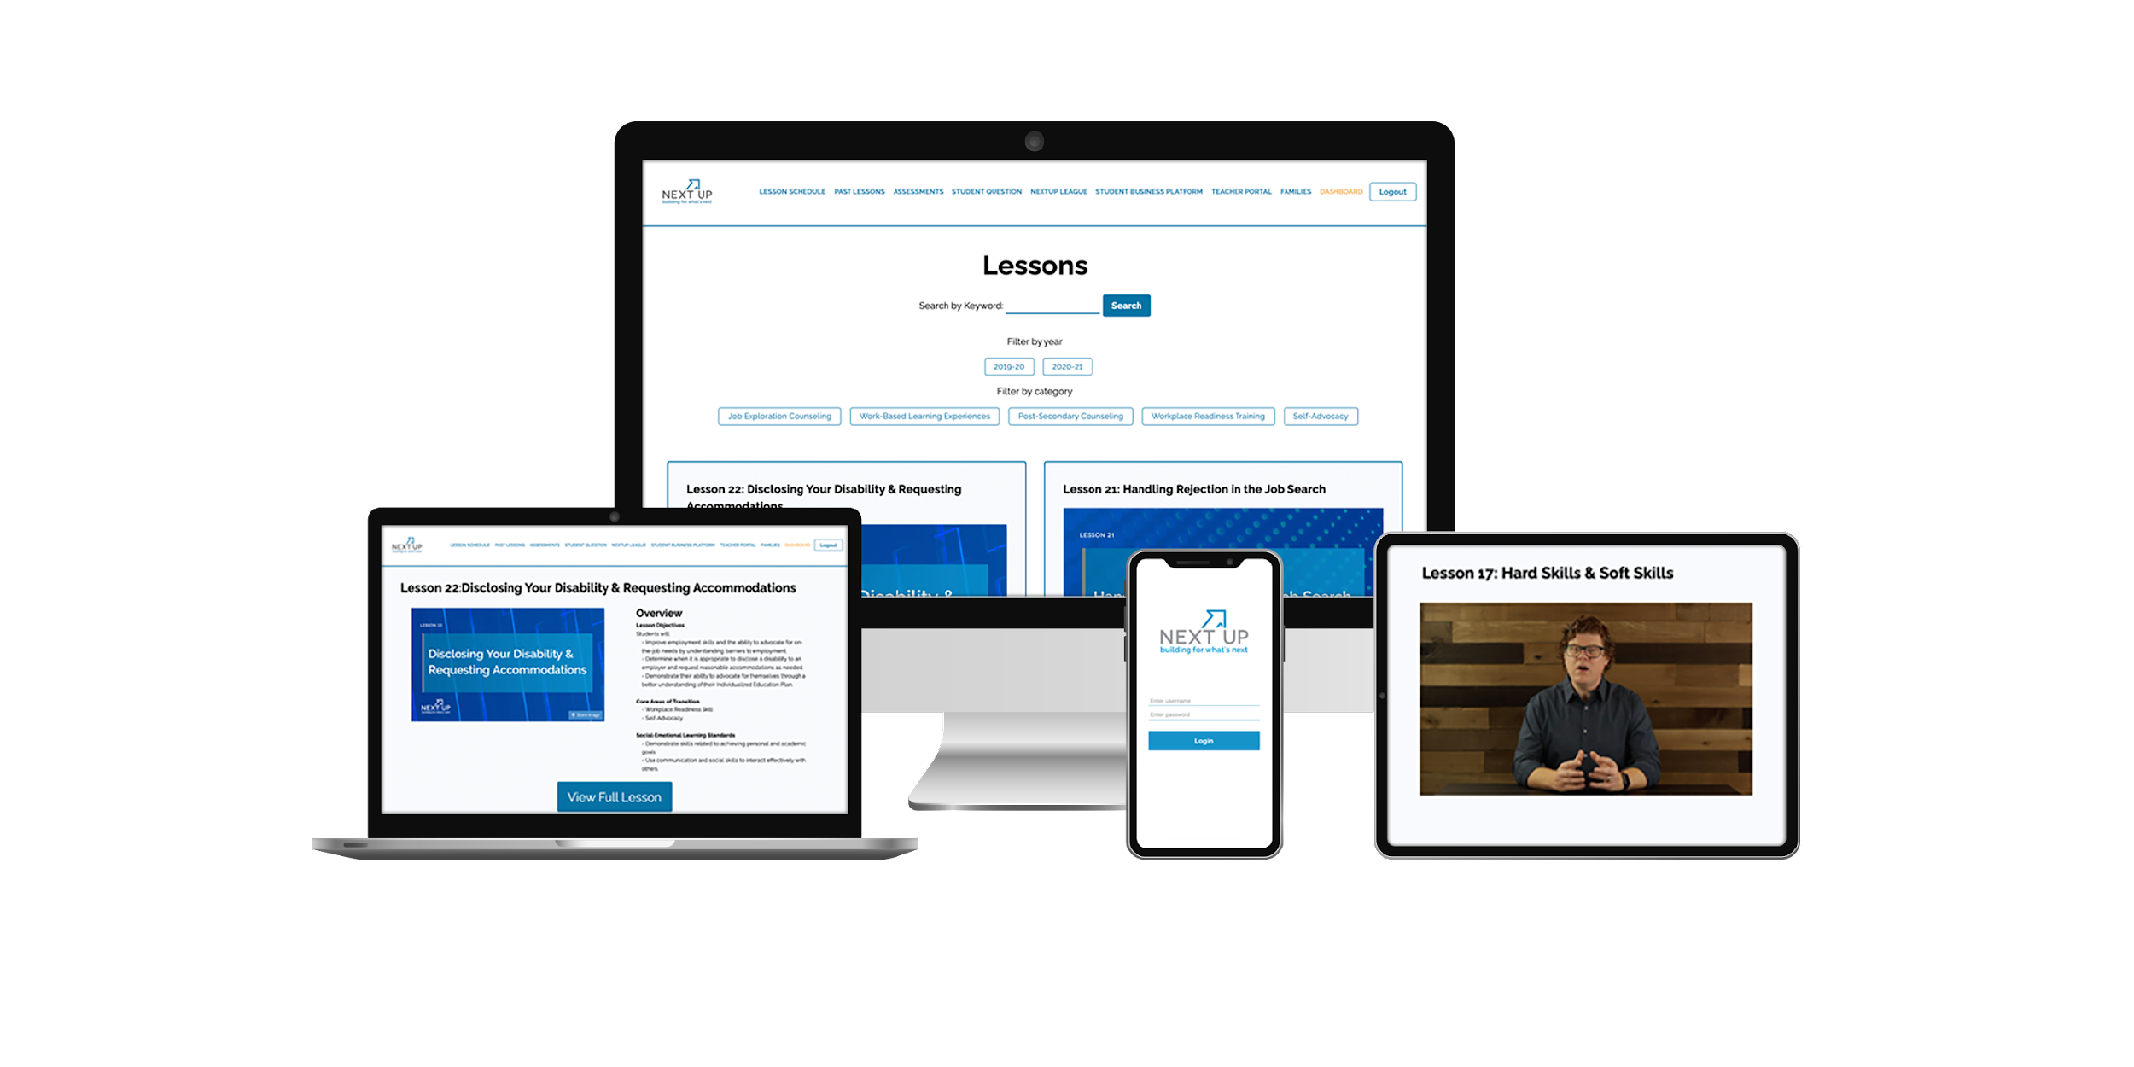
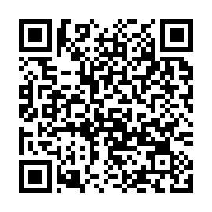
Product Features
Engaging Online Videos Videos recorded weekly, Student interactivity, Always relevant content
Comprehensive Assessments Pre- and post lesson, student growth, and transition assessments
LMS Compatibility Google Classroom, Schoology, Canvas, and more
Student Outcome Driven Preparing students for work readiness and competitive employment
Student Business Platform Online platform for facilitating student work experiences like Coffee Club
Adaptable Lesson Plans Out-of-the-box, Full lessons tailored to class or individual student needs
Supplemental Activities Three to five activities per lesson plan to reinforce lesson objectives
Unlimited Users Per campus pricing with unlimited teacher and student logins
Transition Compliance Common Core, Social/Emotional Learning, IEP Goals, Indicator 13
Scholarship Opportunities Financial assistance for post-secondary education and vocational training
Scan the QR code to submit Questions.

Slide 5
www.NextUp.work

Slide 6
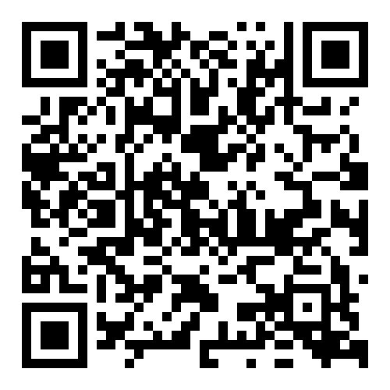
Transition Planning Resources
http://transitioncurriculum.com/transitionplanning

Slide 7
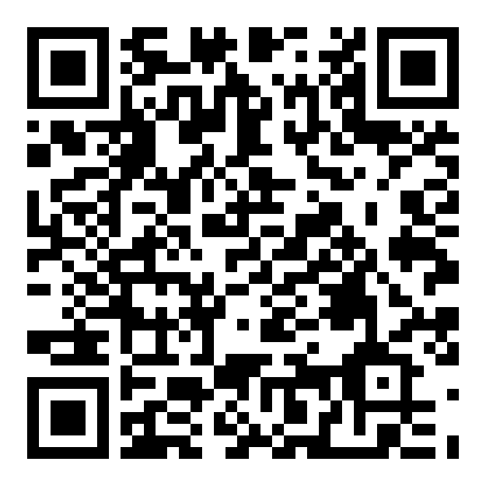
Student Business Resources
http://transitioncurriculum.com/studentbusinessresources

Slide 8
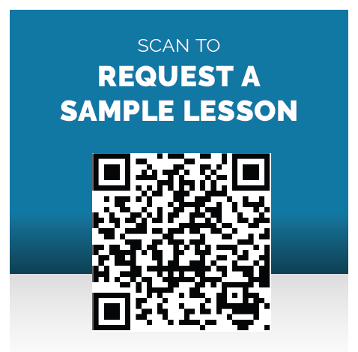


Slide 9
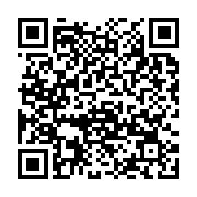
Thank you!
Contact:
Corey.Fineran@transitioncurriculum.com
Lindsay.Zerull@transitioncurriculum.com
Tiffany.Springer@transitioncurriculum.com
https://transitioncurriculum.com/conference
Take our Post-Presentation Survey:

