Slide 1
Cultivating Success
JMG’s Journey to Post-Secondary Achievement
PRESENTED BY
Kim Bordeau
DATE
February 22, 2024

Slide 2
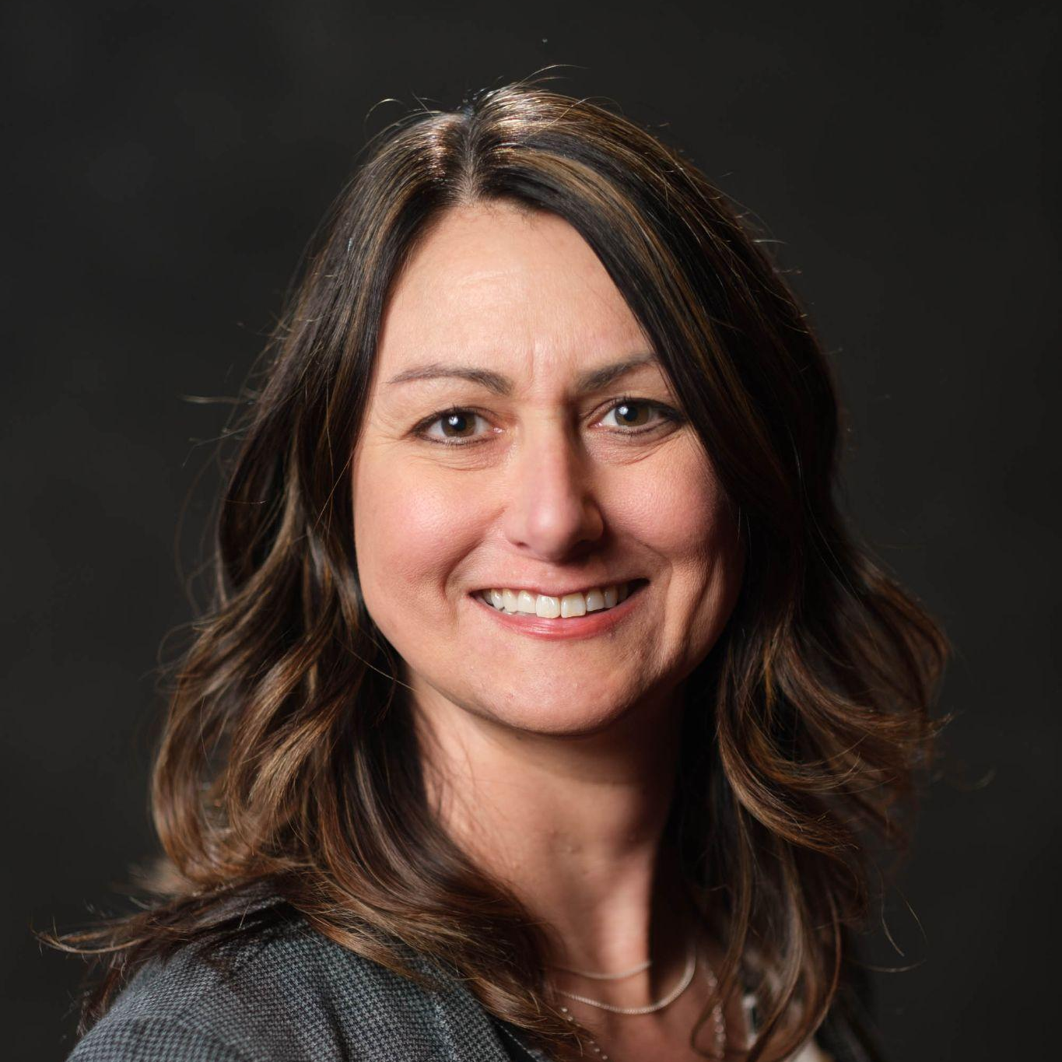
Welcome!
Kim Bordeau
Senior Manager of Program Success, Youth Solutions, Inc.

Slide 3

The Game of
Reality

Slide 4

Game Directions
Each player gets $1,000
A list of 15 statements is read
Each statement = $100
If a statement is TRUE, KEEP your money
If a statement is FALSE, PAY $100
The player with the most money at the end of the statements WINS!

Slide 5

I knew from an early age what I wanted to do for a career and actually ended up doing it.

Slide 6

I had a counselor or adult mentor who worked with me in middle school to help me explore career options.

Slide 7
I had multiple opportunities to explore my interests, skills, and talents and understood how they related to potential careers.

Slide 8
I had a course in high school or middle school that focused on career exploration.

Slide 9
I was able to take courses while in high school that directly related to my career interests.

Slide 10
I had a counselor or adult mentor who worked with me in high school to help me explore career options.

Slide 11
I engaged in an internship/work experience while in high school in a career field I was interested in.

Slide 12
I knew where to go for help with financial aid options.

Slide 13
I knew pathways other than college that were options in my region.

Slide 14
I had assistance with building my resume, writing a cover letter, and applying for a job.

Slide 15
I chose post-secondary training or education based on the career I wanted to pursue.

Slide 16
I had an adult mentor who worked with me throughout my transition from graduation to post-secondary success.

Slide 17
As a young adult, I knew how where to go for help and support with education, employment, and life’s basic needs.

Slide 18
I had the skills needed to be successful in my career when I completed my degree or certification.

Slide 19
I was aware of multiple career options that my degree or certification would apply to.

Slide 20

Were our winners more prepared for life? How?

Slide 21

Imagine…
Living in a Michigan where every young person graduates with an actionable plan for life after high school.
All students are prepared for postsecondary education and the workforce with purpose front-and-center and the skills to succeed.
This is not just a DREAM.
This is our YOUTH SOLUTION.
Notes:
Beginning today, I would like to ask all of you to imagine living in a Michigan where our youth are educated, employed, and career-bound.
They graduate from high school prepared for postsecondary education and the workforce with purpose front-and-center and the skills to succeed.
Do you like the image? I hope so. Because it isn’t just a dream - for us, it’s our youth solution. And it’s what I’m here to talk to you about today.

Slide 22
EDUCATION + CAREER DEVELOPMENT
= ACHIEVE FULLEST POTENTIAL
CHALLENGE
SOLUTION
Michigan is facing a declining population, a steadily rising average age, and our youth are not prepared for successful postsecondary pathways, jeopardizing the economic future of our youth, our communities and our State.
Our vision is to transform postsecondary pathway support for our youth by providing access to career-focused education in every school so that Michigan youth graduate with a clear actionable plan for their futures.

Slide 23
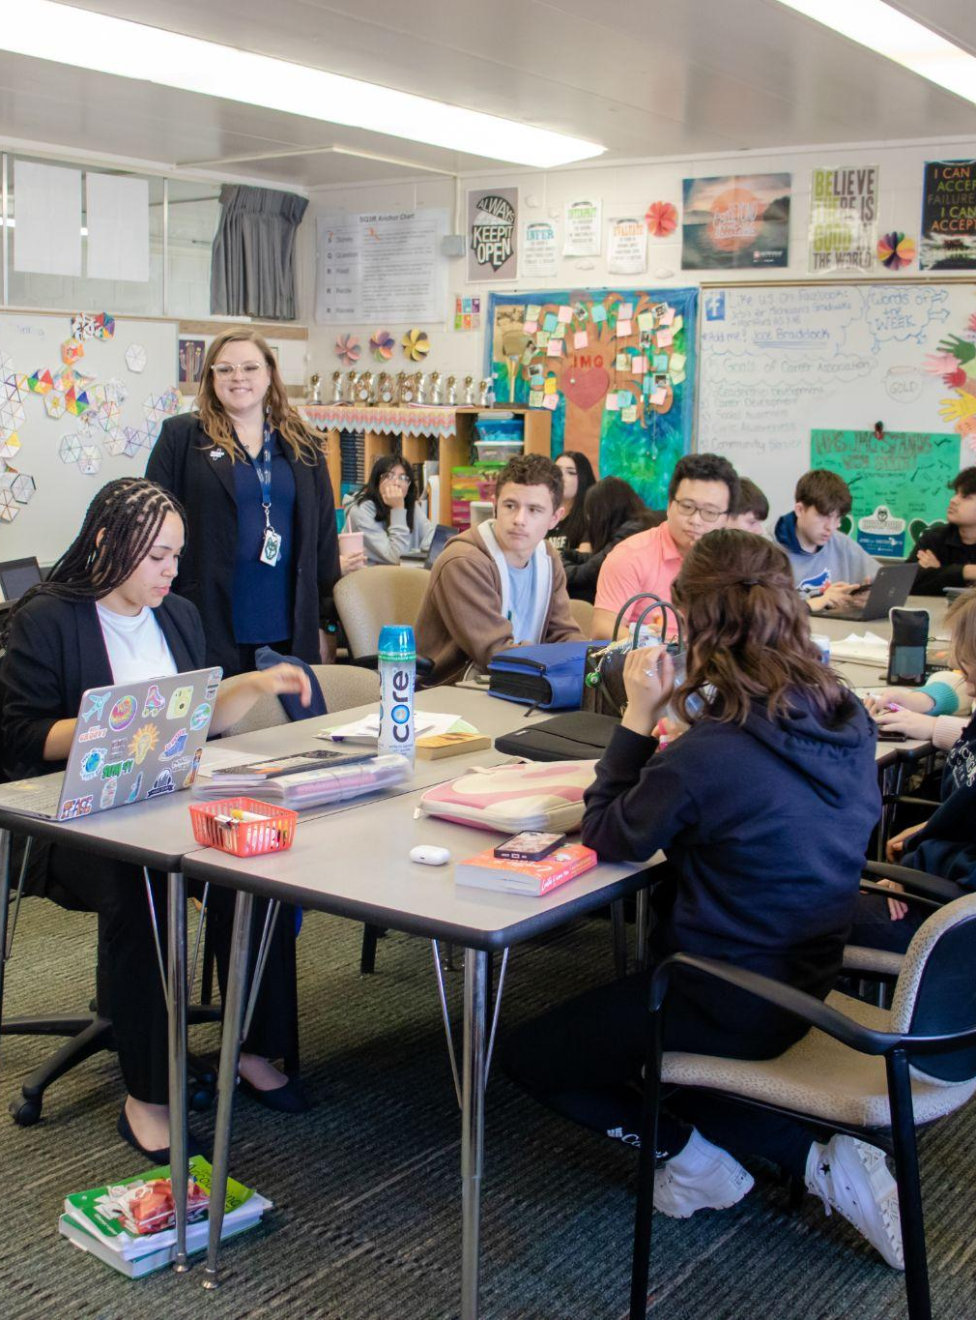
Career-Focused Education
Career-focused education is about helping youth navigate their path, whether it leads to college, credential attainment, the military, an apprenticeship or entering the workforce after graduation.
Lifelong Learning

Slide 24

Do your students know WHY they are in school?

Slide 25

Without a high school diploma, youth face an increase of:
61%
59%
3.5x
UNEMPLOYMENT
POVERTY
INCARCERATION
How can we guide youth to a brighter future?
U.S. Census Bureau 2021 1-Year American Community Survey Estimates

Slide 26
Jobs for Michigan’s Graduates
Jobs for Michigan’s Graduates
OUR PREMIER PROGRAM

Slide 27
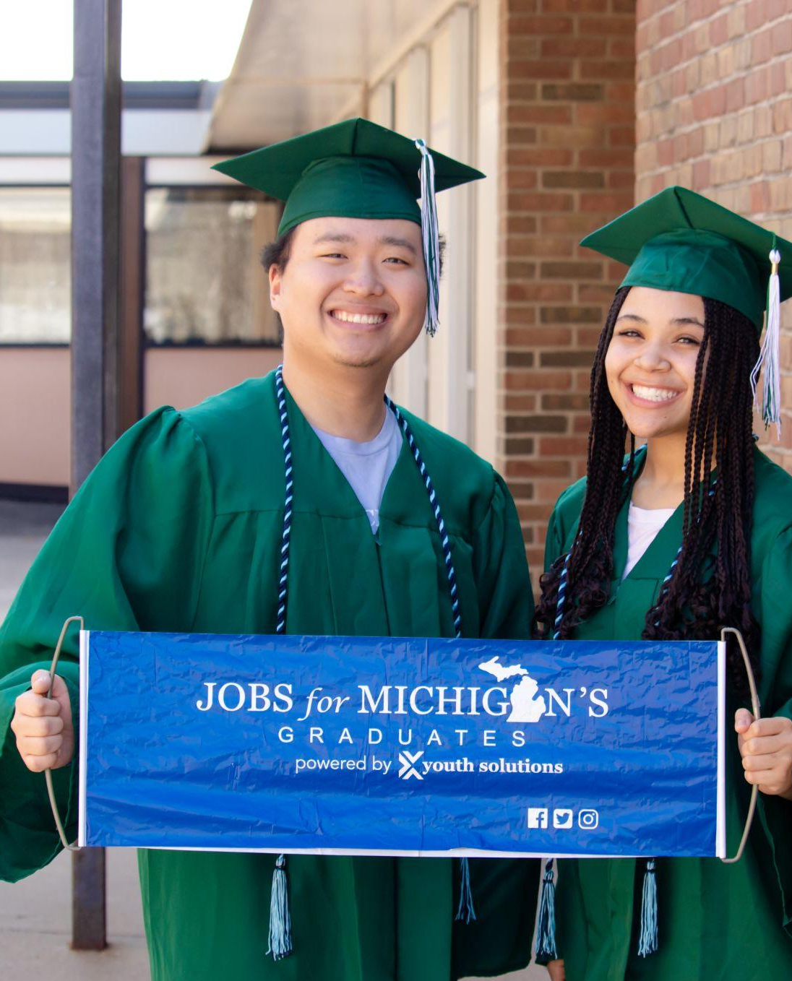
What is Jobs for Michigan’s Graduates (JMG)?
JMG is a comprehensive program for youth in and out of schools, providing them with the skills and knowledge needed to make educated decisions about their futures, all while helping them overcome individual barriers.

Slide 28



Our Partnership Structure
Direct School District Partnerships
Jobs for America’s Graduates (JAG) franchise holder in Michigan
Provides programming, training, resources, technical assistance, and general oversight
JMG program management
Employs and manages JMG specialists
Provides access to workforce programming
Connections to employers
Incorporates JMG as a course for elective credit
Supports the cost of JMG specialists - Specialists work within the schools
Becomes part of a statewide network

Slide 29
Gender
ABOUT OUR JMG YOUTH
Average Age: 18
Age Range: 11-24
Average Number of Barriers: 8.05
Economically Disadvantaged: 80%
Potential First Generation College: 75%
1%
Other
50% Male
49% Female
Ethnicity
2%
N/A
57% Minority

Slide 30

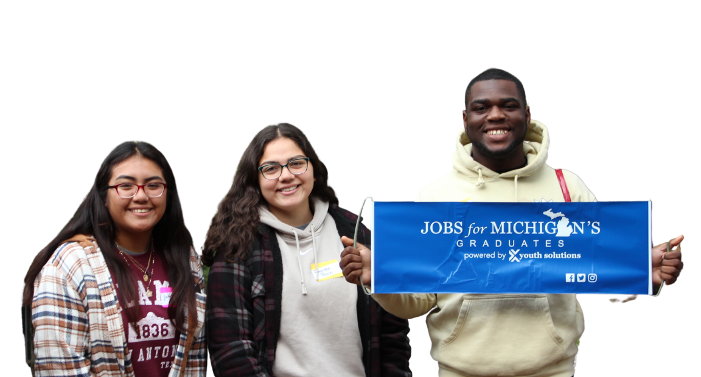
Core Components
Adult mentorship, trauma-informed care, and barrier removal
Instruction in work-readiness skills, soft skills, and academic remediation
Youth-centered, demand-informed approach to career
development
12 Months of Follow-Up Services after graduation or GED attainment

Slide 31
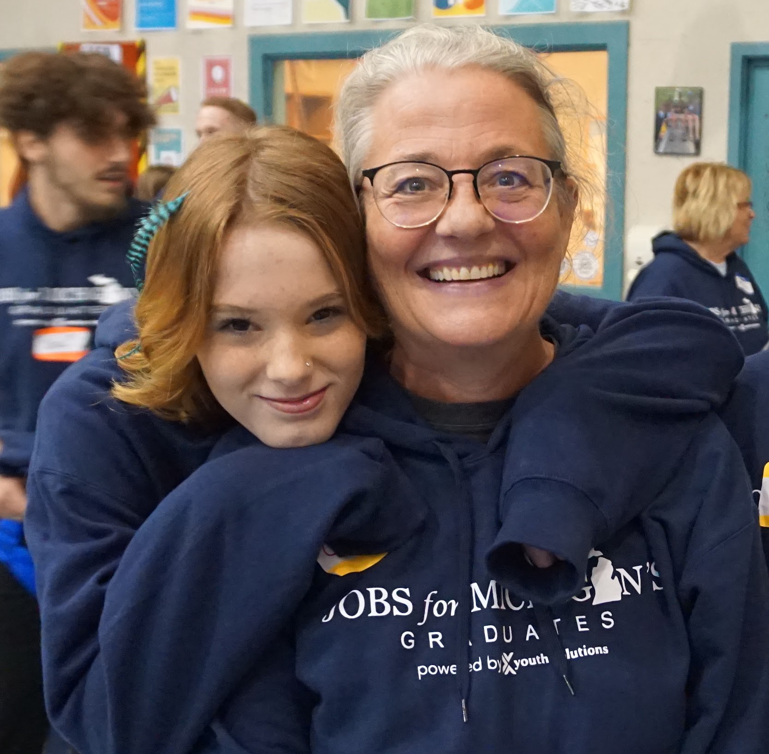
The Role of the JMG Specialist
Mentor
Advocate
Teacher/Coach
Caring
Adult
Notes:
“Specialists are the local, on-the-ground teachers who work with JAG’s students on a daily basis. They are often the first trusted adults in these students’ lives. They work with the students to help them overcome the many barriers at school and in their personal lives that can prevent them from graduating and reaching their full potential. Specialists push their kids forward and pull them along. They are the safe harbor, the secure anchor every teenager wants and needs.”
Forbes Magazine, May 12. 2020

Slide 32




Our Impact
 | In-School 1,850 Youth | Out-of-School Time 2,619 Youth
GRADUATION | 98% | 89%
EMPLOYMENT | 68% | 82%
FURTHER EDUCATION | 54% | 44%
Jobs for Michigan’s Graduates (JMG)
6,659
4,469
2,190
More youth than ever before!
TOTAL YOUTH IMPACTED
JOBS FOR MICHIGAN’S GRADUATES
YOUTH SOLUTIONS SELECT

Slide 33
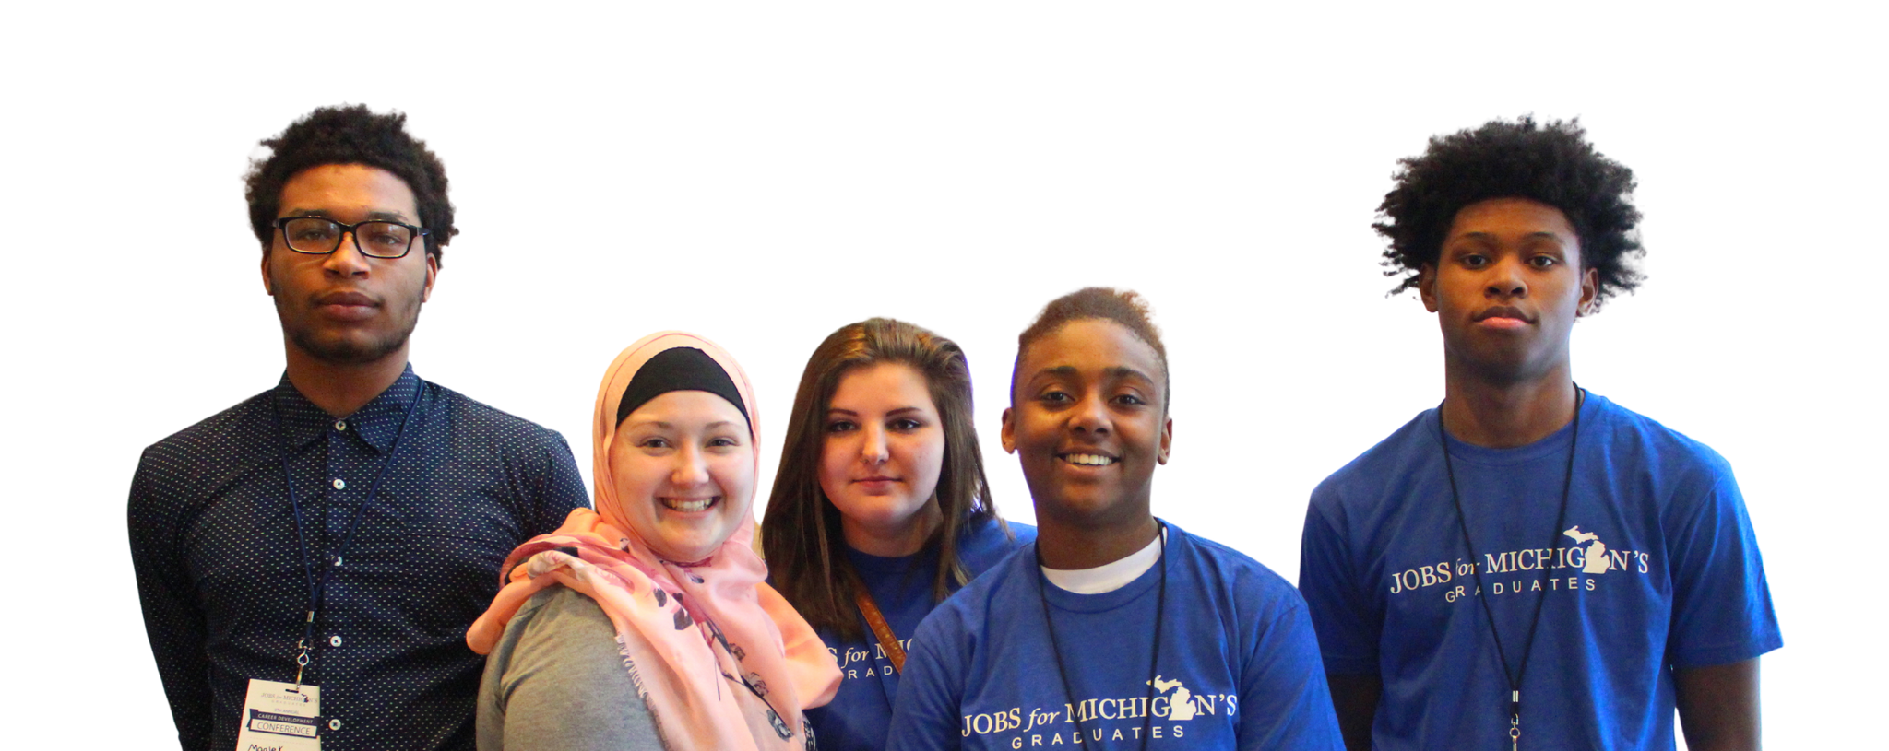

Jobs for Michigan’s Graduates (JMG)
90%
Our premier program, JMG guides young people, helping them gain the skills for success in school, employment and beyond.
GRADUATION RATE
11+ Years Running
an affiliate of the national Jobs for America’s Graduates network
Notes:
Jobs for Michigan’s Graduates is the state affiliate of the national Jobs for America’s Graduates organization. For 40 years, JAG has worked across the country to help young people build professional skills, earn credentials, enter postsecondary education, and gain employment. Through a combination of classroom learning, coaching, leadership development, job placement and other services, youth and young adult students are set on pathways to academic and economic success.
JAG has served over 1.5 million vulnerable young people in its 40-year history across a 40-state national network. They’ve consistently maintained a 90% or higher graduation rate for young people in traditional high school programming.

Slide 34
WHY THIS MATTERS?
75%
84%
ONLY 53%
of jobs will soon require education beyond high school
of the 50 Hot Jobs in Michigan require education beyond high school
of high school students go on to postsecondary education 6 months after high school
Source: Department of Labor and Economic Opportunity Skills to Work. michigan.gov
Source: State of Michigan’s Hot 50
Job Outlook through 2030. milmi.org
Source: MI School Data College Enrollment by High School. mischooldata.org

Slide 35
Student-Centered, Demand Informed
Employer and Partner Engagement

Slide 36
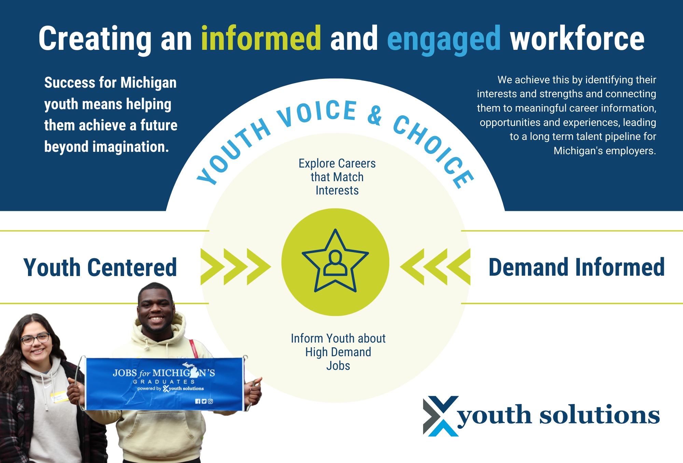

Slide 37
Closing the gap between education and workforce development to build an educated youth talent pipeline.

Slide 38
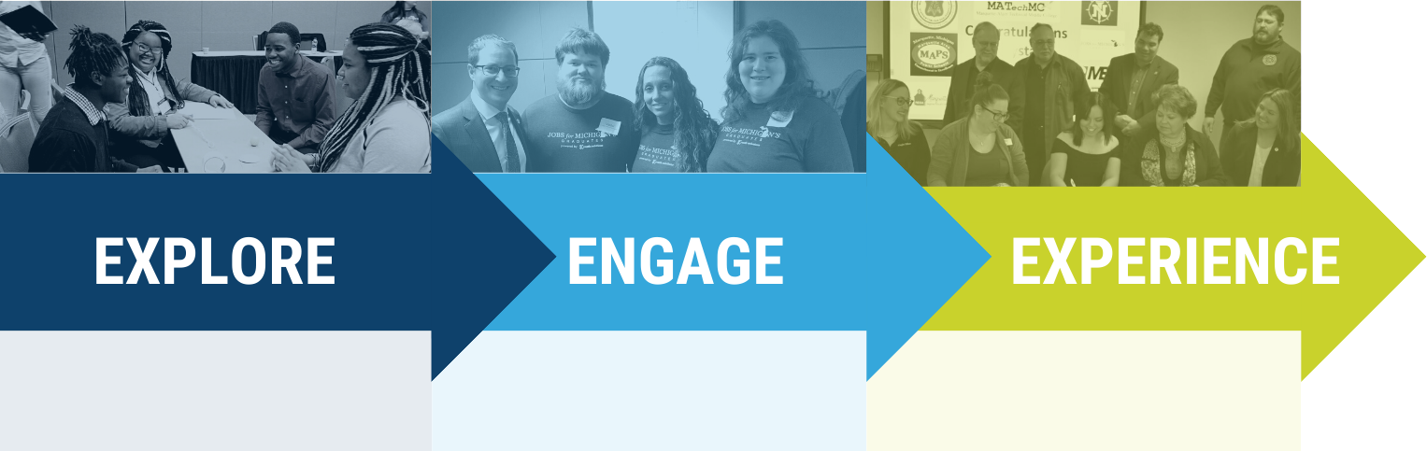
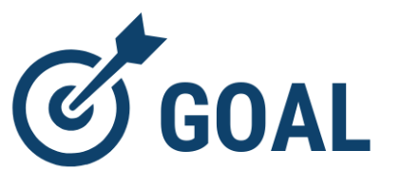
Partner Engagement Model
every participant graduates with an actionable plan for life after high school.
Notes:
The Postsecondary Engagement Framework is a tiered approach that provides participants with the opportunity to EXPLORE educational pathways, ENGAGE with different educational institutions, and gain hands-on educational EXPERIENCE.The ultimate goal is for each participant to hone the educational competencies deemed critical by postsecondary partners so they achieve success in the educational pathway of their choice.

Slide 39


Individual Development Plan
Created together
Updated quarterly
✔ A record of the youth’s goals
✔ A roadmap for how the youth will reach their goals
✔ An action plan listing the steps the youth must take
✔ An action plan listing the steps the specialist must take
Notes:
Another key piece of data that is recorded during the youth’s time in our program is the Individual Development Plan (IDP). Similar to an EDP, this is a living, breathing document collaboratively created by the youth and the specialist. Career assessments and interest inventories, postsecondary education and career goals, along with a personal action plan to help the youth overcome their barriers to success is just some of the data that is captured by a robust IDP.
The IDP is not “one and done,” it is a living, breathing document that is revisited at least quarterly, and serves as a pivotal discussion piece for both the youth and the specialist as they work towards the youth’s postsecondary goals. Once students graduate, earn their GED, or complete the final year of either the middle school or College Success model, the Specialist’s job is not complete– they continue to work with the youth for 12 months of follow up, and the IDP continues to serve as a focal point throughout that time.

Slide 40
Ongoing Support
for Post-Secondary Success

Slide 41

Bridging the Gap with
TRANSITION
SERVICES
Notes:
Often, when I speak with high school administrators, counselors, and others working in the school setting, they feel that there is something missing in their work with youth– when they graduate, and walk out that door, their work is officially over, but it doesn’t feel complete. A clear plan for providing transition services is really what they are looking for. Special education students have a transition plan written into their IEP, but why isn’t that true for all students? Do teachers, counselors, and administrators have time to dedicate to students after they graduate? Do you have a clear plan and a support system in place for students after they graduate?

Slide 42
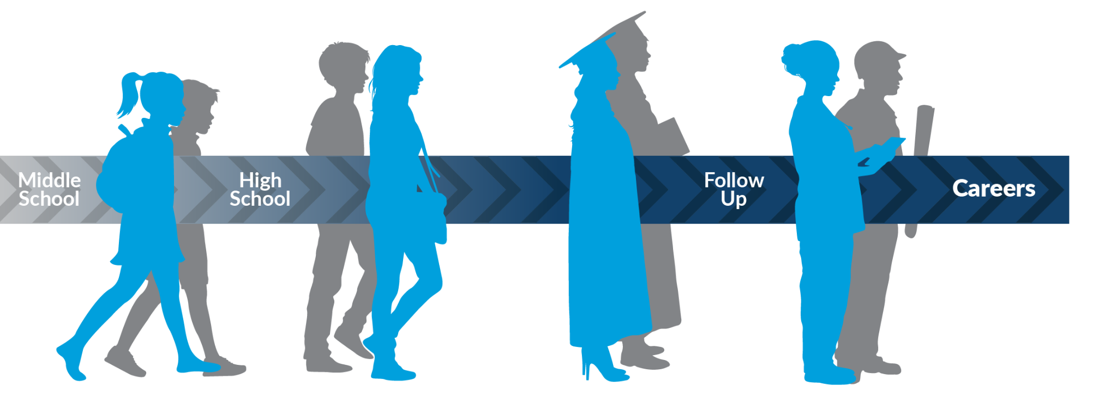
Continuum of Support
Youth ages 11-24 (at time of enrollment)

Slide 43
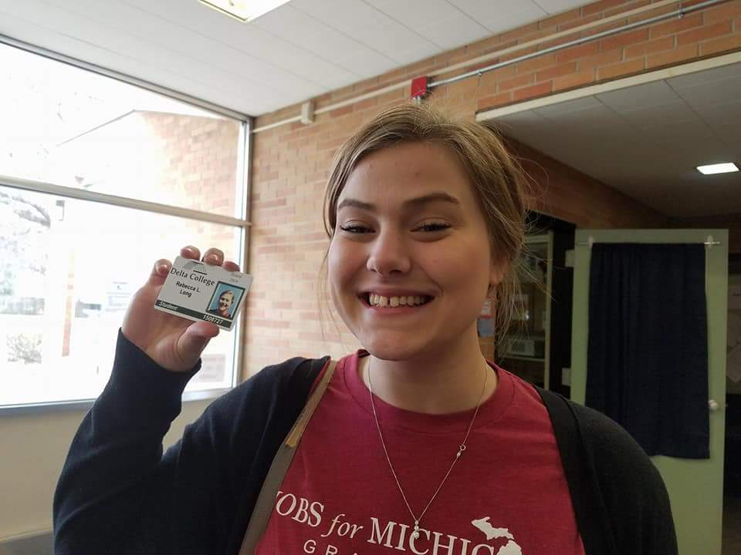
12-Month Follow-up Period
Mentoring relationship continues
Check in on goals from IDP
Services delivered as needed
Youth should have a positive outcome by the end of the 12-Month Follow Up
Follow up with youth, employers, and post-secondary institutions
Follow up contacts entered into JAGForce at least monthly, but likely more often

Slide 44

“If it wasn’t for Jobs for Michigan’s Graduates, I wouldn’t be where I am today. I am employed with two jobs, a certified CNA and becoming self-sufficient and career-bound. I am confident in myself and my future because of Jobs for Michigan’s Graduates. I was a kid with a dream; now I am a kid with a plan.”
Youth just like Hunter.
Hunter Daniels, West Michigan

Slide 45

“Before I enrolled in JMG, I didn’t think that it would be possible for me to go to college, but now I know that I can. I want everyone to know how this program can change lives for youth across the state of Michigan. JMG gives us tools that help us build our futures."
Youth just like Lila.
Lila Bobolz, Family Literacy Center
Notes:
Youth from GST MW/FLC

Slide 46

“I never knew that joining JMG would change the course of my life until I met Lisa Baldyga, my JMG specialist. Lisa helped me with missing resources, and this support that ensured my success is something I will carry with me forever. It was much larger than a pair of shoes and a backpack. I have never had someone who was willing to go out of their way to support me. This simple action and support from JMG helped me continue my education and my career. JMG is breaking the cycle and allowing first-generation students to achieve something I never believed was possible.”
Youth just like Taryn.
Taryn Indish, Networks Northwest
Notes:
Youth from Networks Northwest

Slide 47






YOU
can help us ensure that every youth in Michigan has access to the resources needed to achieve a future beyond imagination.

Slide 48

Contact
Kim Bordeau
Senior Manager of Program Success
Youth Solutions, Inc.
989-464-0035 or bordeauk@ouryouthsolutions.org
ouryouthsolutions.org

