Slide 1
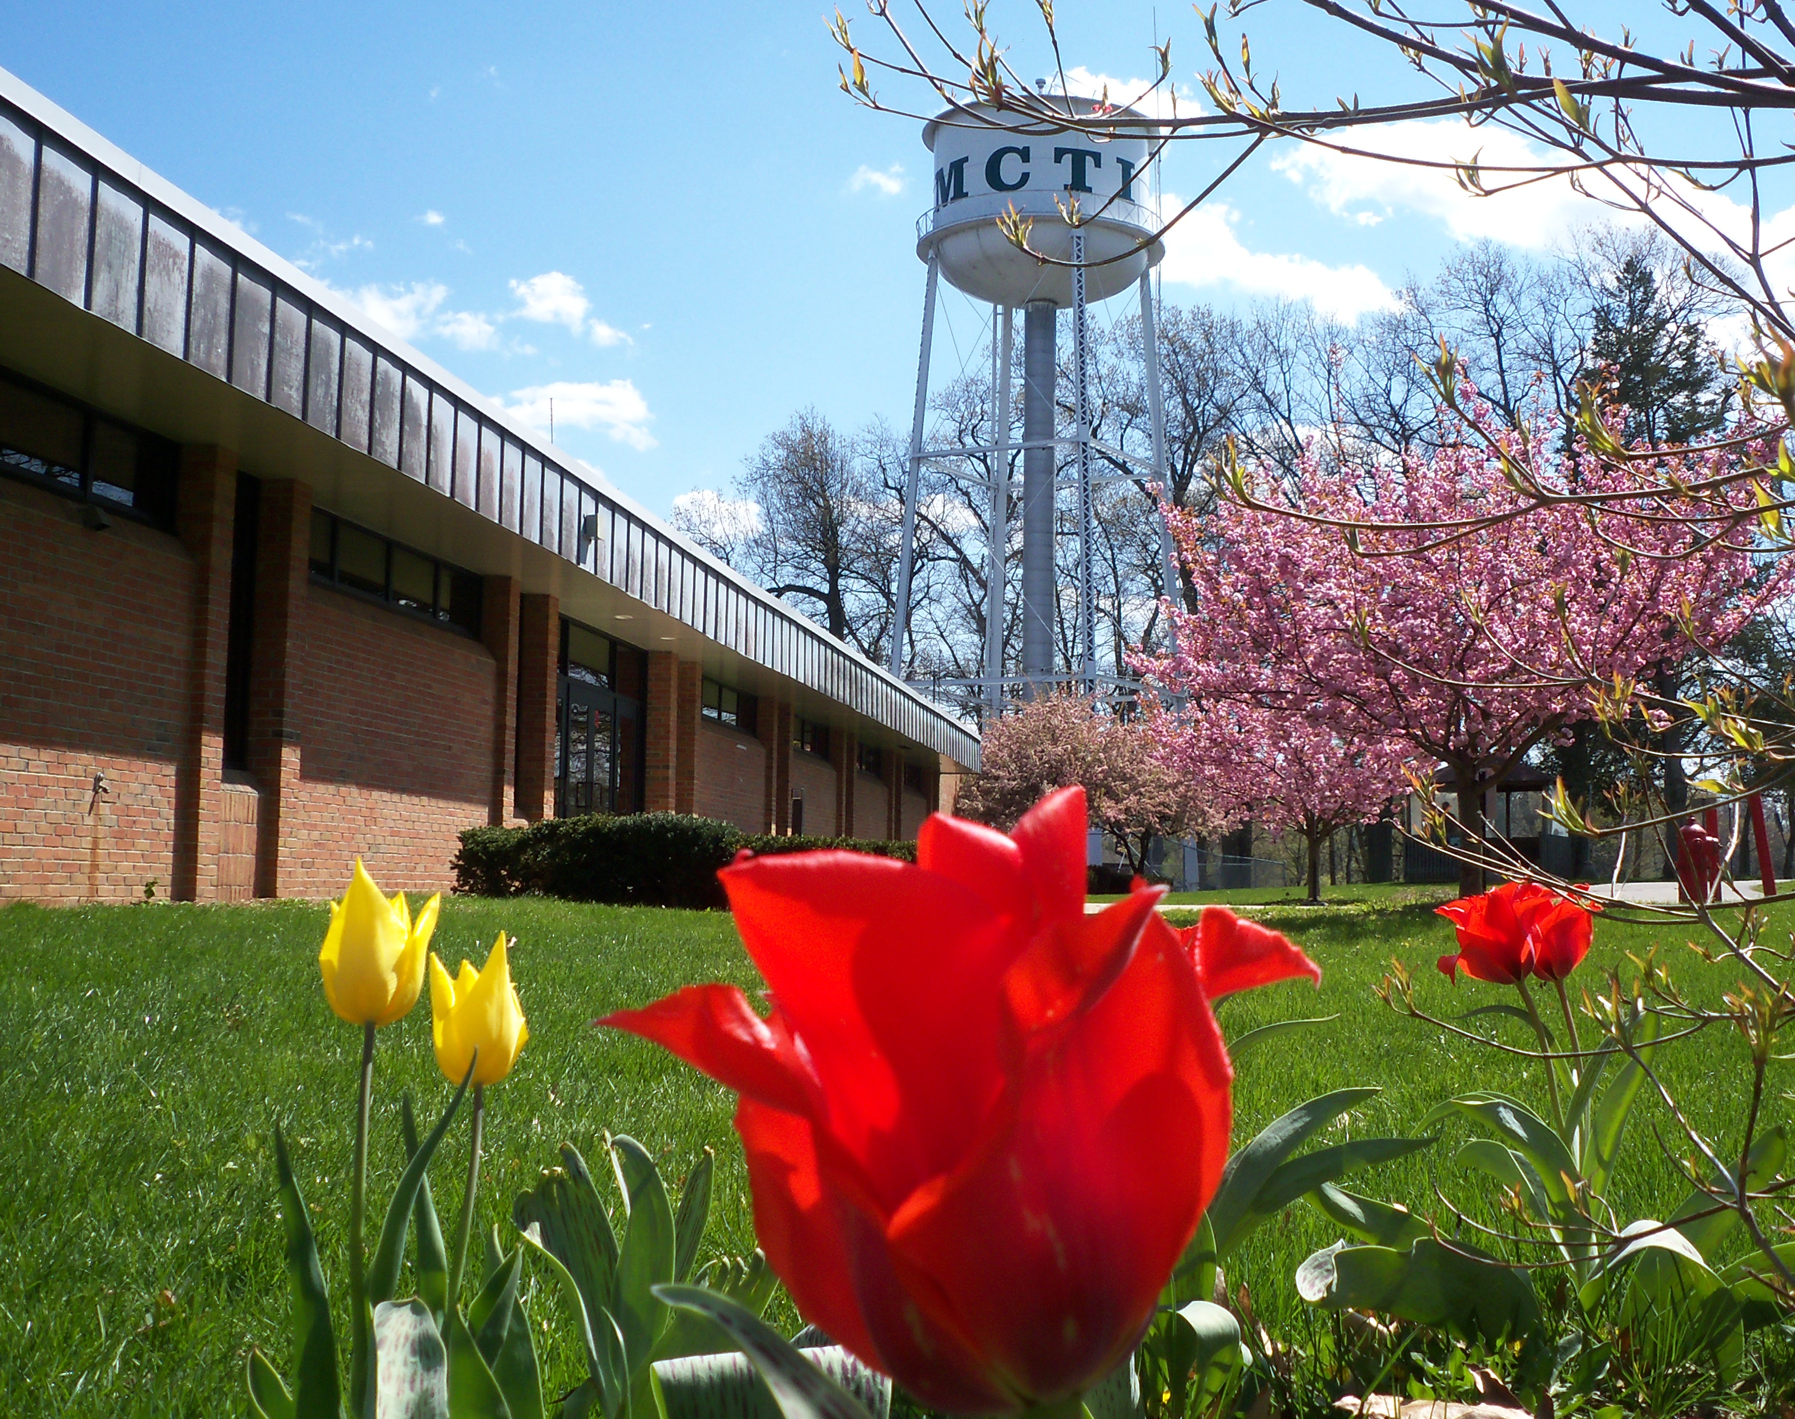
Exploring Michigan Career and Technical Institute as a Post-Secondary Education Option
Mandy Matthews
Ben Post
Brian Townsel

Slide 2
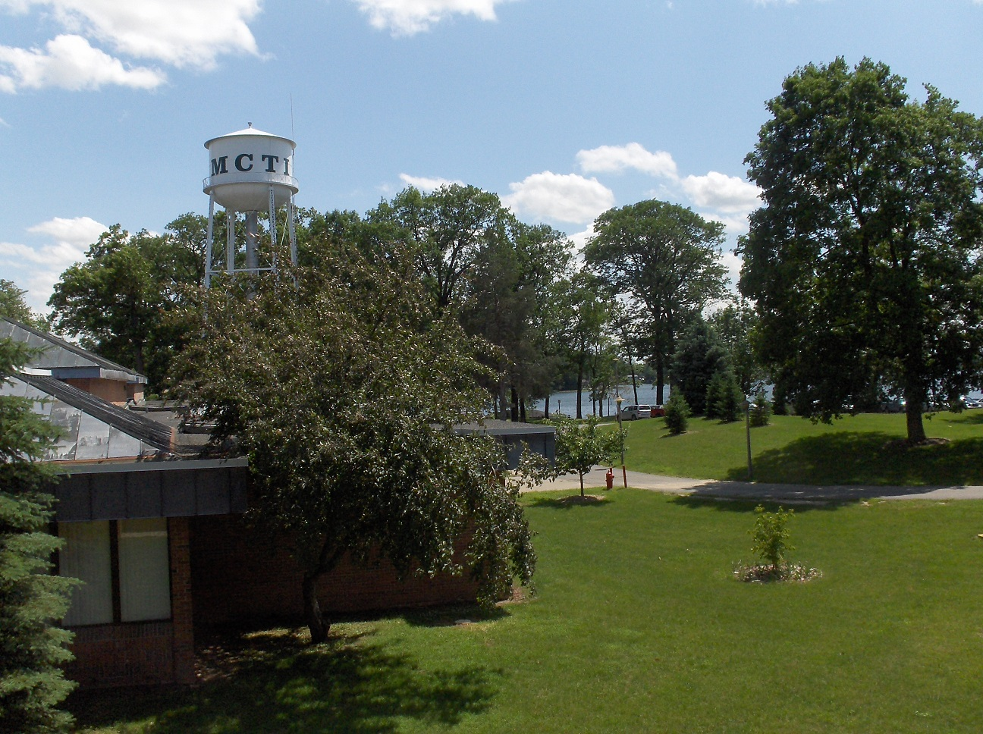

What is MCTI?
Accredited postsecondary institution that provides Career and Technical Education
Career Assessment Services
12 Trades
Designed for students with disabilities
Located on Pine Lake in Plainwell, MI
Halfway between Kalamazoo and Grand Rapids

Slide 3
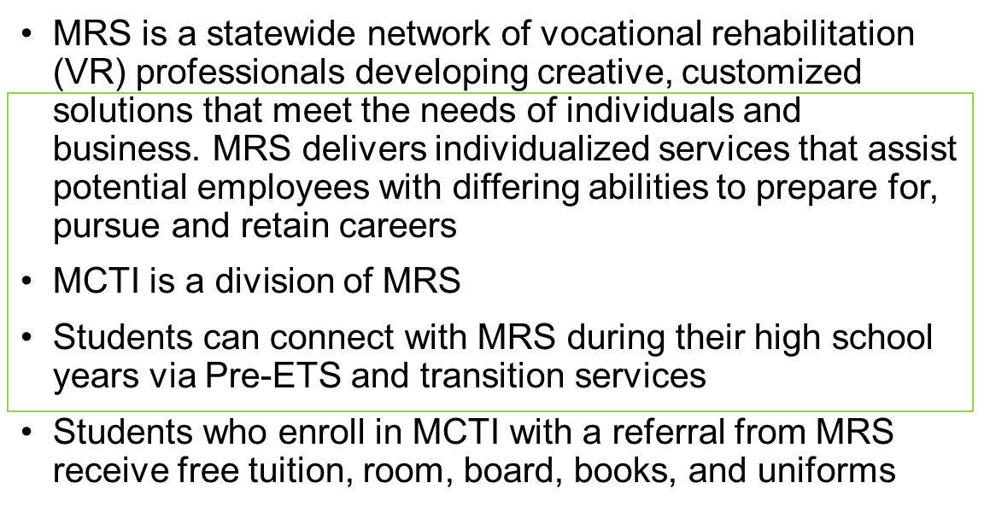
Michigan Rehabilitation Services (MRS)

Slide 4
Career and Technical Education
Prepares students for careers in specific skilled trades, applied sciences, and technologies. Technical colleges are singularly focused on preparing students for jobs in the real world.
- Council on Occupational Education (COE)

Slide 5
Facts about MCTI
Campus is located on 72 acres with access to 700 feet of Pine Lake
MCTI has been in operation since 1944
Dormitories are attached to the main building and house 350 students
MCTI has assessment services, remediation services and 12 trade training programs
Students do not have to have an IEP, HS Diploma or a GED to attend MCTI

Slide 6
MCTI Demographics – Students Served
 | 2022-2023 | 2021-2022 | 2020-2021
Students Served | 454 | 346 | 536

Slide 7
MCTI Demographics – Age
 | 2022-2023 | 2021-2022 | 2020-2021
Age 18-22 | 80.6% | 79.1% | 84.4%
Age 23-26 | 15.6% | 16.0% | 11%
Age 27-31 | 3.1% | 3.9% | 3.4%
Age 32-35 | 0 | 0.5% | 0
Age 36-45 | 0.7% | 0.5% | 0.8%
Age 46+ | 0 | 0 | 0.3%
Unknown | 0 | 0 | 0.1%

Slide 8
MCTI Demographics – Gender
 | 2022-2023 | 2021-2022 | 2020-2021
Male | 82.4% | 80.6% | 75.8%
Female | 16.7% | 18.7% | 23.1%
Did not wish to self-identify | 0.9% | 0.7% | 0.2%

Slide 9
MCTI Demographics – Ethnicity
 | 2022-2023 | 2021-2022 | 2020-2021
White | 79.5% | 78.6% | 76.4%
Black/African American | 9.9% | 12.3% | 11.5%
Multi-Racial | 7.9% | 7.4% | 9.5%
American Indian or Alaskan Native | 0.4% | 0.5% | 1%
Asian | 2.0% | 1.2% | 1.2%
Arab | 0 | N/A | .3%
Native Hawaiian or Other Specific Islander | 0 | N/A | .5%
Hmong | 0 | N/A | 0

Slide 10
MCTI Demographics – Disability
 | 2022-2023 | 2021-2022 | 2020-2021
Autism | 38.8% | 33.2% | 28.8%
Specific Learning Disabilities | 21.6% | 23.8% | 24.3%
ADHD | 17.2% | 17.4% | 17.8%
Intellectual Disability | 6.6% | 7.9% | 9.7%
Depressive/Mood Disorders | 3.1% | 4.2% | 4.2%
Congenital/birth injury | 3.7% | 2.7% | 2.5%
Anxiety Disorders | 1.3% | 3.2% | 3.2%
Physical Disorders/Conditions | 2.9% | 2.5% | 3.1%
Mental Illness | 1.3% | 1.2% | 1.2%
Cerebral Palsy | 0.9% | .7% | .8%

Slide 11

How do I get to MCTI?
Applicants must be 18 years of age or older and have a documented disability
Students do not apply directly to MCTI, they are referred by one of the following agencies serving the county in which you reside;
Michigan Rehabilitation Services (MRS); contact the office in your county to open a case
Michigan Bureau of Services for Blind Persons (BSBP)
U.S. Department of Veteran’s Affairs
Private rehabilitation agencies

Slide 12

A typical school day schedule for students
Monday - *Friday
8:00 am Class is in Session
10:00 am-10:15 am Break
11:30 am -12:30 pm OR 12:00 pm – 1:00 pm Lunch
2:00 pm – 2:15 pm Break
3:30 pm Class Dismissed
* On Fridays, students are dismissed at 2:30 pm
The culinary and custodial trade start and finish times may vary

Slide 13
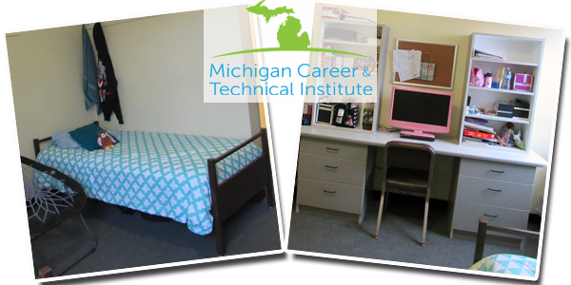
MCTI Life
Students live in suite style dorms
Currently 1 student to every room with (2) students sharing (1) bathroom
All meals are provided
3 meals M-F
2 meals S & S
Weekly room inspections
There are washer & dryers for students with use of laundry card (students load money on to the card)
Dorm/Fire & Safety staff available 24 hours/day
Handicap Accessible rooms including rooms/devices for the Deaf & Hard of Hearing students
Can bring own T.V./DVD/Video game system and mini refrigerator
MCTI is an open campus

Slide 14
Support Services
Vocational Counseling and Guidance
Medical Services
Supportive Counseling
Occupational Therapist
Interpreters (ASL and ESL)
Accommodations and Assistive Technology
Career Communications Club
Leisure Services
Employment Readiness

Slide 15
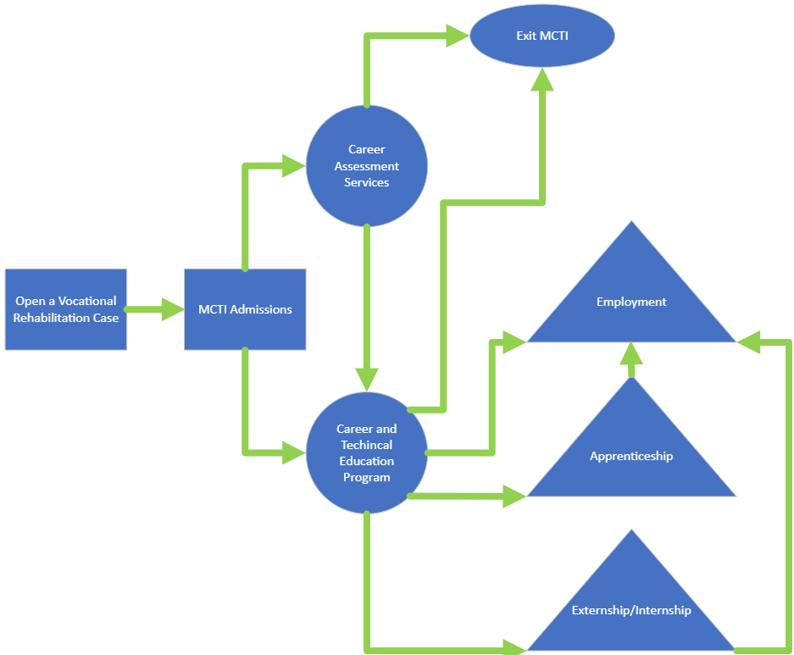
MCTI Flowchart

Slide 16
Career Readiness Center Career Assessment
Designed for students who have completed high school and are interested in MCTI
Assess aptitudes, abilities and readiness for employment and independent living
Allows students to explore available/appropriate trade options to best suit their abilities

Slide 17
Career Assessment Services CAS
Three-week Hybrid CAS
Recommended
Virtual CAS
Student Request
Students will participate in a three-week hybrid session with the following schedule:
Week 1: Intake and preparatory meetings through
Microsoft Teams (virtual)
Week 2: On-campus completion of assessments, trade
exploration, and hands-on experiences. Students
register Monday morning and depart MCTI on
Friday afternoon
Week 3: Virtual review of assessments results, trade
options, and next steps
While on campus, students live independently in the MCTI dormitory. Breakfast, lunch, and dinner are provided. Evening activities are organized by MCTI Leisure Staff
Students work virtually with an MCTI vocational rehabilitation counselor to navigate the CAS process, including proctoring of some assessments
Students will complete most assessments individually at their convenience with virtual assistance and support available from counselor as needed. Some virtual meetings will be required with MCTI staff. MCTI counselor coordinates virtual meetings with student, parent/guardian, and MRS counselor
Virtual CAS offers more flexibility with scheduling for students and does not require the student to come to MCTI’s campus during the process. Students must have access to a computer with a webcam and microphone, as well as reliable internet connection

Slide 18

Integrated Trade Remediation Services
Has replaced the Step-Up program
Remediation for academic skills such as math, reading and measuring is integrated directly into the first and continuing terms of a student’s trade training
Taught by trade and pre-vocational instructors
Skills taught are directly related to meet trade curriculum expectations
Assists in determining a student’s success for additional terms

Slide 19













Michigan Career & Technical Institute 12 Vocational Training Programs
Automotive Technology
Cabinetmaking/Millwork
Certified Nurse Assistant
Commercial Printing
Culinary Arts
Custodial
Grounds Maintenance
Industrial Electronics
Information Technology
Machine Technology
Pharmacy Technician
Retail Marketing

Slide 20
Training Programs
Focused on entry level employment
Competency based
Employment focused; employment expectations are discussed beginning the first day in the training program
Trade recommendation may differ from initial trade interest after CAS is completed
Each training program has specific recommended entrance criteria

Slide 21
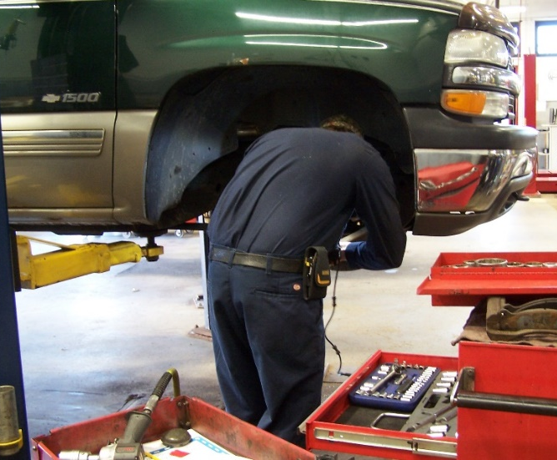
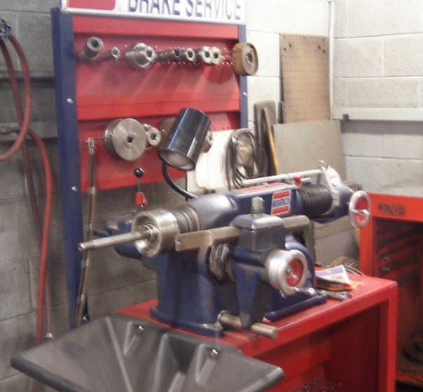
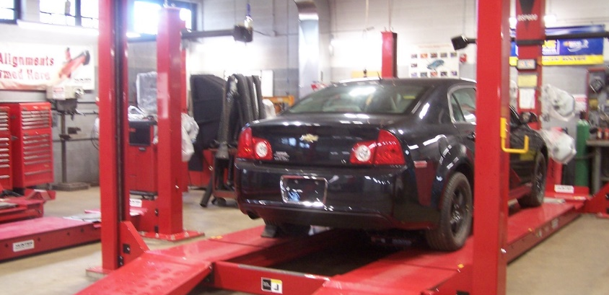
Automotive Technology
Up to 6 terms depending on student skills, abilities, and interests
Students work to become certified by the State of Michigan or through the National Institute for Automotive Service Excellence (ASE)
Entry level skill training may include general maintenance, brakes, suspension and steering, tires, electrical, automotive HVAC and engine performance
Additionally, there is a Parts Specialist program for retail automotive parts personnel
All courses incorporate the ASE Education Foundation industry standards
Students must have a valid driver’s license prior to enrollment

Slide 22
Automotive Technology
Auto Tech/Mechanic Certification – National Institute for Automotive Service Excellence (ASE)
Entry Level Certification – National Institute for Automotive Service Excellence (ASE)
SP/2 (Safety and Pollution Prevention)
State of Michigan (technician/mechanic)
Certified Auto Information Specialist (CAIS)
Procut OTV (Brake) Lathe
Occupational Safety & Health Administration (OSHA) Outreach Training Course / OSHA 10 –General Industry
General Maintenance Technician
Suspension/Steering Technician
Brake Technician
Automotive Electrical Technician
Engine Performance Technician
HVAC Technician
Auto Parts Specialist

Slide 23
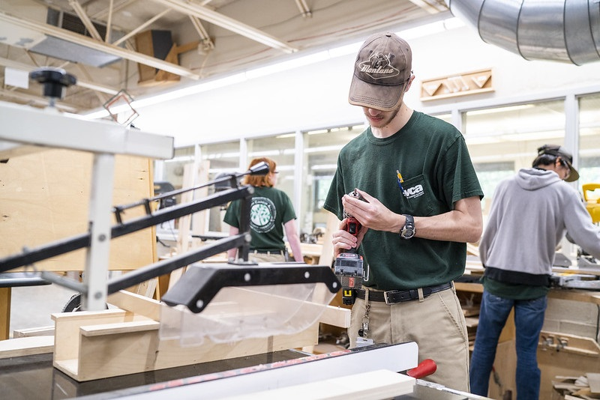
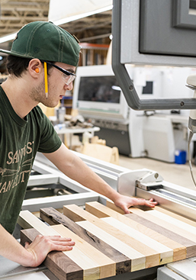
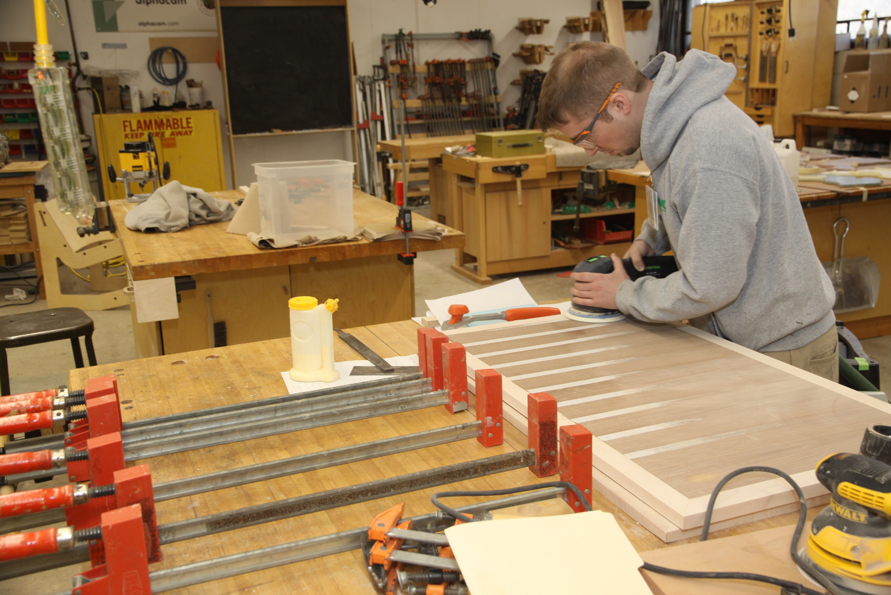
Cabinetmaking
Up to 5 terms depending on student skills, abilities, and interests
Individual and production projects help students develop their skills and knowledge
Students are trained in the operation of state-of-the-art CNC panel processing equipment, spindle molders, profile grinders, and with numerous other woodworking machines and software
Students earn national skill credentials directly from the Woodworking Career Alliance

Slide 24
Cabinetmaking
Woodworking Machine Operator I
Woodworking Machine Operator II
Woodworking Machine Operator III
Technical Machine Operator
Cabinetmaker / Bench Carpenter
Woodwork Career Alliance National Woodworking Skill Standard Credentials
American Heart Association
CPR/First Aid/AED

Slide 25
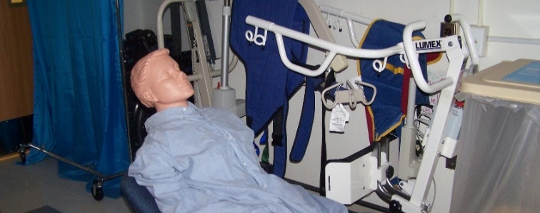
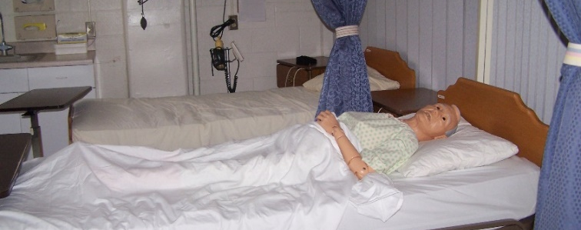
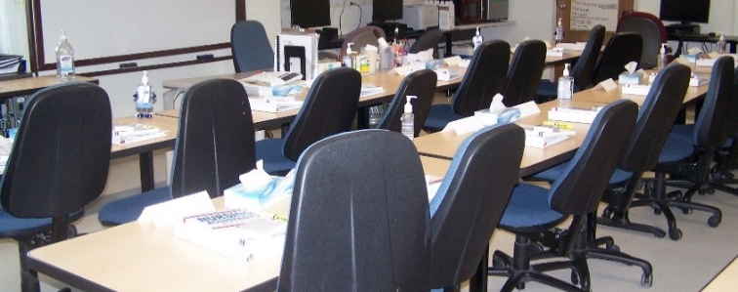
Certified Nurse Assistant (CNA)
1 term training program
Students learn in a simulated lab environment and classroom studying patient care, communication, medical terminology, documentation, medical equipment, CPR and first aid, and specialized dementia training to prepare for the State of Michigan competency exam
Students participate in a clinical rotation at a local nursing home
Students are subjected to background screening
Students are also required to submit a drug screen and have a flu shot prior to beginning their clinical rotation

Slide 26
Certified Nursing Assistant
Nurses Aid
Certified Nursing Assistant
American Heart Association
CPR/First Aid/AED

Slide 27
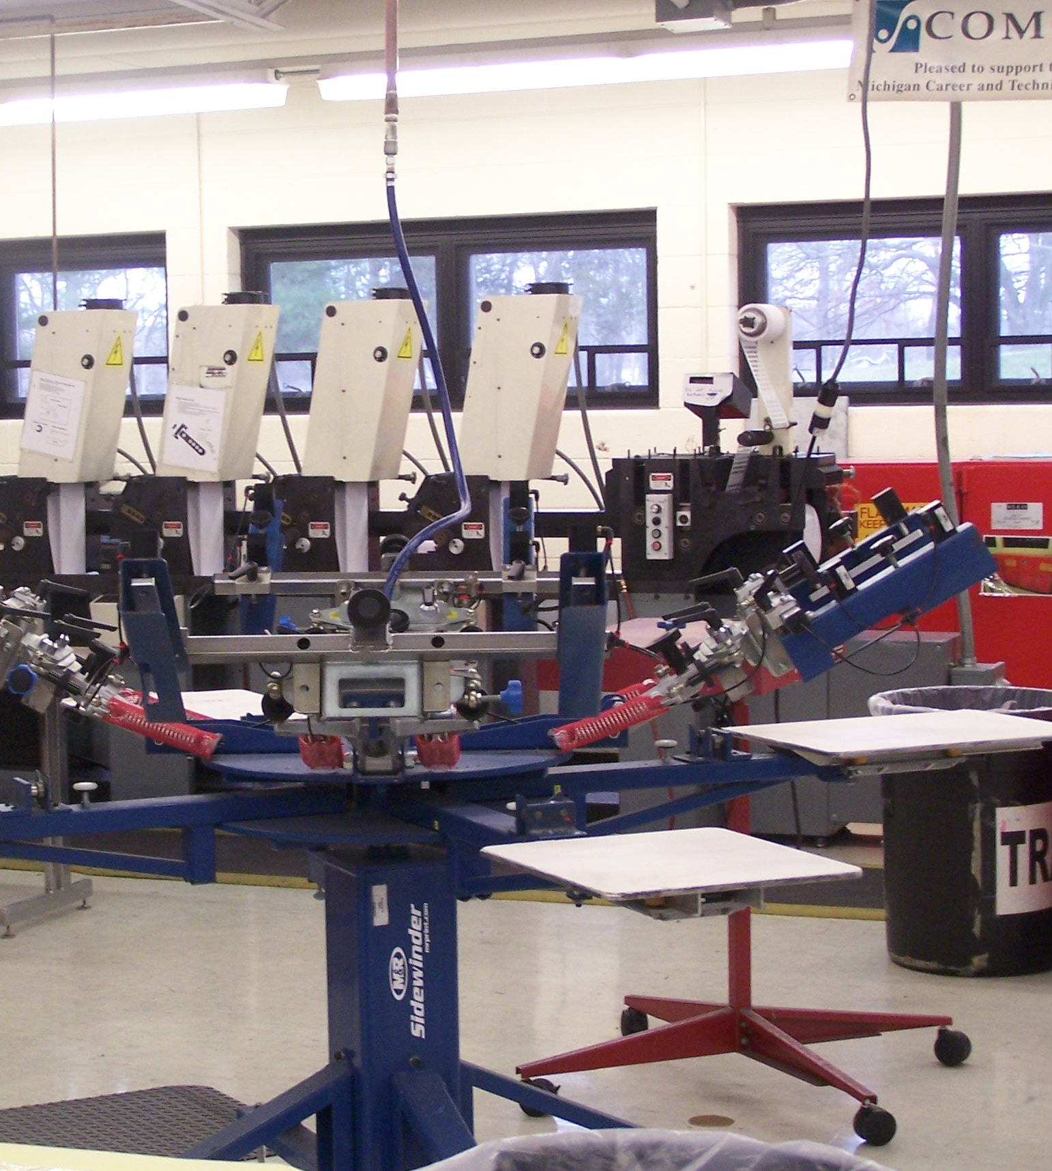
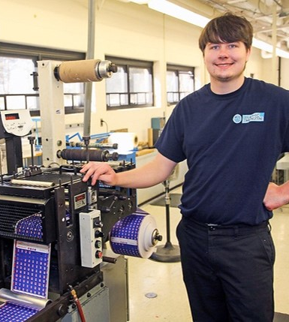
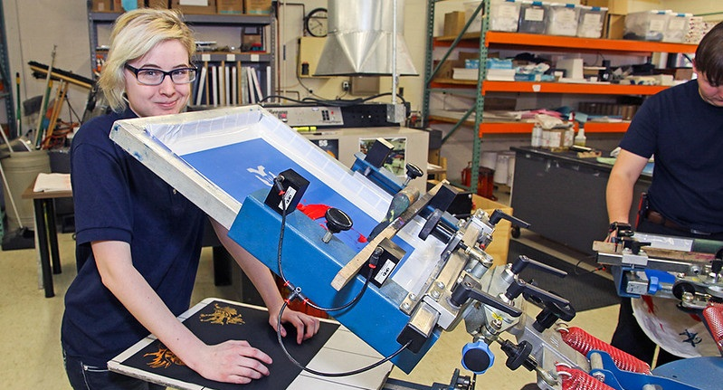
Commercial Printing
Up to 3 terms depending on student skills, abilities, and interests
Students work to develop job competencies while operating specialized printing equipment in a manufacturing setting in three areas: offset and bindery, flexographic, and screen printing
Students produce a variety of products depending on the course – brochures, booklets, labels, packaging products, signs, etc.

Slide 28
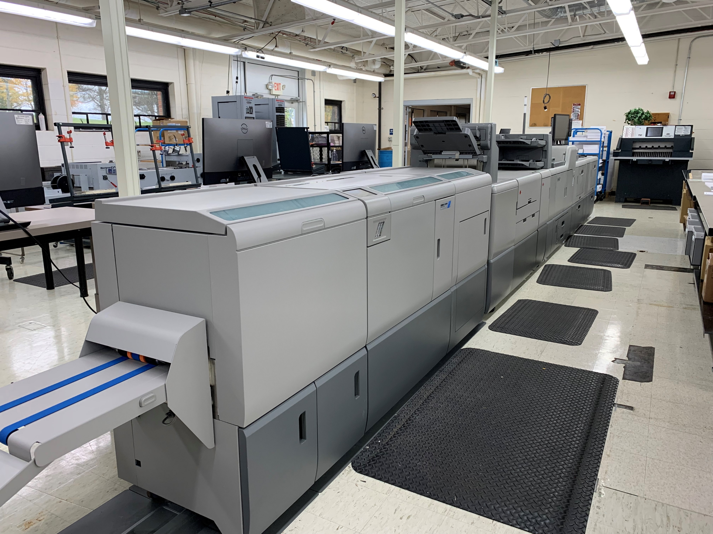
Commercial Printing
Screen Printer
Bindery/Finishing Worker
Offset Press Assistant
Flexo Press Assistant
Occupational Safety & Health Administration (OSHA) Outreach Training Course / OSHA 10 –General Industry
American Heart Association
CPR/First Aid/AED
*With a new digital press available, additional curriculum and industry certifications are being created at this time

Slide 29
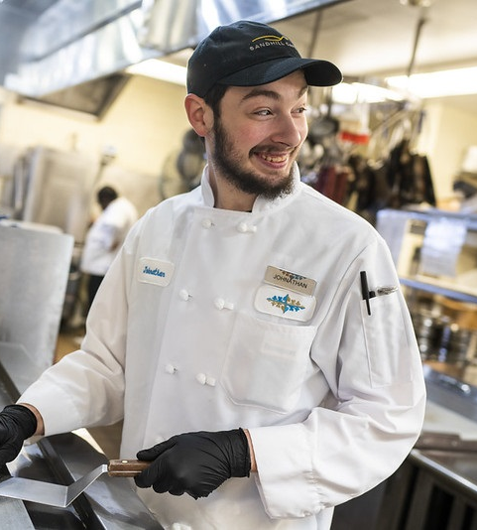
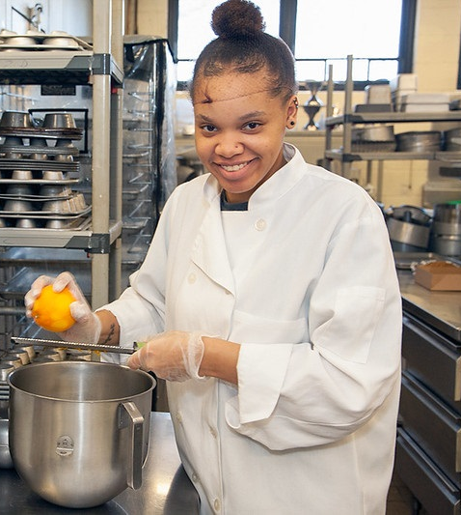
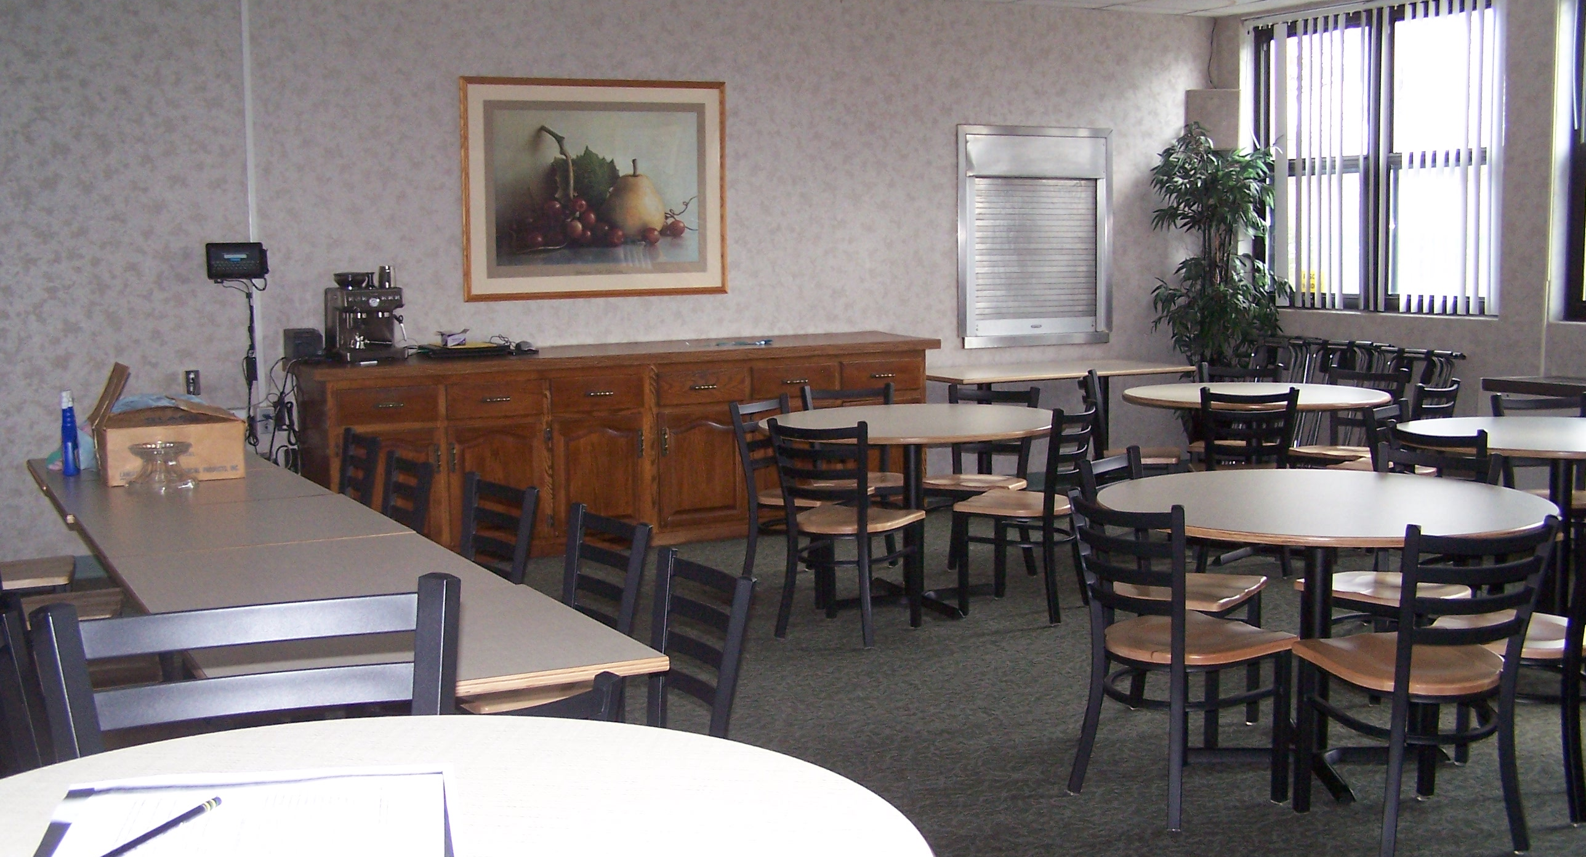
Culinary Arts
Up to 3 terms depending on student skills, abilities, and interests
Students receive training in large-quantity food preparation and assist with cooking and serving in the school cafeteria
Advanced students operate the Pine Cove Restaurant on campus
Students work toward the completion of ServSafe certifications

Slide 30
Culinary Arts
Food Services Worker
Cook’s Helper
Cook
ServeSafe Food Handler
ServeSafe Allergen
ServeSafe ManageFirst Professional
American Heart Association
CPR/First Aid/AED

Slide 31
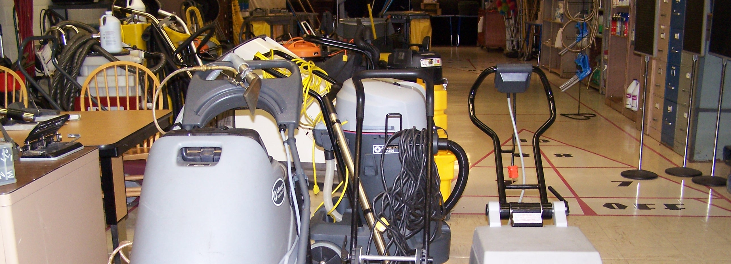
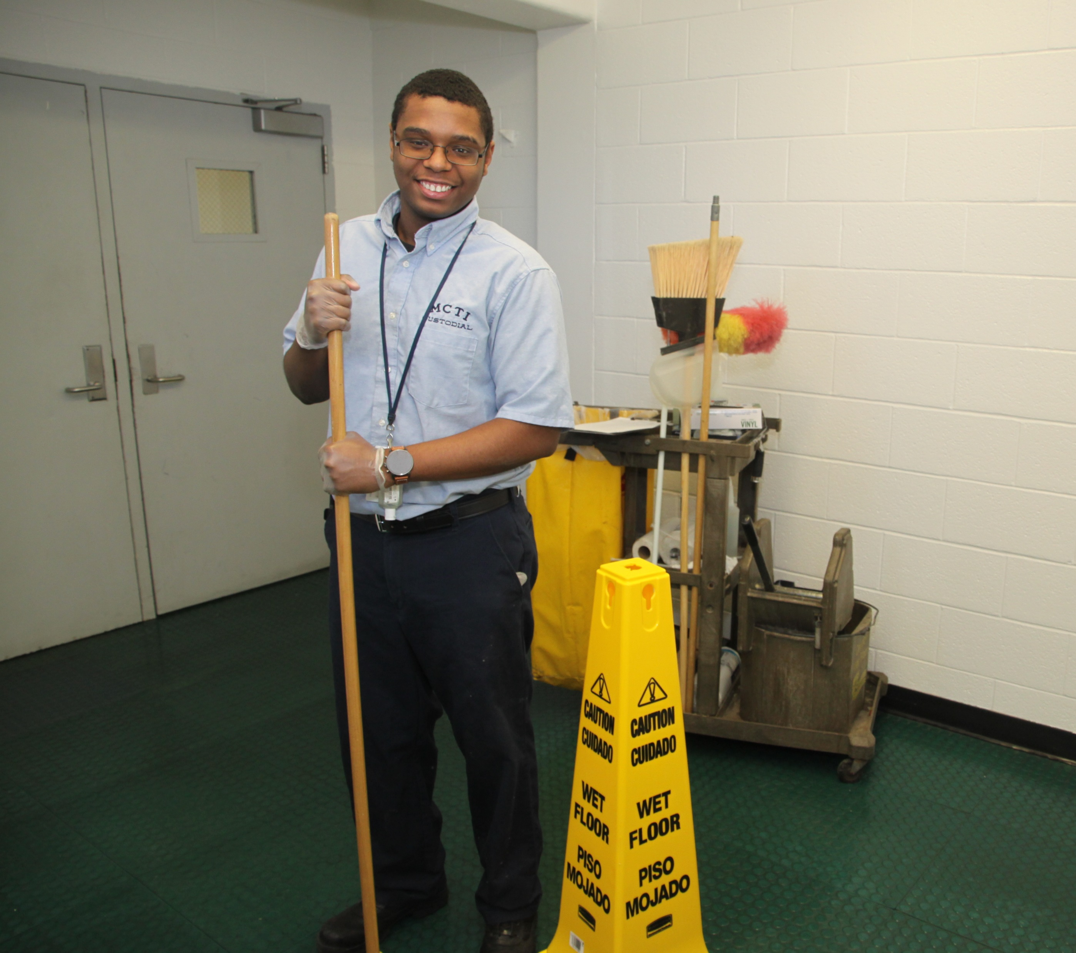
Custodial
Up to 2 terms depending on student skills, abilities, and interests
Students learn to become skilled, experienced building and commercial custodians by using updated equipment and learning at on-campus job stations
Students gain experience in daily cleaning, floor maintenance, stripping of floors, restroom sanitation, daily carpet cleaning and shampooing, and operating and maintaining equipment

Slide 32
Custodial
Custodial Support Worker
Custodian
Spartan Chemical Clean Check Program
American Heart Association
CPR/First Aid/AED

Slide 33
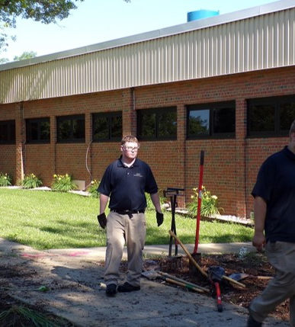
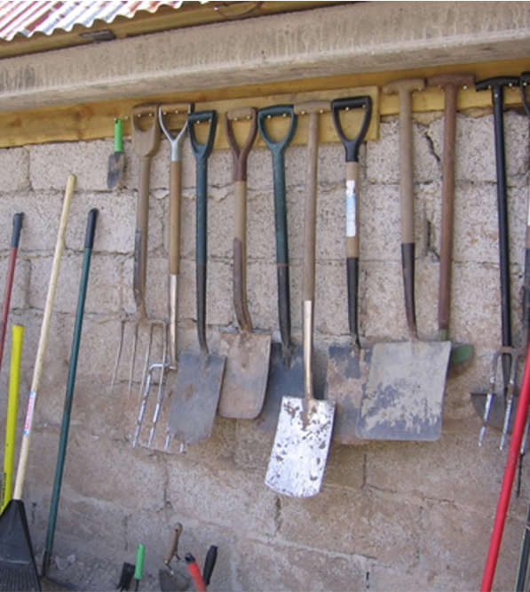
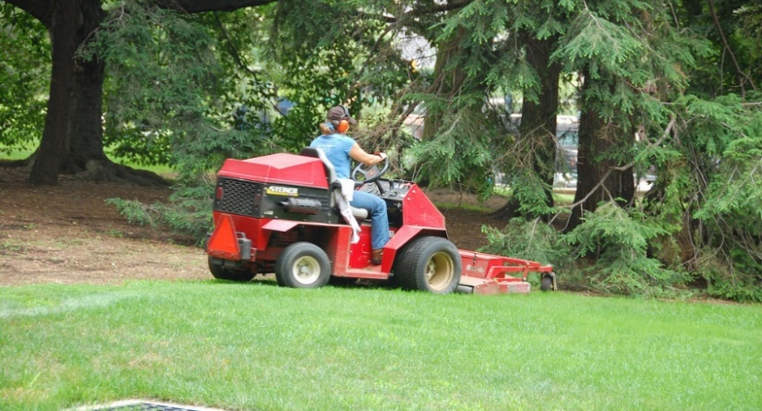
Grounds Maintenance
Up to 2 terms depending on student skills, abilities, and interests
Students gain actual experience working on the school campus using power equipment and hand tools, trimming and pruning hedges and bushes, plating trees, shrubs and flowers, doing snow and ice removal, and studying pesticides and irrigation
Safety and the proper use of personal protective equipment is a strong focus
Students learn to maintain the equipment used in servicing the campus grounds

Slide 34
Grounds Maintenance
General Maintenance Worker
Grounds Maintenance/ Landscaping Tech
Registered Pesticide Technician
(Michigan Dept of Agriculture and Rural Development)
American Heart Association
CPR/First Aid/AED

Slide 35
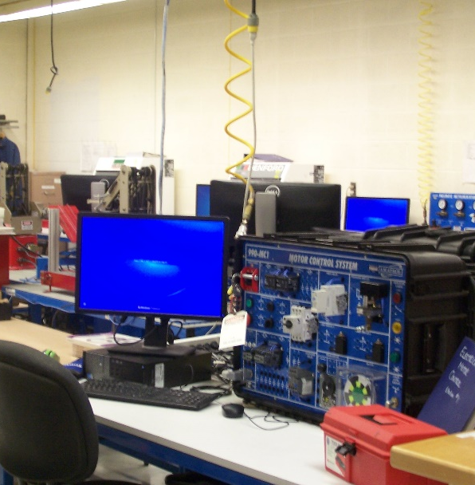
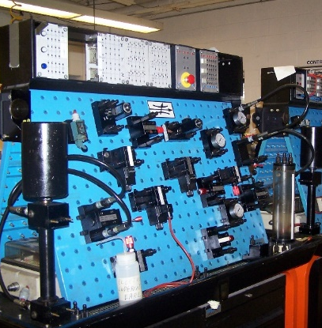
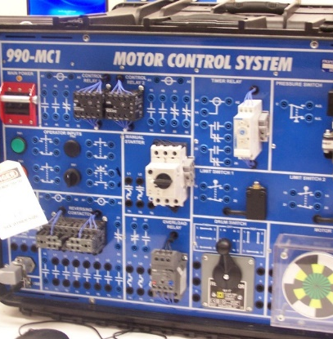
Industrial Electronics
Up to 4 terms depending on student skills, abilities, and interests
Students learn skills in AC/DC electronics, power distribution, control panel wiring, fluid power, automation and controls, and more
Training helps prepare students for entry-level positions in manufacturing production, assembly, and machine maintenance

Slide 36
Industrial Electronics
Assembler/Tester
Industrial Tester/Installer
Industrial Electronics Technician
Manufacturing Skills Specialist certification & Manufacturing Technician Level 1
Occupational Safety & Health Administration (OSHA) Outreach Training Course / OSHA 10 –General Industry
American Heart Association
CPR/First Aid/AED

Slide 37
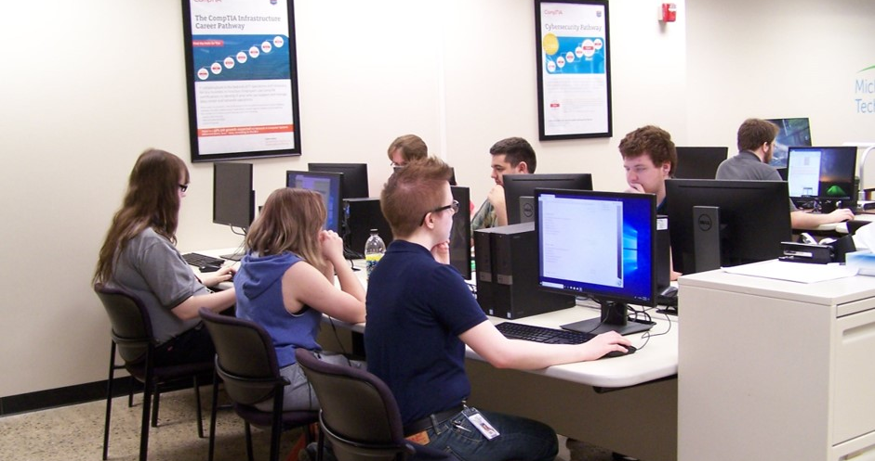
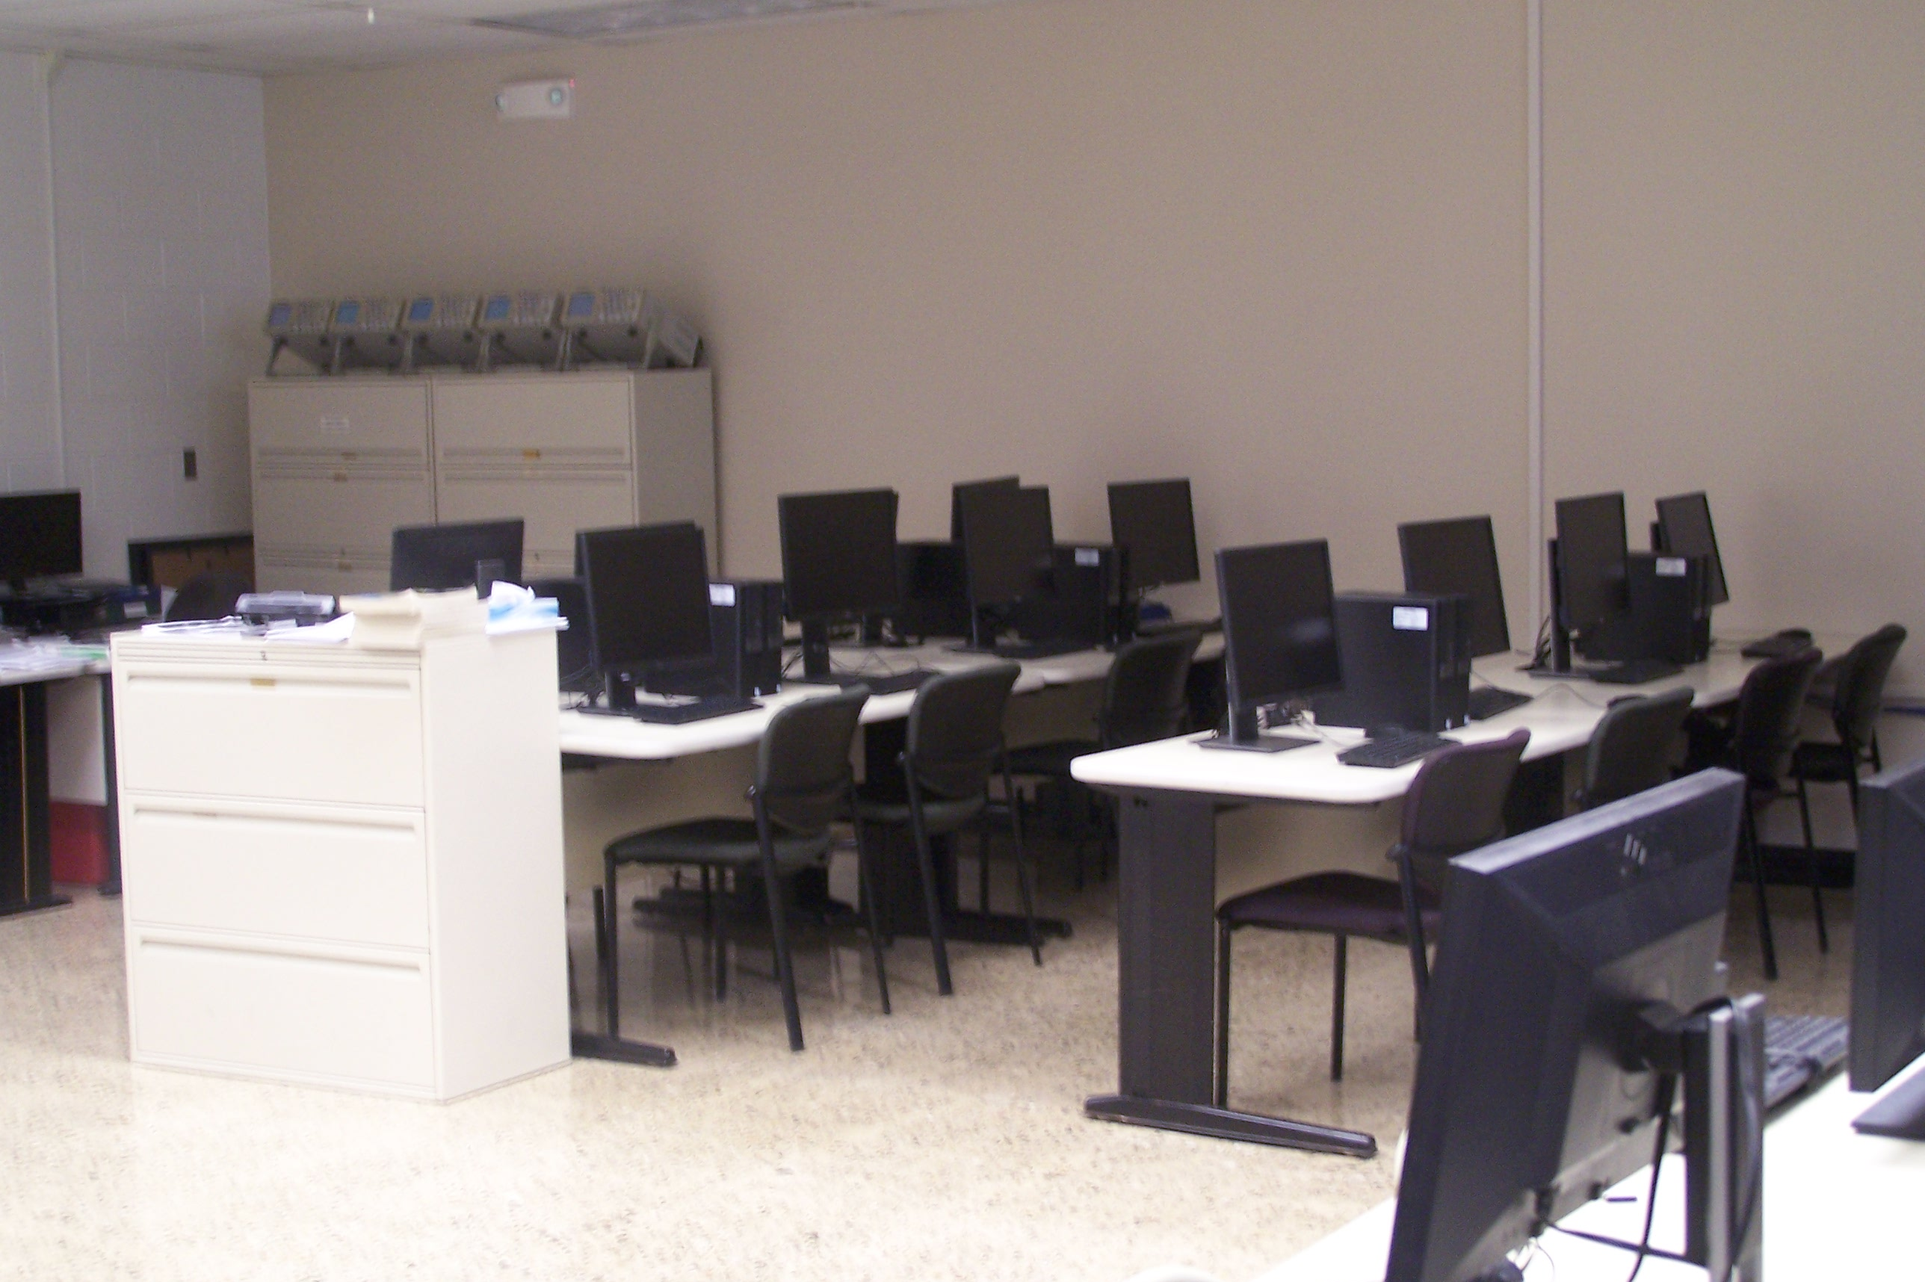
Information Technology
Up to 6 terms depending on student skills, abilities, and interests
Recognized CompTIA Authorized Academy and Cisco Networking Academy
Students learn to maintain and repair office management systems, computers, laptops, mobile devices, copiers, printers and other office equipment
Training is focused on customer service, problem solving and help desk technician skills

Slide 38
Information Technology
Microsoft Office Specialist – MOS
Office Certifications 2016-Word; Excel; Access 2016
Cisco CCNA R&S Intro to Networks
Cisco Cybersecurity Essentials
Cisco CCNA CyberOps
Cisco IoT Fund: Connecting Things
Cisco IT Essentials
Cisco Networking Essentials
NDG Linux Essentials
CompTIA IT Fundamental FC0-U61
CompTIA A+ 220-1000 Series
CompTIA Network+ N1-007
CompTIA Security+ SY0-501
CompTIA Server+ SK0-004
Microsoft MTA - Network Operating Systems - 98-365
Microsoft MTA - Security Fundamental 98-365
Microsoft MTA - Windows Fundamentals - 98-349
Microsoft MTA -Network Fundamentals 98-366
American Heart Association
CPR/First Aid/ AED
IT Customer Support
Cable Installer
Copier Servicing & Repair Tech
Computer/Peripheral Servicing & Repair Tech
Network Support Tech

Slide 39
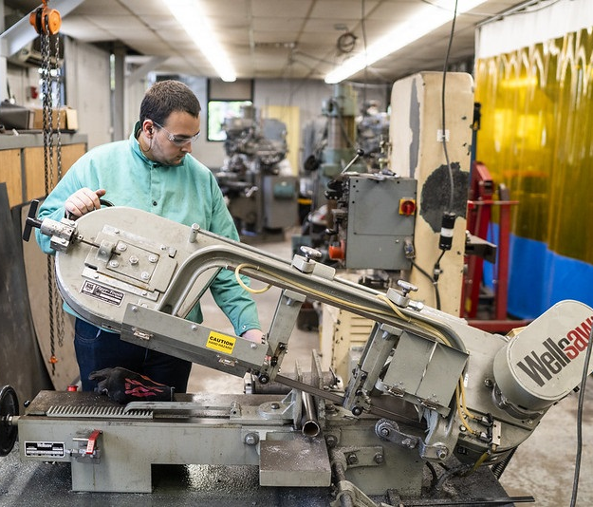
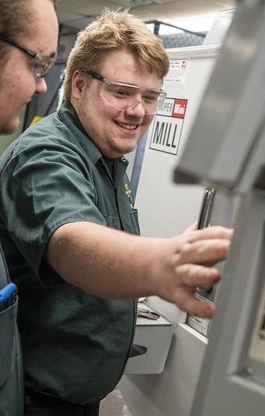
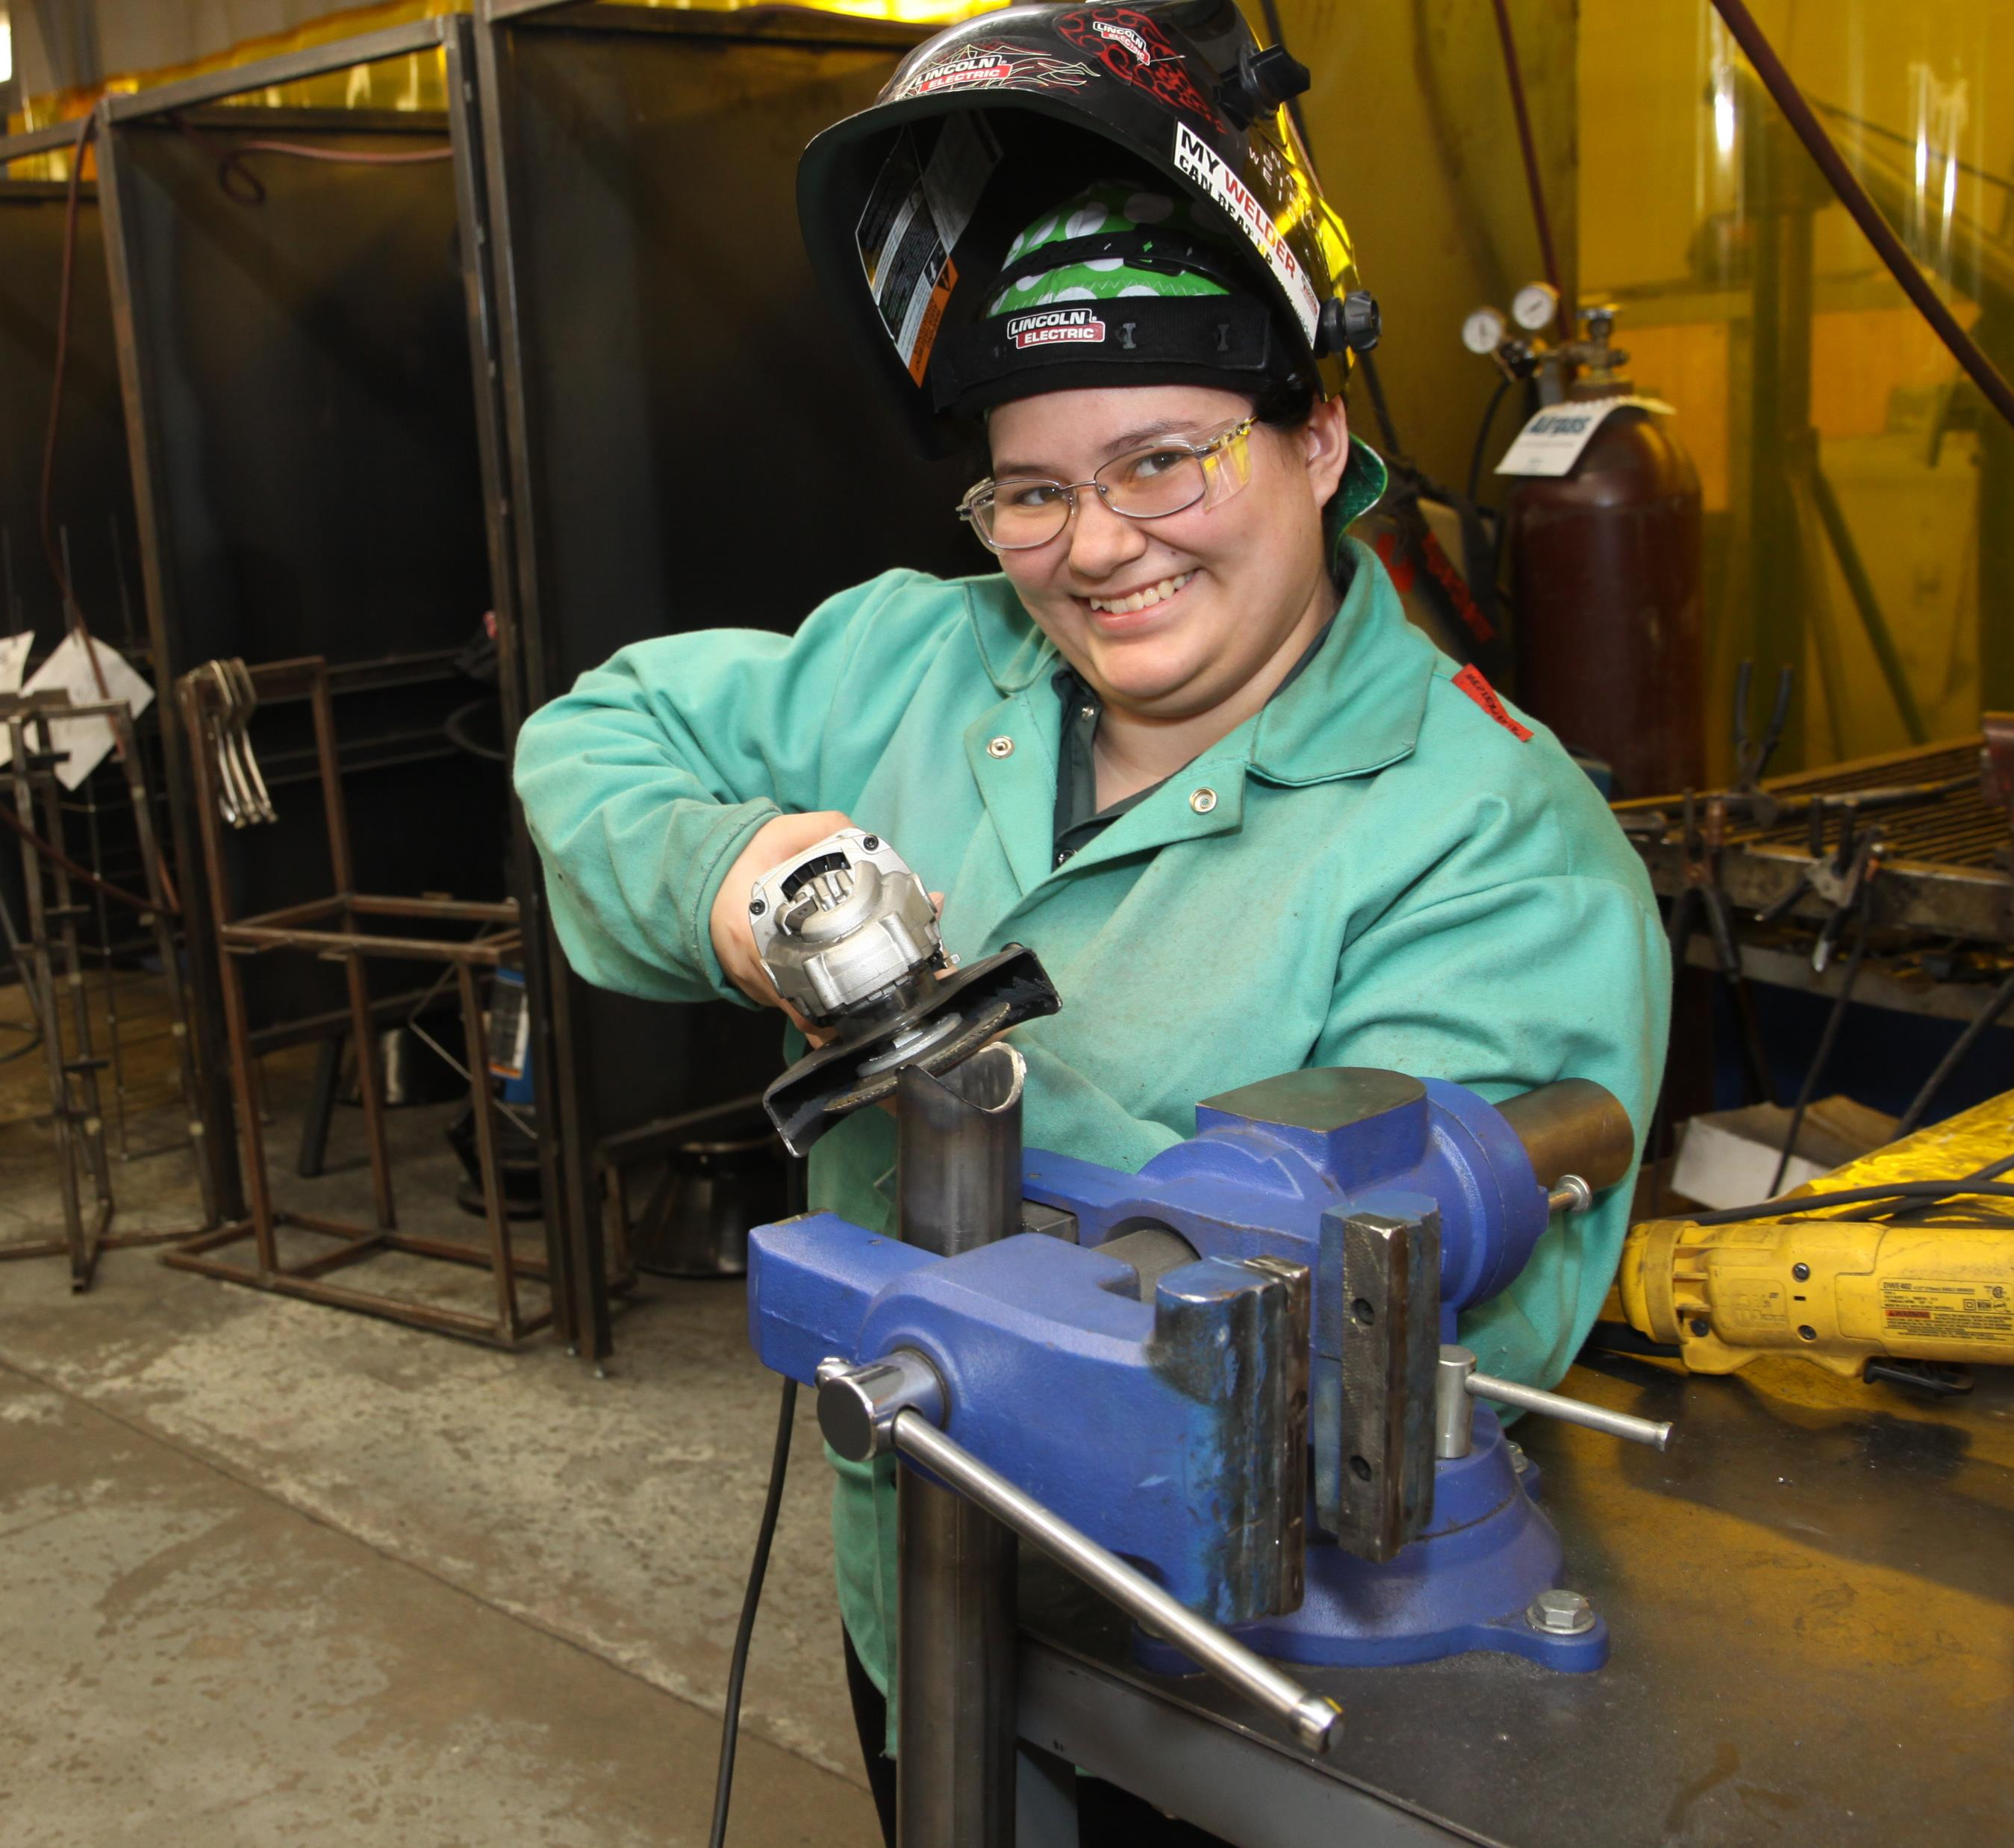
Machine Technology – CNC and Welding
Up to 3 terms depending on student skills, abilities, and interests
During the first term, students have the opportunity to earn a Metalworking Manufacturing Certificate
Successful completion of term one may lead to one of two tracks – Welding and CNC machining
Welding students learn MIG and TIG welding; production and fabrication welding based on skills and ability
CNC students learn various machining operations such as manual milling, turning and grinding, and G&M code programming using both manual and Computer Aided Manufacturing (CAM) software

Slide 40
Machine Technology
Metalworking Manufacturing
Machine Operator
Production Welder
Fabrication Welder
CNC Operator
Occupational Safety & Health Administration (OSHA) Outreach Training Course / OSHA 10 –General Industry
American Heart Association
CPR/First Aid/AED

Slide 41
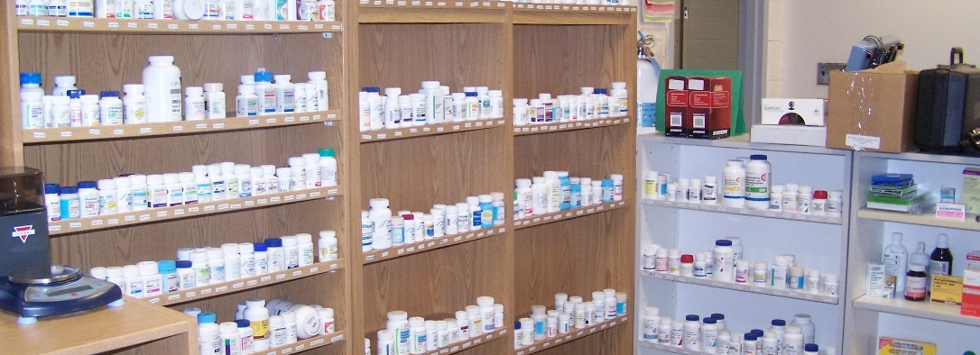
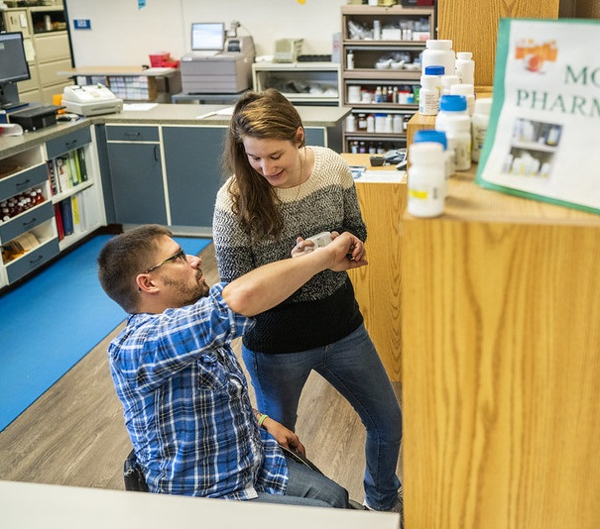
Pharmacy Technician
Up to 2 terms depending on student skills, abilities, and interests
Students receive hands-on experience related to retail pharmacy procedures; receiving, processing, and distributing prescriptions; and other essential job duties of a pharmacy technician
Students also receive training in customer service and pharmacy related laws and regulations
Students are fingerprinted and a criminal background check is also conducted in order to obtain their temporary license
Students must have earned a diploma or GED (to take the national certification exam)

Slide 42
Pharmacy Technician
Pharmacy Aide
Pharmacy Technician
(temporary license)
Pharmacy Technician License
American Heart Association
CPR/First Aid/AED

Slide 43
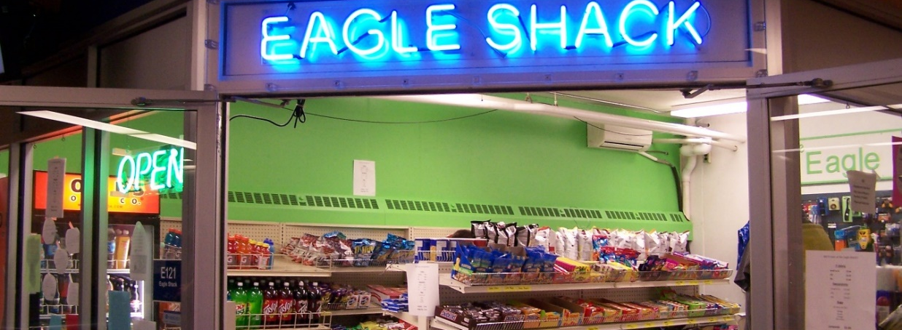
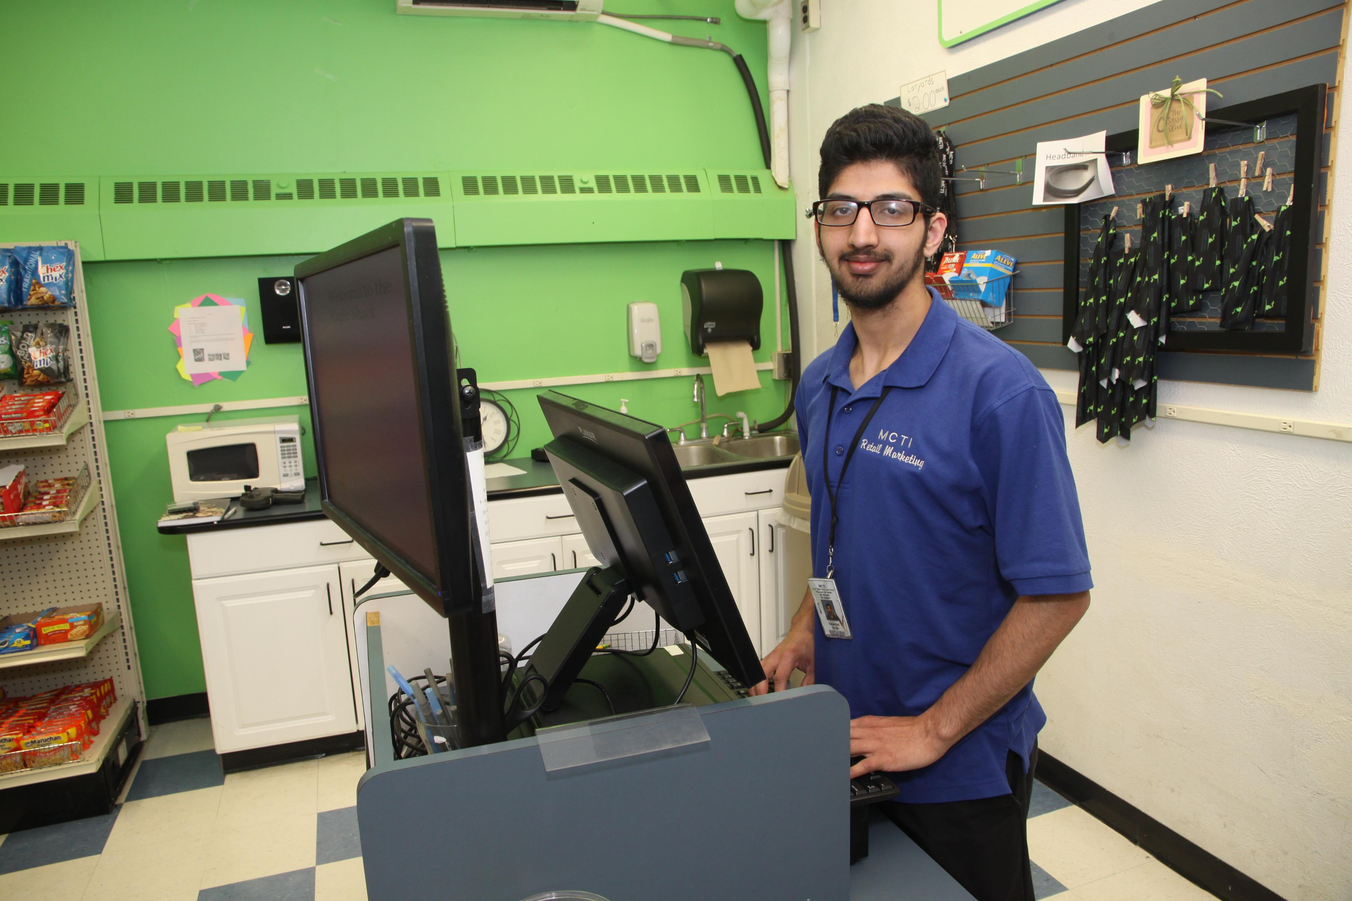
Retail Marketing
Up to 2 terms depending on student skills, abilities, and interests
Students receive hands-on training in customer service, cash handling, inventory control, merchandizing, safety procedures, promotion/advertising and the National Retail Skill Standards for loss prevention
Students are responsible for operating the Eagle Shack, MCTI’s on-campus store

Slide 44
Retail Marketing
Stock Clerk
Cashier
Sales Associate
National Retail Federation (NRF)
Industry Fundamentals Specialist Certification
Occupational Safety & Health Administration (OSHA) Outreach Training Course / OSHA 10 General Industry
American Heart Association
CPR/First Aid/AED

Slide 45
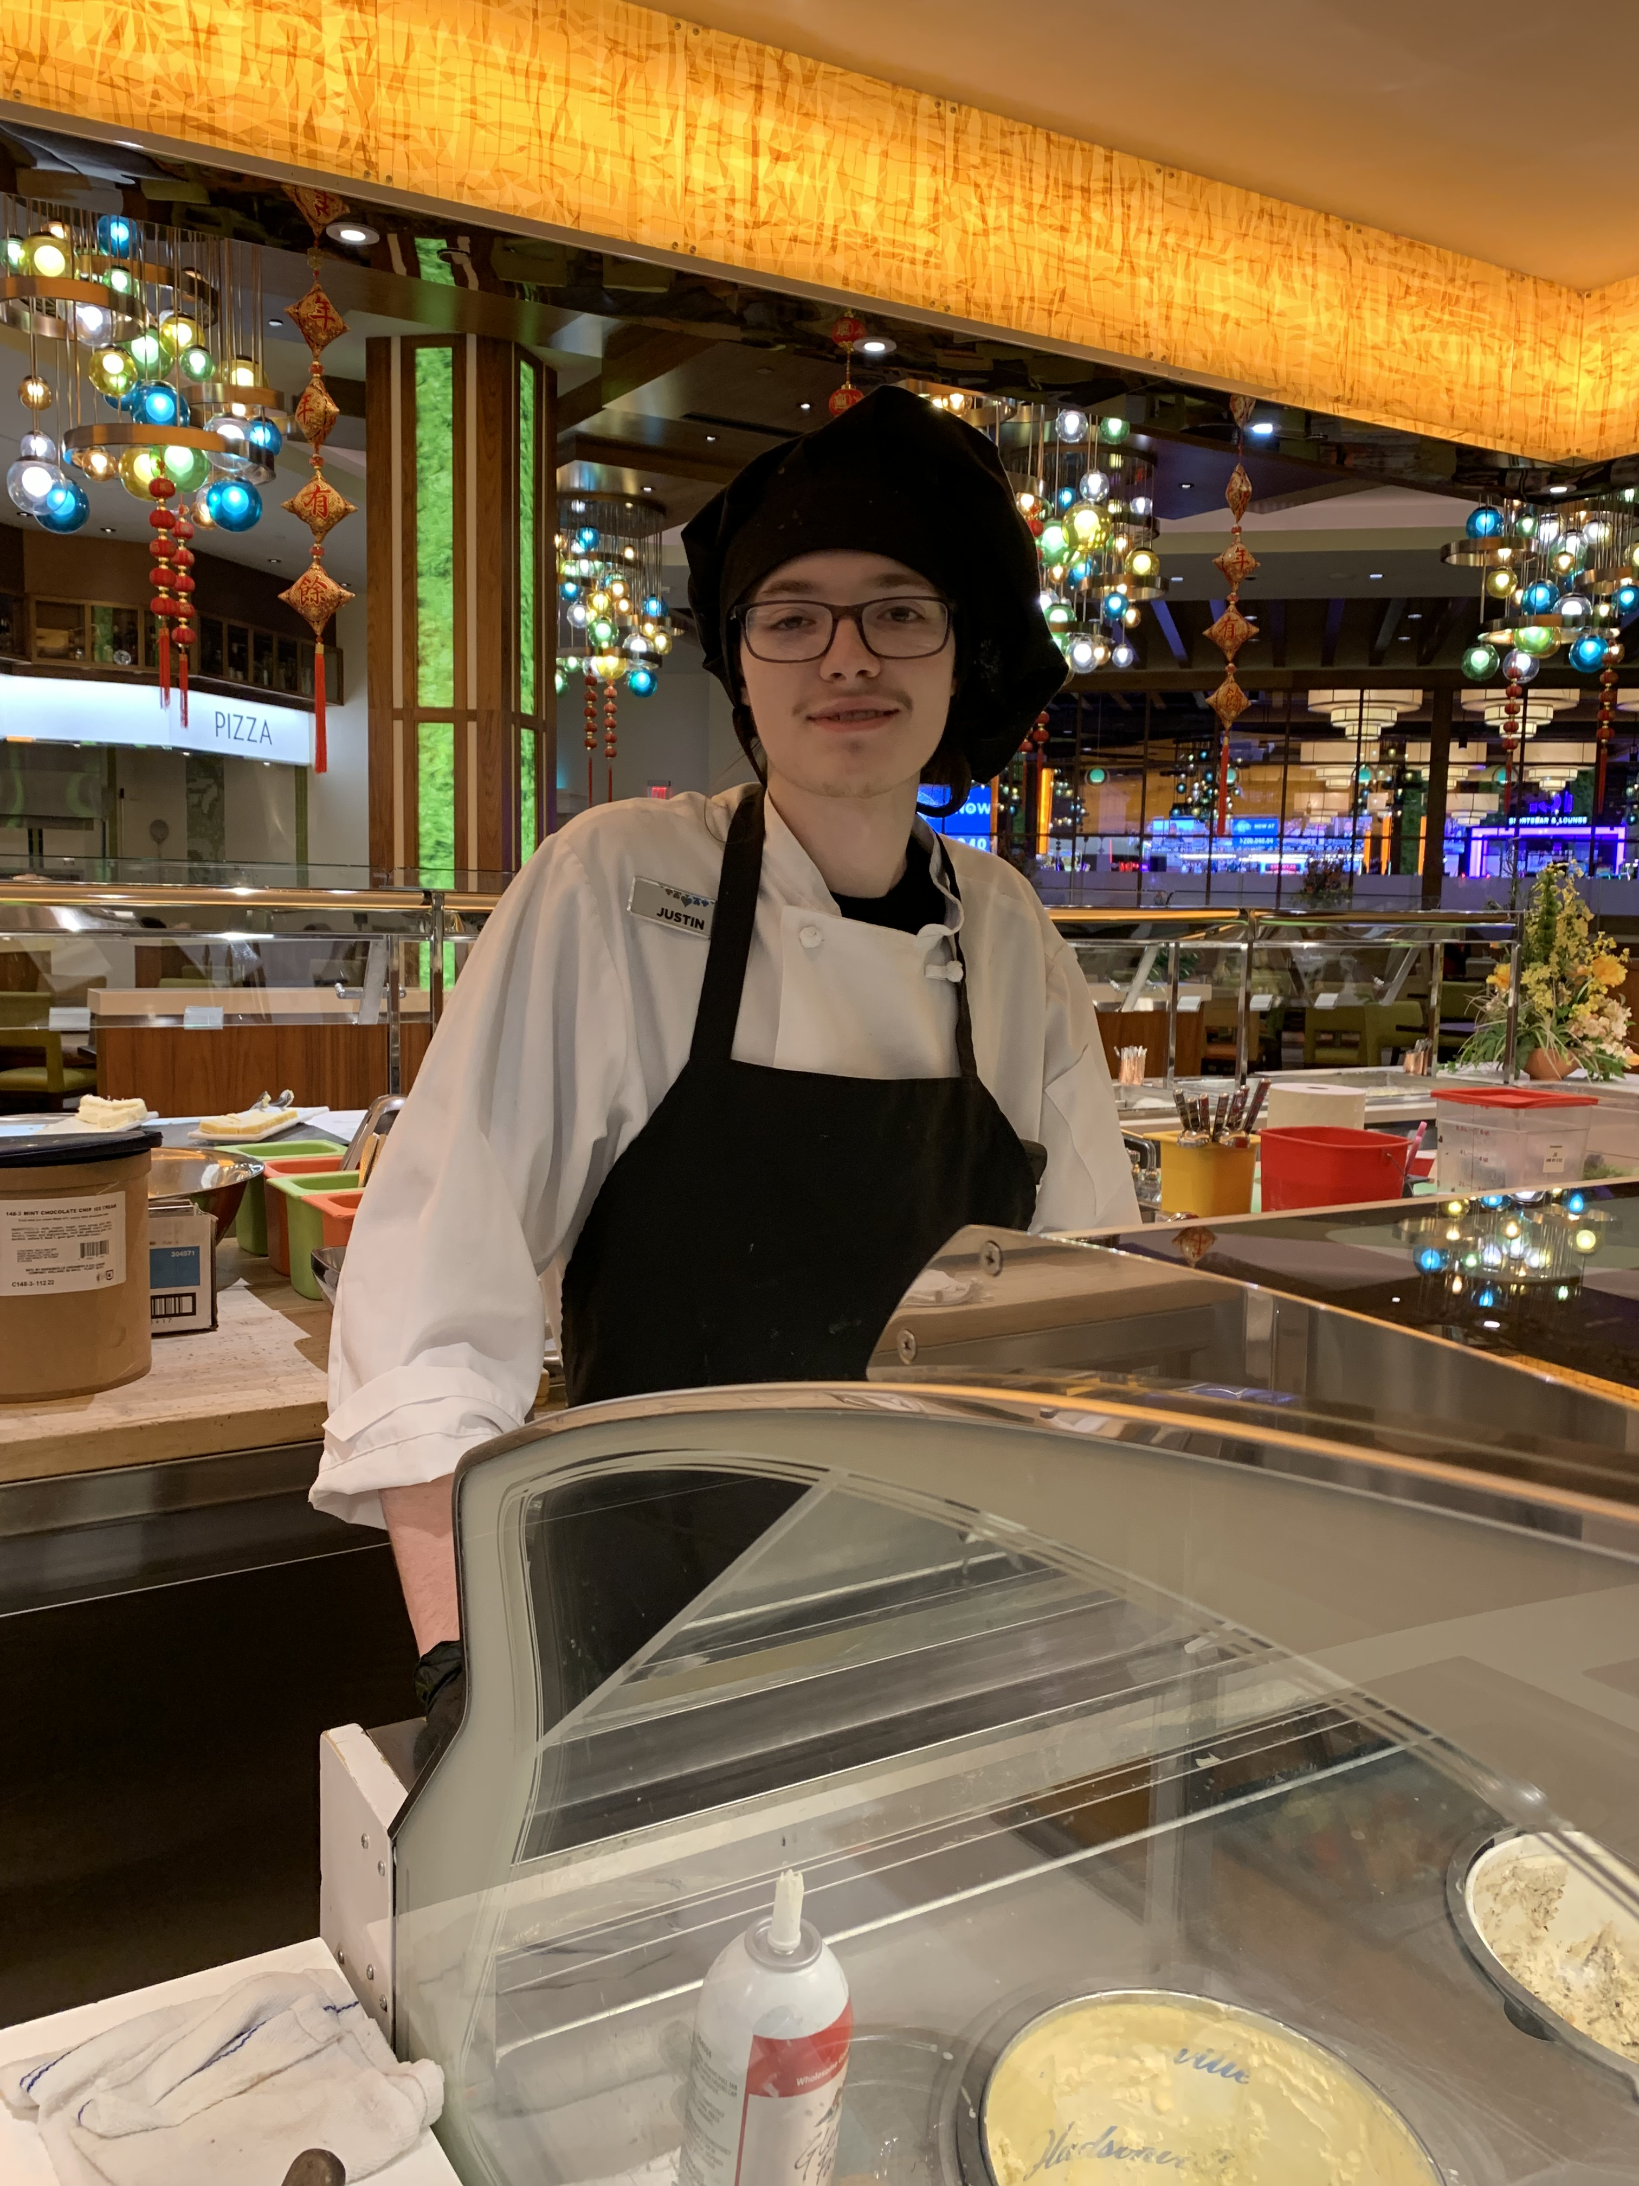
Student Success Stories
Despite the delays created by Covid, MCTI Culinary graduate, Justin continued to advocate and persevere in pursuit of opportunities.
Justin began his MCTI culinary studies in January 2022. He immediately demonstrated a keen eye for detail in every dish he created. Justin’s cleaning skills are impeccable.
During his final term, Justin approached his instructors and support team to advocate for an externship. With supports from his team, he applied, interviewed for and was hired in a sanitation role at Gun Lake Casino, just north of the MCTI campus. He pursued his driver’s license and the purchase of a vehicle. Within just a couple of months on the job, MCTI worked with human resources and the food services staff at GLC to move him into an externship role as a food prep worker.
Justin has worked in food prep at GLC since August 2022 in two of the four casino restaurants: learning and adapting to each menu and kitchen/chef expectations. GLC Chef Dustin Dexter noted, “Justin has gained more experience in his short time with GLC than most new direct hires.”
Justin shared that from his training at MCTI he was able to, “take away general knowledge like knife usage, portioning and safe food handling practices. I learned how to meet sanitation expectation. I take those methods into my work where it has been recognized at in my current job.”

Slide 46
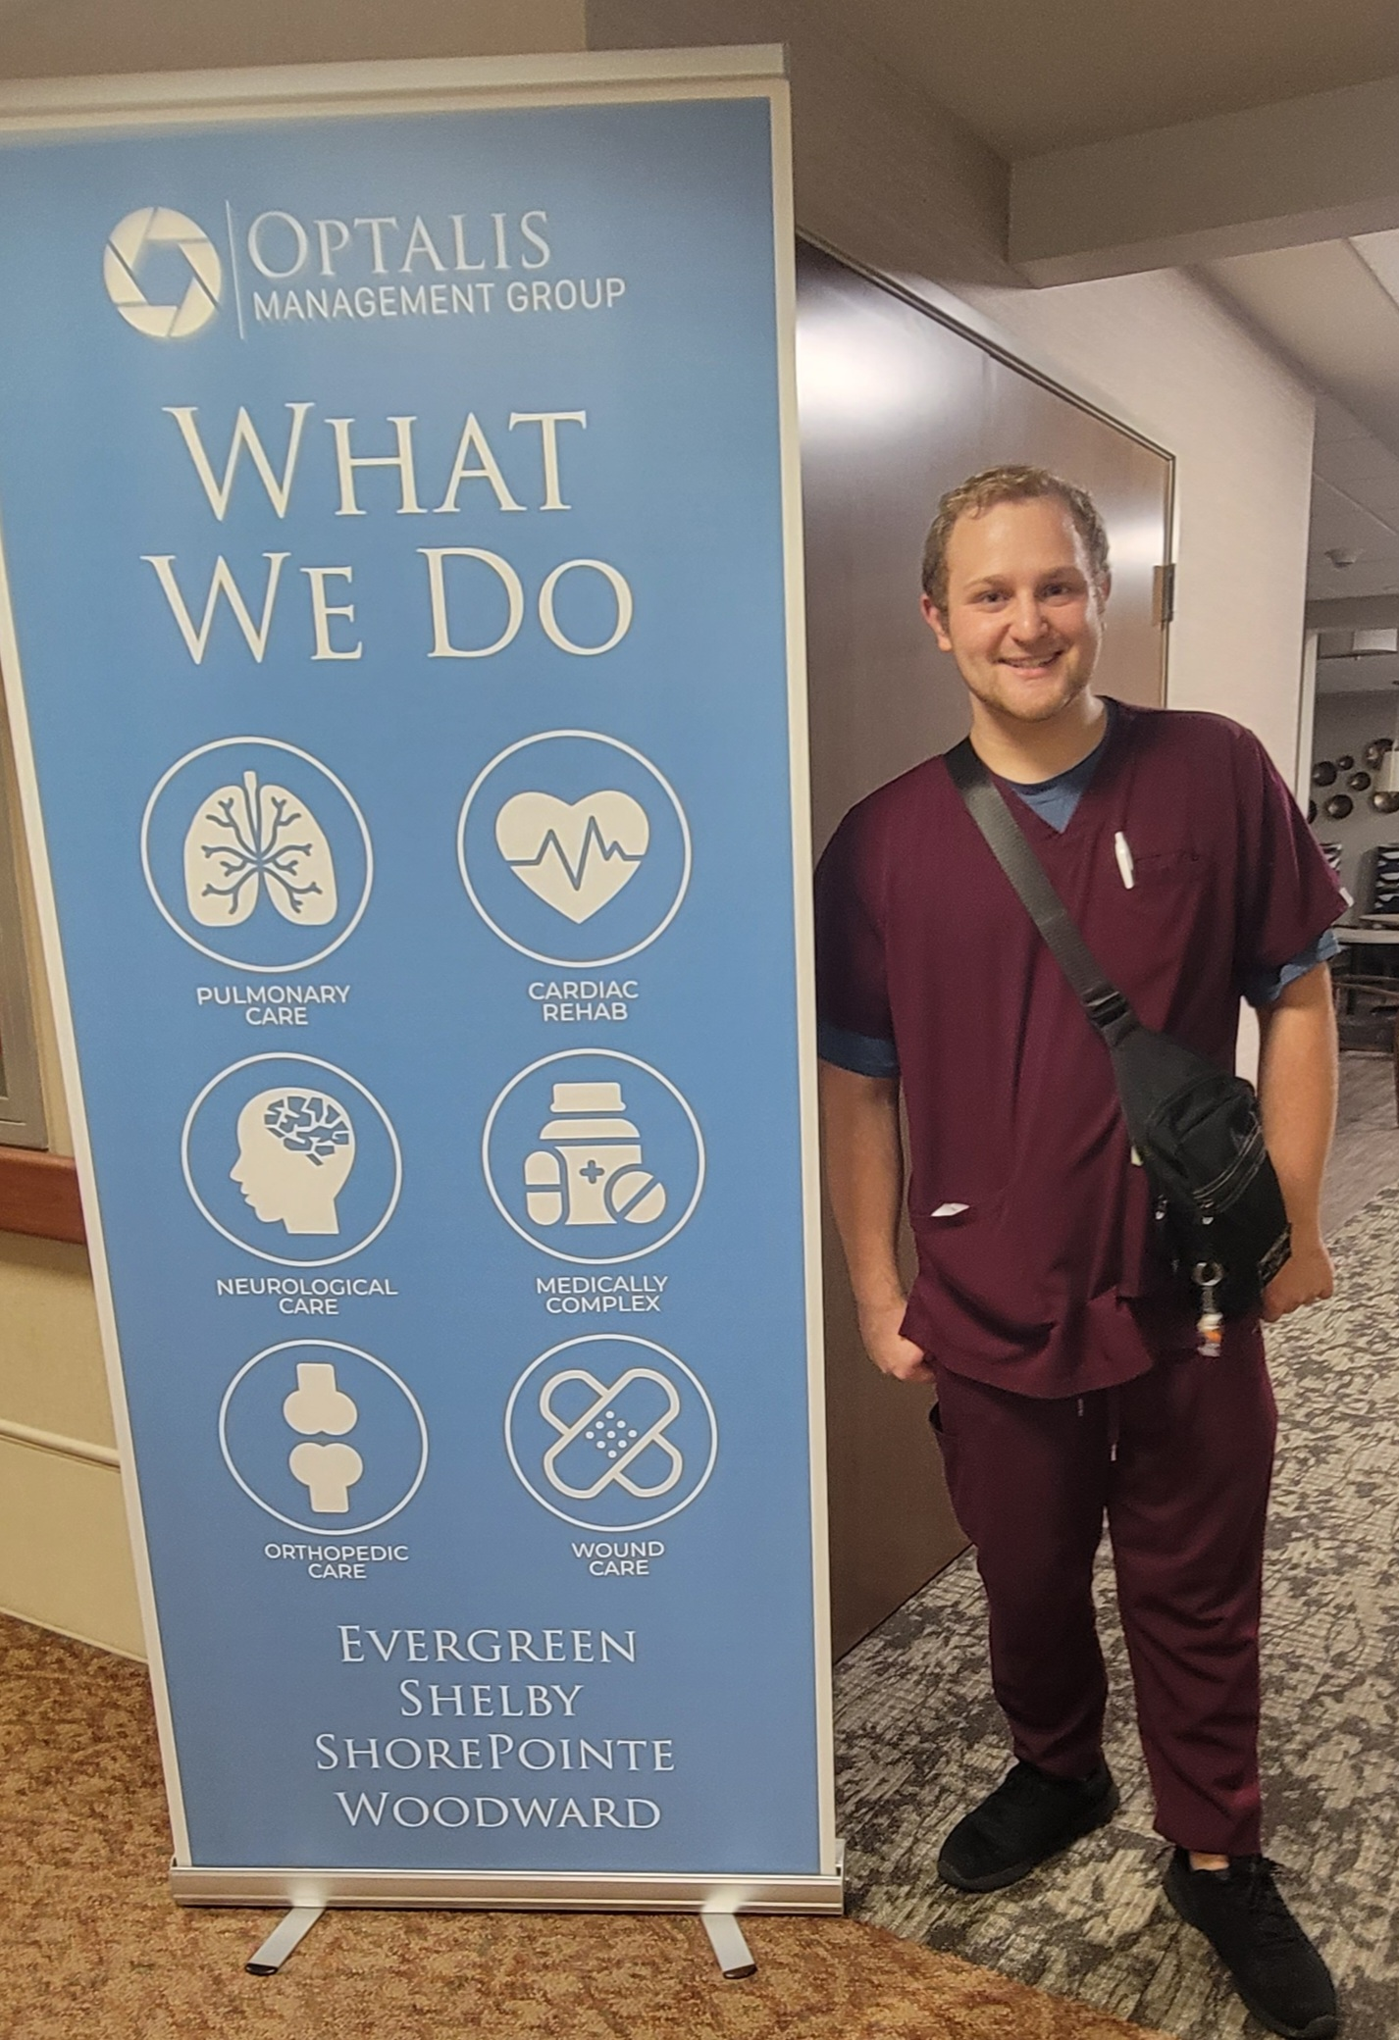
Student Success Stories
“He displays great peer relations, has a positive attitude, good communication skills, and is caring and helpful.” These are some of the strengths the MCTI Certified Nursing instructors shared when talking about MCTI Fall CNA 2022 graduate Brendan. He has been working as a CENA since May 2023 at Woodward Hills Health and Rehabilitation. Brendan shared, “ What I like about my work is the relationships I make with the residents and the good rapport I have with my coworkers. I was never a great student in school, but I excelled at MCTI doing a subject I genuinely enjoyed. It propelled me into my career in the medical field and it’s an experience that I will cherish forever.”

Slide 47
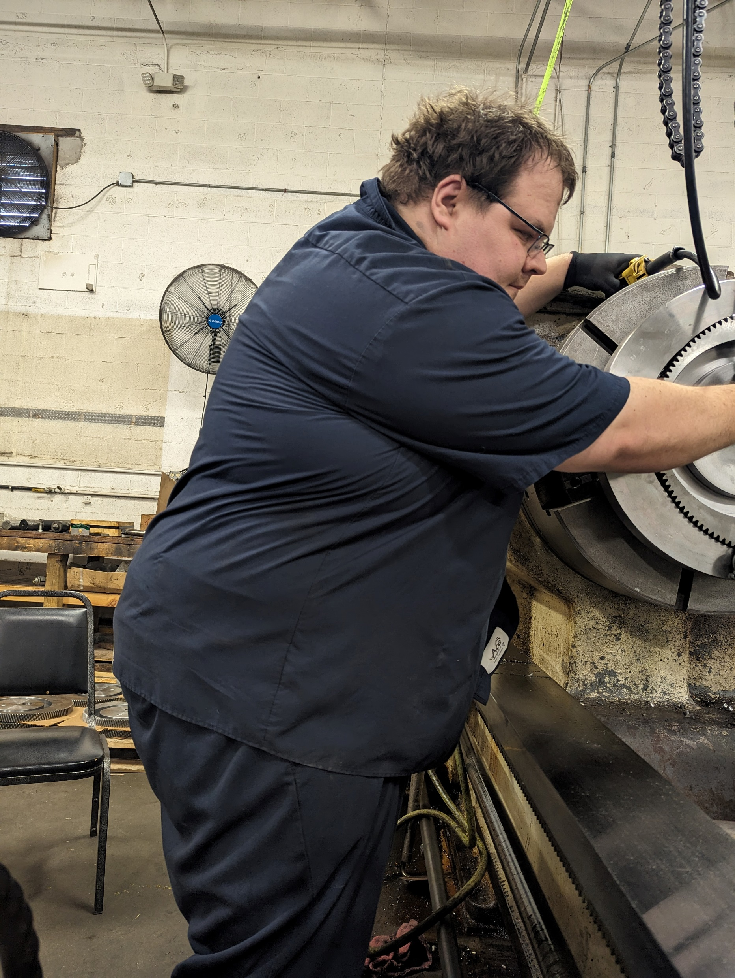
Student Success Stories
Kyle is a Fall 2022 graduate of the Industrial Electronics program at Michigan Career and Technical Institute. Kyle was an exemplary student. He successfully completed his programming and exceeded the academic expectations, earning academic achievement honors and perfect attendance in all four terms.
He became one of five students to earn his Manufacturing Specialist and Manufacturing Technician certifications from the Manufacturing Skills Institute. While at MCTI, Kyle demonstrated leadership and dedication to the training and was actively involved on MCTI’s campus.
Kyle was very motivated to find employment in his trade and took the initiative to apply for jobs on his own. Kyle has been working as a Mechanic at Gear Headquarters in Kansas City, Kansas for almost one year. Kyle recently shared, with his MCTI instructor Dave VanHoose, “The lessons in pneumatics has provided a road map to my favorite task at my job which is deconstruct cylinders for customers. Nick, my boss, has been an amazing teacher. Duane praises me about the top-notch quality control I provide. The work is not boring however it is exciting.”

Slide 48
Questions?
LEO-MRS-MCTIAdmissions@michigan.gov
269-664-4461
www.Michigan.gov/MCTI
Labor and Economic Opportunity - Student Resources (michigan.gov)

