Slide 1



Cultivate School & Agency Collaborations
Jennifer Coston, Supervisor for the Midland County ESA
Mitch Wheatcraft, Assistant Principal & Transition Coordinator for the Saginaw ISD
Jenille Kent, Transition Coach for the Bay Arenac ISD

Slide 2
Agenda
Agency overview - Arc, CMH, Disability Network, MRS
Identification of student’s agency needs
How to build relationships and capacity across adjacent ISD’s in regards to program and service implementation
Action Item List - What is your plan of action when you return to the classroom or office?

Slide 3
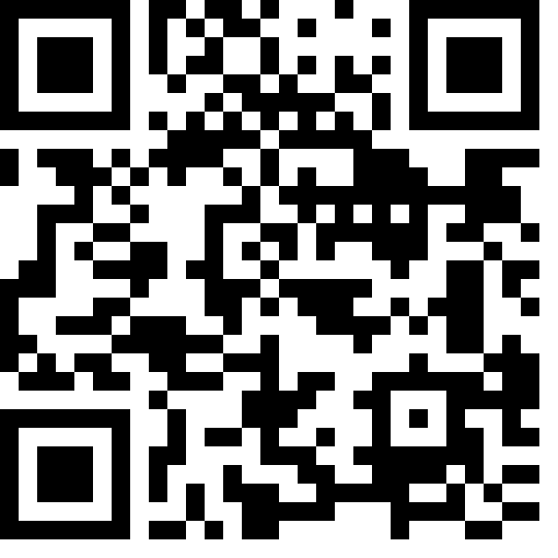
Quick Poll

Slide 4
Agency Overview
How do agencies tie into school/student needs
Arc
Community Mental Health
Bay-Arenac Behavioral Health
Central Michigan
Saginaw County
Disability Network
Michigan Rehabilitation Services
Vendors:
Do-All
New Dimensions
Arnold Center
Goodwill
Simmons Advantage
Selective Case Management
Saginaw ISD STW

Slide 5
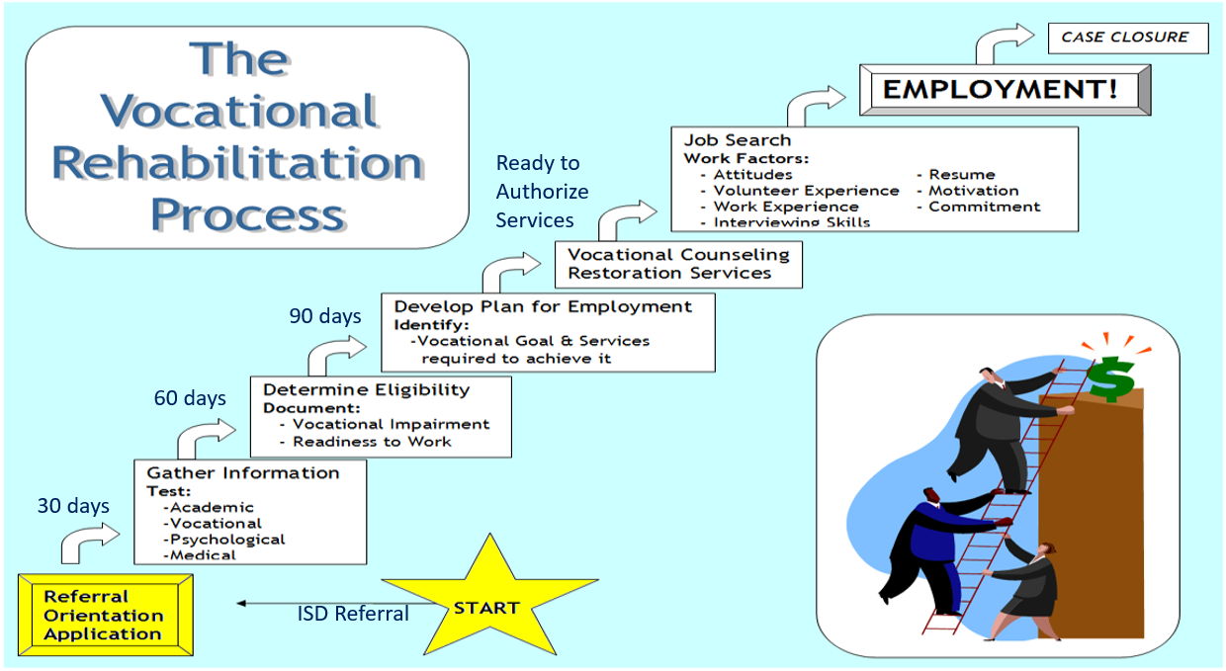
MRS/VR Process

Slide 6
Identification of Student’s Agency Needs
See the attached PowerPoint for an overview of the Student Mapping process.
Bay-Arenac Transition Request Link
Scheduling Document
Parent Letter
BAISD Mapping Sheet
Bay & Saginaw - Mapping Process
Midland - IEP team decision
Saginaw ISD Mapping Sheet
Mapping Process STW Referral Sheet

Slide 7
How to Build Relationships & Capacity
Our current Tri-County Collaboration
Tri-County Teachers
A collaboration between Saginaw ISD, Midland County ESA and BAISD has created an opportunity for special education teachers to spend a day together. The goal of this day is for these educators to collaborate and share content and programming being implemented in their respective districts.
October Agenda Link
Flier
Tri-County Transition Coordinators & Department Heads of Local Partnering Agencies
Focus:
Needs per county - summer programs, resource ideas, areas of concern, staff issues, referrals for work experience
How to get information into the hands of students, families, and school teams
Goal: Students transitioning from school to adulthood
Connected to community agencies
Leading productive adult lives

Slide 8
Action Time:
What is your plan of action when you return to the classroom or office?

Slide 9
Contact Information:
Jennie Coston jcoston@midlandesa.org
989-631-5890 ext. 2140
Jenille Kent kentj@baisd.net
989-686-4410 ext. 3130
Mitch Wheatcraft mwheatcr@sisd.cc
989-399-7400

