Slide 1


Collaboration in Action: Schools, Vendors, and MRS
Michigan State University
Michigan Transition Services Association Conference
February 21, 2024
Aliza Lambert, Ph.D., CRC
Alicia Strain, Ph.D., CRC, LPC

Slide 2

Services
Training
and Research
for Independence
and Desired Employment

Slide 3
Providing Services, and Training
ASSET- Assistive Soft Skills & Employment Training
EPASS​- Employment Preparation & Skills Support
Community Safety and Navigation Training
BOSS- Building Opportunities for Spartan Success

Slide 4


Curricula
Communication
Teamwork
Professionalism
Positive Attitude & Enthusiasm
Critical Thinking & Problem Solving
Networking
Mental Health
Awareness of Self & Others
60-minutes: 30 sessions
90-minutes: 15 sessions
Same content,
different pace
Setting Goals
Personal Brand
Job Search
Resume & Cover Letter
Mock Interviews
Disability Disclosure & Accommodations
Workplace Etiquette & Relationships
Work-Life Balance

Slide 5
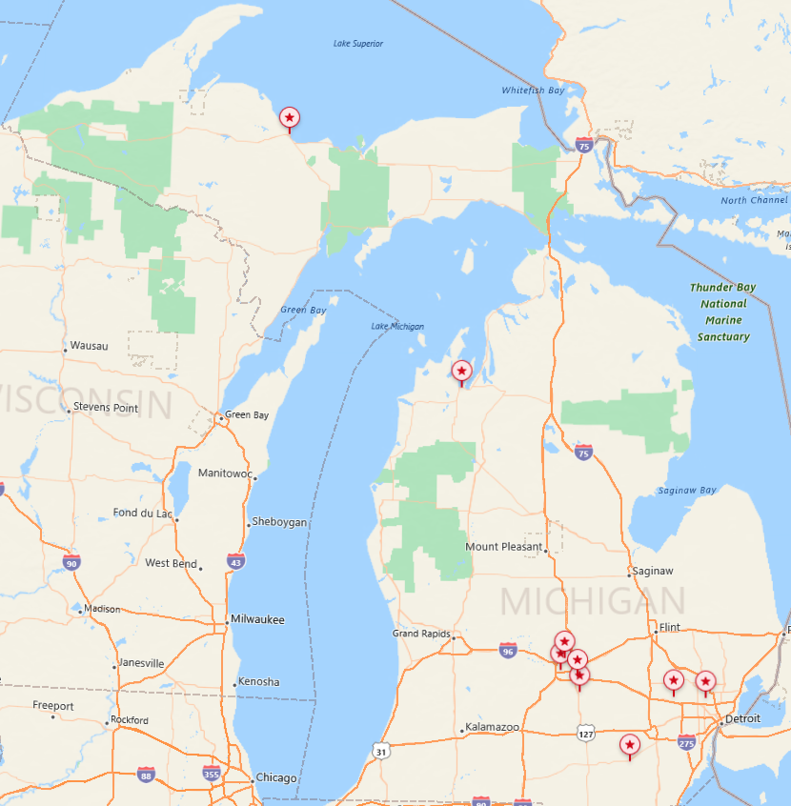
Engaging with Communities
Waverly, Okemos, Mason, Traverse City, & Marquette-Alger RESA
MRS, Clinton County, Oakland County, Lansing School District
Creating Partnerships

Slide 6
STRIDE Provides Services
ASSET Fall, EPASS Spring
Two 60-minute sessions weekly Or One 90-minute session weekly
ASSET purchased first & EPASS next
One semester (two 60-minute sessions or one 90-minute session weekly) ASSET year 1, EPASS year 2
ASSET in year one, followed by EPASS in year two
Once weekly, 60-minute sessions

Slide 7
STRIDE Provides services & Builds Capacity
Side-by-Side
Year 1 – STRIDE Center staff implement all sessions
Professional Development & Coaching
Intensive in-person Professional Development Two-day training Up to thirty coaching sessions Coaching sessions include troubleshooting and accountability checks
Year 3 – STRIDE Center staff provides up to thirty coaching sessions
Year 2 – STRIDE Center staff provides side-by-side support

Slide 8
Stakeholder Collaboration

Slide 9
Michigan Rehabilitation Services
Collaboration
Students & families
Classroom teacher
Transition coordinator
STRIDE facilitators
Waverly High School ​
Individual referrals​
Individual authorizations​
Monthly reports

Slide 10
Marquette-Alger RESA
Collaboration
Students & families
MARESA-STRIDE facilitator
MARESA administrator
Classroom teachers
STRIDE coaching & consultation
MARESA
RESA administration approval
Professional development
Coaching
Program Evaluation Data

Slide 11



Panel Discussion
Marquette-Alger RESA:
Jill Mielcarek, ASSET-EPASS Facilitator
Kyra Thorpe, SPED Supervisor
Michigan Rehabilitation Services:
Sara Kalt, VR Counselor
Waverly High School:
Amanda Batten, SPED Teacher

Slide 12
Panel Discussion
Introductions
How are you using ASSET and EPASS?

Slide 13
Panel Discussion
What classrooms or students are a good fit for ASSET & EPASS?
How do you decide (individual basis or classroom basis)?
How has ASSET & EPASS impacted students outside of class?

Slide 14
Panel Discussion
What did you learn about working with MRS and STRIDE?
What did you learn about working with teachers, administrators, and STRIDE?

Slide 15

Questions
STRIDE: stride@msu.edu​​
Email​​
​​
Contact: Aliza Lambert ​​
lambe15@msu.edu ​​
​​
Address: 2875 Eyde Parkway,
East Lansing, MI 48823​​
​​
Website: https://stride.msu.edu/​

