Slide 1
Empowering Every Vision: BSBP Transition Reboot
Bureau of Services for Blind Persons
Michigan Department of Labor and Economic Opportunity MTSA Conference 2024

Slide 2


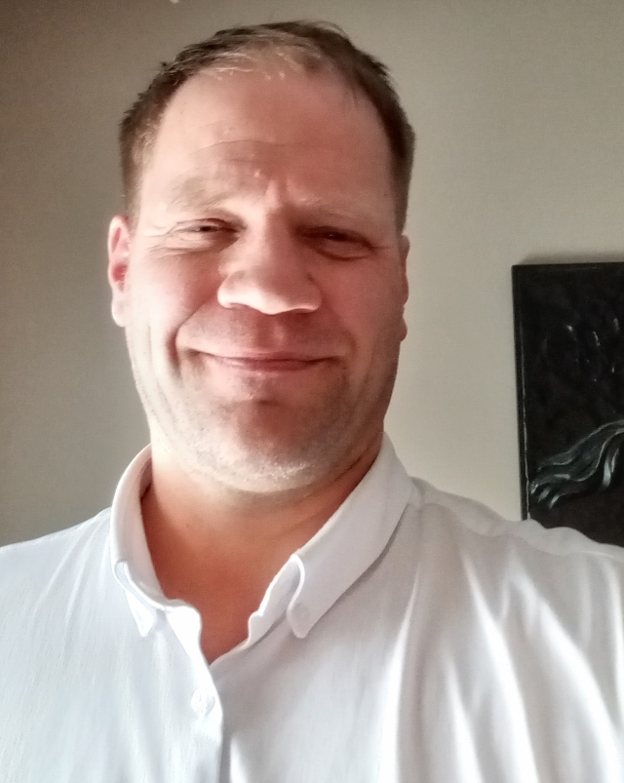

Transition Reboot: Meet the BSBP Pre-ETS Team
Samantha Duke
East Region Transition Services Consultant
Jereme Vanden Heuvel
West Region Transition Services Consultant
Shannon McVoy
Transition Services Manager (Statewide)
Rebecca Flatt
Statewide Transition Services Consultant
Notes:
All introduce self

Slide 3
Vocational Rehabilitation (VR): BSBP
History of VR:
Soldiers Rehab Act 1918 – Established VR services for disabled veterans
Smith-Fess Act 1920 – Expanded services to civilians with physically disabilities (established public VR)
Barden-LaFollette Act 1943 – Expanded services to people with blindness, intellectual, & mental impairments
Rehab Act Amendment 1973 – Expanded funding & prohibited discrimination in federal programs/employment
Americans with Disabilities Act 1990 – Prohibited discrimination in private, local, state employment & reasonable accommodations
Workforce Innovation and Opportunities Act 2014 – Emphasis on services to youth (Pre-Employment Transition Services) & collaboration with partners
Michigan is one of 22 states with two separate VR agencies:
Blind/Visually Impaired agency: Bureau of Services for Blind Persons (BSBP)
General Agency: Michigan Rehabilitation Services
Benefit of Separate vs. Combined Agencies:
More likely to achieve competitive integrated employment
More likely to report wage/earnings as primary source of support at closure (rather than public assistance)
More likely to serve economically & socially disadvantaged customer, at higher risk of poor employment outcomes
Notes:
Sam:
RSA provides formula grants to VR agencies to administer the VR, Supported Employment, and IL-OIB programs in all 50 states, the District of Columbia, Puerto Rico, and four Territories.
*BSBP and Michigan Rehabilitation Services are sister agencies– operate under the same federal regulations, the largest difference is the population that we serve.
Separate agencies serve more economically and socially disadvantaged populations- Have more severe vision loss • Be Hispanic • Have less than a high school diploma • Have a secondary disability • Be female • Receive public assistance In general, the population served by separate agencies contains more consumers at higher risk for unemployment due to their sociodemographic characteristics, such as lower levels of education and the presence of secondary disabilities.
Resources:
History | Vocational Rehabilitation | Florida Department of Education (rehabworks.org)
https://www.blind.msstate.edu/sites/www.blind.msstate.edu/files/2020-06/Does-VR-Agency-Structure-Matter.pdf
https://rsa.ed.gov/about/states

Slide 4
Pre-Employment Transition Services (Pre-ETS)
Services designed to provide early job exploration and training to students aged 14-26 with a visual impairment in the following areas:
Job Exploration Counseling
Work-Based Learning Experiences
Counseling on Opportunities for Enrollment in Post-Secondary Education
Workplace Readiness Training
Instruction in Self-Advocacy
Pre-ETS may be provided to students individually or in groups
Notes:
Sam:
Intended to provide counseling and guidance to help students explore career options. Could include informational interviews with employers, job shadows, researching job opportunities
Job Exploration Counseling: and labor market information. Job exploration options are intended to foster motivation, consideration of opportunities and informed decision-making.
Work-based Learning Experiences: Experiences outside the traditional school setting, real work to provide students with the knowledge and skills that will help them connect school experiences to real-life work activities and future career opportunities.
Counseling on opportunities for enrollment in comprehensive transition or postsecondary educational programs: This activity area includes exploration of both post-high school transition programs at institutions of higher education, trade and vocational schools, as well as two and four-year colleges.
Workplace Readiness Training: Workplace Readiness Training is designed to develop Social Skills and Independent Living Workshops/job clubs on social skills, workplace behavior and interaction, multicultural awareness, problem-solving skills. Designed to develop independent living and social skills necessary for a student to be successful in employment.
Instruction in Self-Advocacy: Opportunities to learn about rights, responsibilities and how to request accommodations, services or supports students may need to successfully complete the transition from secondary to post-secondary education and/or employment. These experiences may include mentoring by peers working in competitive integrated employment.

Slide 5
Pre-ETS: 2 Options for Students
Potentially Eligible Pre-ETS:
General & exploratory in nature
Who qualifies?
14-26 years of age
Student with a Visual Disability
Currently enrolled in a recognized secondary, post-secondary, or other recognized educational program
Five categories of services available:
1. Job Exploration Counseling
2. Work-based Learning Experiences
3. Counseling on post-secondary or transition education programs
4. Workplace Readiness Training
5. Instruction in self-advocacy
Vocational Rehabilitation Pre-ETS:
Allows students to receive a range of services required to obtain, retain and advance in competitive integrated employment, in addition to Pre-ETS. A VR case can follow the student out of school and into adulthood.
Who is eligible?
14+ years of age
Legal Blindness, or severe visual impairment with degenerative diagnosis
Currently enrolled in a recognized secondary, post-secondary or other recognized educational program
Many categories of services available, including:
Pre-ETS (for students aged 14-26)
Vocational Counseling
Skills of Blindness Training
Vocational, Employer or College Level Training
Low Vision Equipment
Job Placement Services and more…
Notes:
Sam:
PE: Provides an early start at job exploration to assist students with identifying career interests that may be further explored through VR services.
Differences:
- VR has eligibility process that requires medical information and assessment
- VR case can follow the student once they are no longer in school
- VR case can offer all 5 areas of Pre-ETS services and more
- PE pre-ets is exploratory in nature and VR services are comprehensive
NOTE: Out of School Youth can access VR, but do not qualify for Pre-ETS services as they do not meet the definition of as student with a disability

Slide 6
Pre-ETS: Why Do they Matter?
Getting an early start to job exploration and training sets a solid foundation for a path to employment after high school.
Build on work skills and experiences, develop resume or portfolio
Learn about oneself- Strengths, barriers, preferences & gain confidence
Build soft skills & meet other students with shared experiences
Network and learn about available resources in the community
Work toward identifying vocational goal and the steps to get there
“Youth who are blind or low vision who had at least two work experiences while in high school are almost twice as likely to be employed as adults as those with no work experiences”
Notes:
Sam
Other stats:
Over half of working-age people who are blind or visually impaired are not in the labor market, meaning they are not working and not seeking work, compared with fewer than a quarter of people without disabilities.
Only 44 percent of people who are blind or visually impaired are employed, compared with 79 percent of those without disabilities.
Stats from: https://www.afb.org/research-and-initiatives/employment/reviewing-disability-employment-research-people-blind-visually

Slide 7
How Are BSBP Services Provided?
Various locations in Michigan, though various formats:
In your home and/or
In the community (locally and statewide) and/or
Virtually and/or
BSBP residential training center – Kalamazoo, MI
Service may be provided:
Internally (services provided to students directly from BSBP staff)
Externally (vetted and approved vendors that provide services on behalf of BSBP)
BSBP counselors may also refer students/families to community resources as appropriate (E.g., public/ADA transportation, Leader Dog, Michigan Works!, and more)
Notes:
Sam

Slide 8
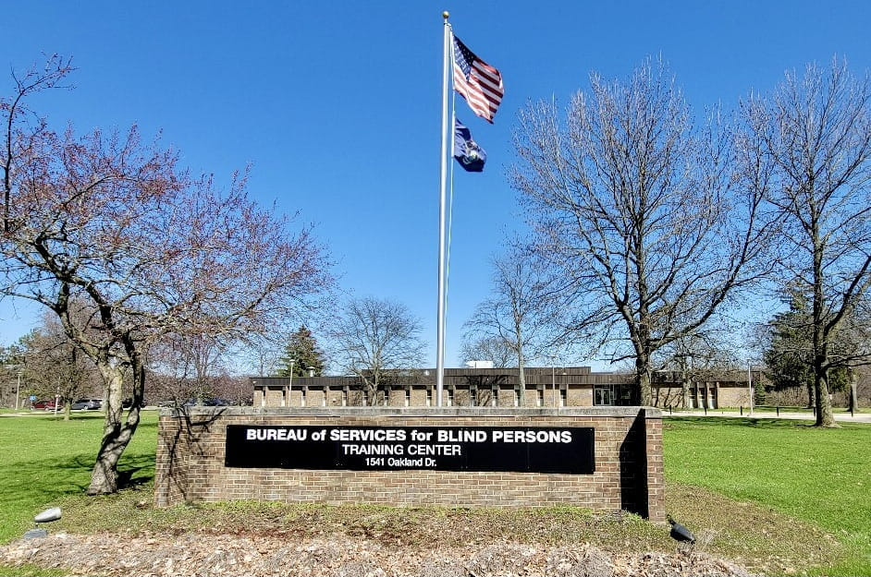
BSBP Training Center (BSBPTC)
The residential BSBP Training Center serves approximately 250 people each year age 16 and older who are enrolled in BSBP programs. All teaching and counseling services, as well as room and board, are provided at no cost to those attending the center. Length of stay is based on individual goals.
Post-Secondary Readiness Program (PSRP)
Workplace Readiness Skills Training
Take a Virtual Tour: LEO - Take a Tour (michigan.gov)
Notes:
Shannon

Slide 9
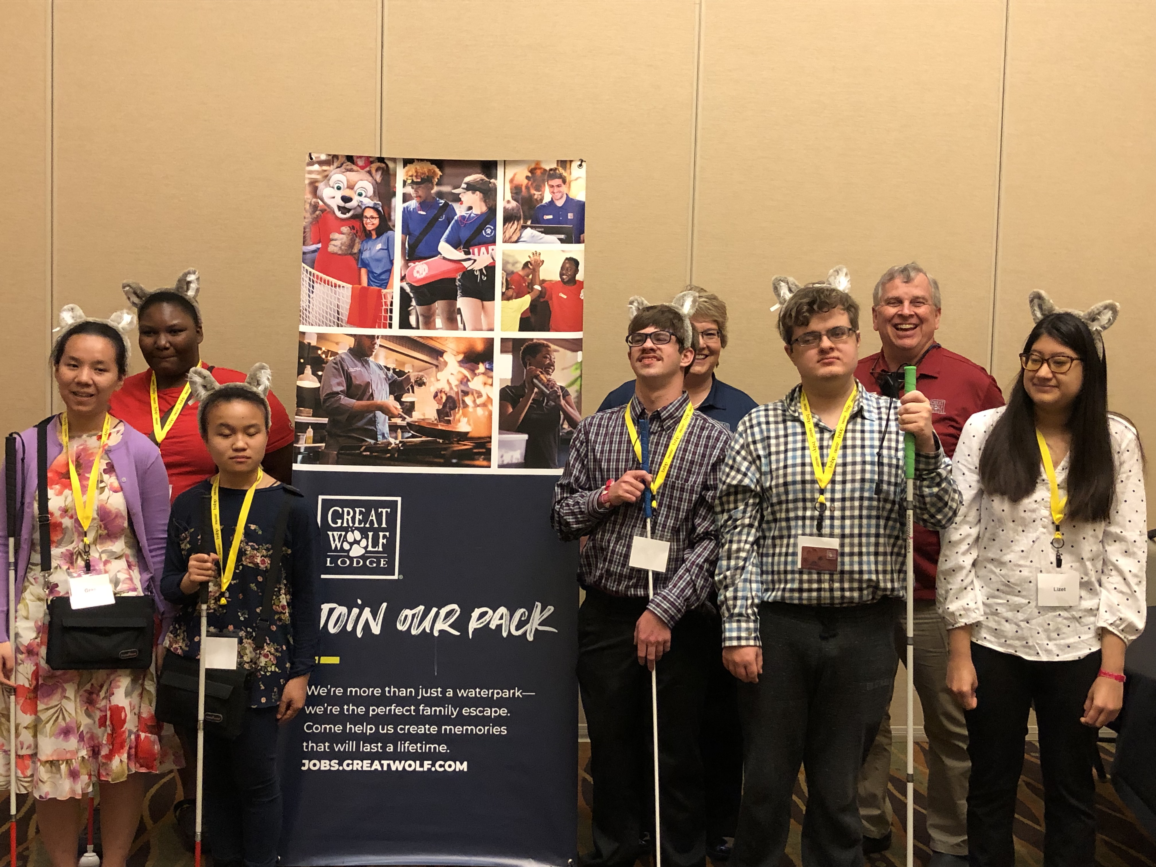
BSBP Statewide Pre-ETS Highlights
Hospitality Careers Exploration-Great Wolf Lodge May 31 – June 2, 2024
Focus on Family Engagement
Students Learn about careers in hospitality
Post Secondary Readiness Program (Training Center)
College Prep at Western Michigan University
Notes:
Shannon

Slide 10
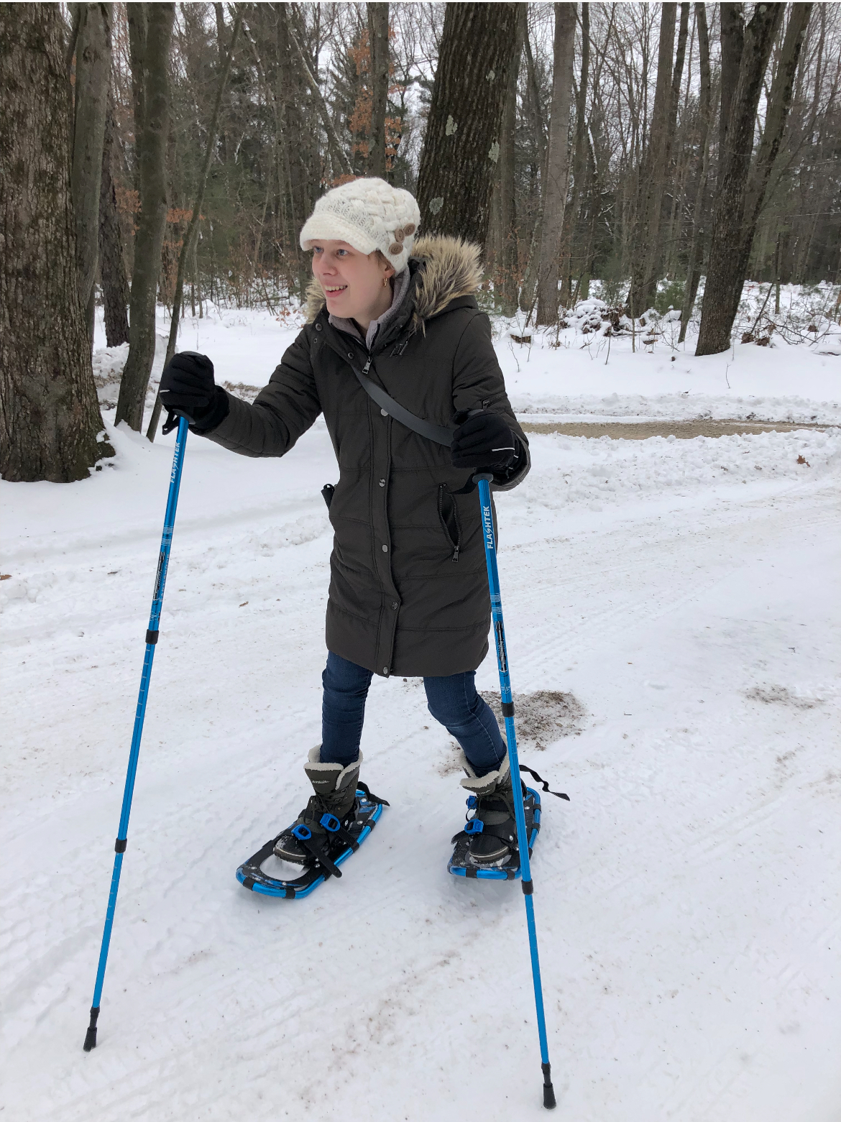
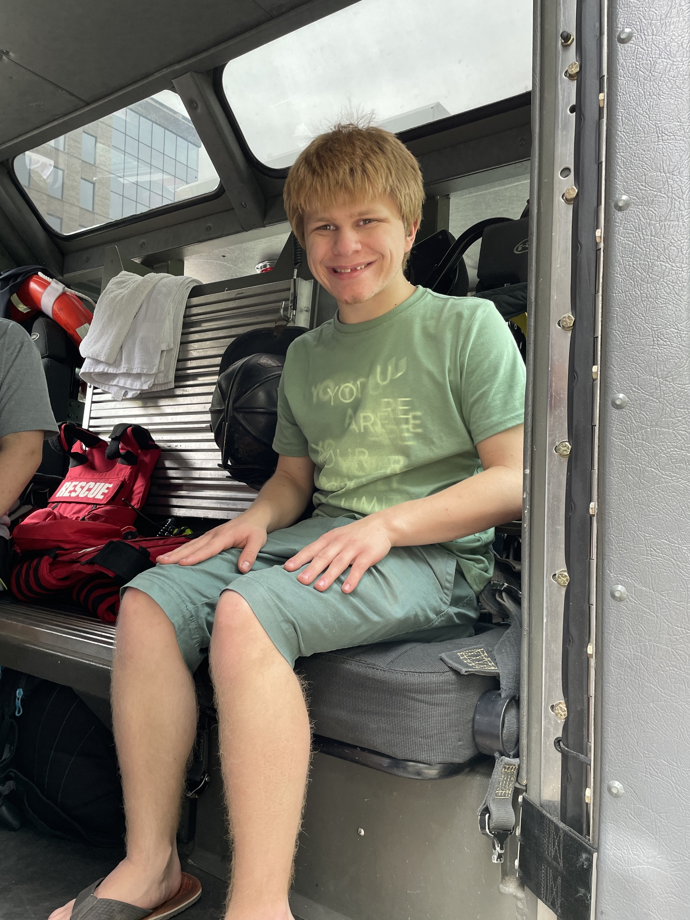
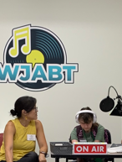
BSBP Regional Pre-ETS Highlights
West Region Programs
Transition Works/STEPs!
Summer in the City
Earth, Wind, and Fire!
Careers Under Construction
Notes:
Jereme WEST Region Slides
West Region highlights and programs

Slide 11
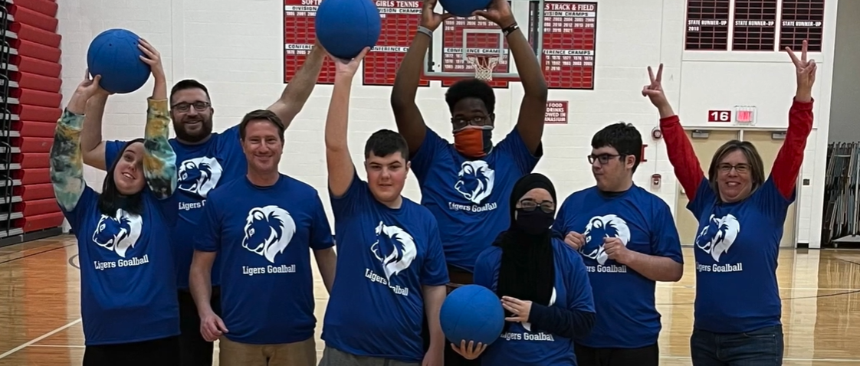
BSBP Regional Pre-ETS Highlights
East Region Program
Pre-ETS Goalball Program
Collaboration: BSBP and Livonia Schools
Workplace readiness and self-advocacy training though instruction and implementation through the sport of Goalball. Skill areas include team work, leadership, problem solving, communication, and more.
Notes:
Sam

Slide 12
BSBP Transition Reboot:
October 2023 BSBP committed to an agency wide Transition Reboot to improve service efforts to assist with transitioning Students with Disabilities from school to post-secondary opportunities.
BSBP's Guiding Purpose for Rebooting:
Repurpose Statewide Unit for strategic initiatives
Increase focus on internal/external trainings
Increased focus on service providers
Increased focus on LEAs and ICTAs
Use of quality and assurance metrics and programs
Deeper dive into mapping for statewide accountability
Performance driven, increase outcomes and measurable metrics
Notes:
Becca

Slide 13
Expanding BSBP's Regional Reach:
Hiring of Regional Consultants for increased local support in two major metro areas
Reassignment of Statewide Transition Unit’s purpose, coupled with Regional roles has allowed BSBP to have increased functionality.
Statewide | Regional
Strategic Planning Statewide collaboration with E&T, other state agencies Promotion of transition services Development of service providers Education of ISD Personnel Identification of gaps in required activities Coordination of Events and Calendars Post Program debriefs to evaluate and inform programming. Participation with Michigan Interagency Transition Team (MITT) Manage MOUs with EDU, MRS Newsletter (great way to stay connected and learn about upcoming programming) | Work with Statewide Unit to Coordinate Events & Calendars Provide regional support to the Field Services Division: Supports Pre-ETS Services Evaluates gaps in Services Family Engagement Program promotion Supporting ICTA’s, other local contracts Service Provider Education and Support Local Programming Business Engagement for Work-Based Learning Experience Case Reviews of regional Pre-ETS cases
Notes:
Becca

Slide 14
Accountability:
RSA Negotiated Levels of Performance (MSG, Credential Attainment, and Employment Related Performance Indicators)
Michigan's Statewide Plan/BSBP Goals
Advance the provision of VR services to Students and Youth who are B/VI
Collaborate and Align with WIOA Core Partners by participating on workforce boards, employment and resource teams, monthly webinars and other special projects.
Increase use and awareness of Assistive Technology
Increase Competitive Integrated Employment v
Labor of Economic & Opportunity FY24 Goals & Objectives
Expand talent within SOM by leveraging resources that lead to 4800 post-secondary credentials
Expose students K-12 to STEM Careers
Placing students in internships!
Notes:
Becca

Slide 15
Coordination with Local Educational Agencies (LEAs):
Pre-employment transition services must be provided in collaboration with local educational agencies
LEAs are obligated to provide transition services under the IDEA (Individuals with Disabilities Education Act)
LEAs are responsible for providing and paying for any transition service that is considered special education or related services necessary for ensuring a free appropriate public education (FAPE), as required under IDEA
Pre-employment transition services provided by VR agencies may not duplicate or supplant services that are already provided by local education agencies through the IDEA
Notes:
Shannon

Slide 16
Coordination and Collaboration:
Vocational Rehabilitation (VR):
Attend IEP meetings when invited
Work with schools to coordinate and ensure the provision of Pre-ETS
Attend person-centered planning meetings when invited
Work with local workforce development boards, one-stop centers, and employers to develop work opportunities for students with disabilities
Education:
Obtain parent permission and invite agencies to attend IEP meetings
Identify interagency coordination and responsibilities of each agency
Create a process and responsibilities for referrals
Provide available student information to assist in VR eligibility determination, and receipt of pre-employment transition services
Notes:
Shannon

Slide 17




Aligning the Individualized Education Program (IEP) and the Individual Plan for Employment (IPE)
Identify IDEA transition services and/or 504 services that are currently being provided by the LEA
Determine the individual needs of the student (i.e. attend IEP meetings, etc.)
Develop an IPE in consideration of the student’s IEP or 504 plan
Coordinate goals and objectives in the IEP with student’s employment goal or projected post-school employment outcome and Pre-ETS services in the IPE
Coordinating Services and Building a Relationship between the IEP and the IPE​​
Notes:
Shannon

Slide 18

Deeper Dive into Coordination
Collaboration is a predictor of positive post school outcomes for students with disabilities.
Well-developed partnerships for planning and service delivery give the greatest benefit to youth and their families!
Notes:
Jereme
WEST REGION ICTAs SOWs/collaboration
So you will want to think about how education and VR currently work together in the coordination of transition-related goals and objectives in the IEP and IPE; and how services between the two are aligned. This will help to reduce duplication and strengthen coordinated service delivery to assist the student in successfully achieving their post-secondary goals
How do we do this? We have different vocabulary, different history, different rules/regulations/etc.! However, hopefully, you are seeing through this presentation that our goal is the same! Positive post secondary outcomes – vocational and independent living. A Student engaged within the community!

Slide 19

Tools: Interagency Cash Transfer Agreements (ICTA) & Statement of Works (SOW)
Notes:
Jereme:
Tools to facilitate partnership and collaboration. - 2 tools that go hand in hand are ICTAs and Statement of Works. The Statement of Work (SOW) partnerships we currently have in motion are meant to help facilitate service delivery and identify gaps in services. We partner with our local Centers for Independent Livings (CILS) to help map all the transition resources available within school districts. The mapping is multipurpose: 1) it helps identify resources that are already being offered within the school districts for transition students so that services can be accessed for our students who are blind / visually impaired. 2) It helps us identify where gaps exist in services and potential opportunities for innovate planning.
The ICTAs are established with ISDs and are designed to provide innovative solutions to problems and gaps in services. The ICTAs can only occur between public agencies (i.e. school districts) and involve cash transactions. They include a local fund source and must demonstrate direct benefit to students. Services provided through ICTAs must not be customary or typical of services that each agency must already be providing. The ICTA leverages 27% non-federal share match with 73% of Federal Funds for the program. Examples of areas with ICTAS include Ottawa County ISD, Macomb County ISD, and Ingham County ISD. Our goal is to develop more ICTAs around the State of Michigan.

Slide 20
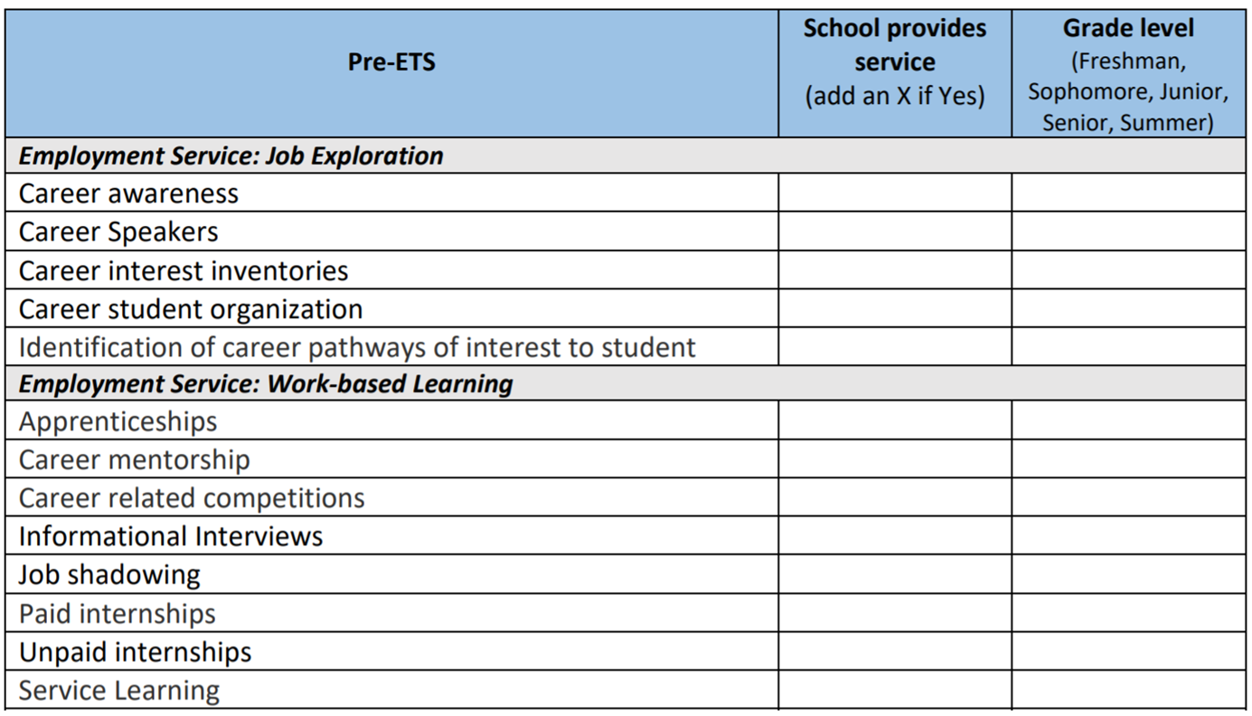
Notes:
Jereme:
In terms of pre- employment transition services – since these services must be provided by VR in collaboration with education, mapping is a crucial step. Not just in ensuring that all students have access to these services, but that we can identify what exists so we are not duplicating or supplanting services.
This is a simple worksheet or tool that identifies the five required pre-ets services and example activities so that staff can identify whether or not these activities are being done or provided by the LEA and when (what grade etc)
Doing this on at least an annual basis can help identify where gaps in services are and what services are most needed vs those already being provided. In some cases VR and the LEA may be jointly providing different pieces or activities within that service. In other cases one entity or the other may be providing that service solely.

Slide 21

Notes:
Partnership Opportunities are limited only be our own creativity! State, regional and local partners must work together. An example of working together in West Michigan is BSBP partnership with Disability Advocates of Kent County (CIL) for the Statement of Work leading towards a high-quality resource mapping project. Once the mapping is complete, BSBP and the local school districts will outline what services will be provided by the school and what are available through BSBP. An outcome will undoubtedly be that there are gaps in services between both due to barriers. This is where an ICTA arrangement is being established between the local ISD and BSBP in order to develop innovative and unique services to address the unmet needs of students who are blind / visually impaired in the area. The services will be provided and coordination documented and measured. Ultimately, our hope is to demonstrate that the services made a difference in the post school outcomes of the students served!

Slide 22
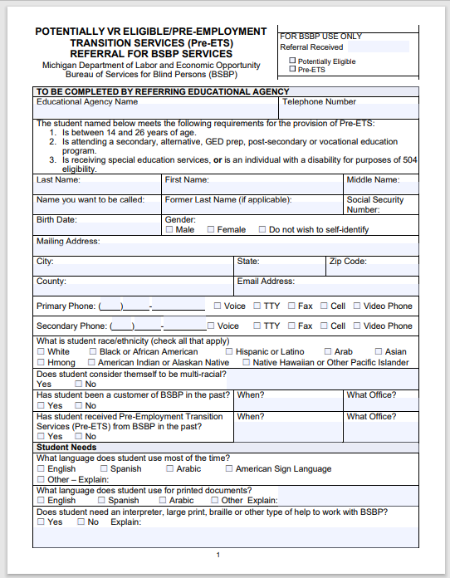


How to Refer a Student for BSBP Pre-ETS
Fax the following documents to your local BSBP office:
The completed Application for BSBP Potentially Eligible Services (michigan.gov)
Latest IEP
Latest eye report, if possible.
Visit LEO - BSBP Local Offices (michigan.gov) to identify your local BSBP office
Notes:
Sam- Search your local office via the website link.

Slide 23
QUESTIONS?
Shannon McVoy – mcvoys@michigan.gov
Rebecca Flatt – flattr1@michigan.gov
Samantha Duke- dukes3@michigan.gov
Jereme Vanden Heuvel – vandenheuvelj4@michigan.gov
Notes:
QUESTIONS slide

Slide 24
Visit LEO - BSBP Local Offices (michigan.gov) to identify your local BSBP office and speak to a local Rehabilitation Professional
Michigan Department of Labor and Economic Opportunity – Bureau of Services for Blind Persons
Michigan.gov/BSBP
The programs described in this PowerPoint are funded as follows: Vocational Rehabilitation (VR) funded 78.7% through a grant from the U.S. Department of Education (USDOE) and 21.3% through State funding; Independent Living Older Blind (ILOB) funded 90% through a grant from the USDOE and 10% through State funding; Pre-Employment Transition Services (Pre-ETS) funded 100 percent through the USDOE VR grant. For the federal fiscal year 2023, federal grant funds were as follows: VR $19,146,385; Pre-ETS reserve included in VR $2,871,958; ILOB $994,565.
This presentation or document is intended for training use only and does not infer legal opinion. The Michigan Department of Labor and Economic Opportunity’s Office of Employment and Training (LEO-E&T) is providing this information as a public service. This information and any related materials are presented to Communications to the Public January 29, 2024 COMMUNICATIONS TO THE PUBLIC | Bureau of Services for Blind Persons give the public access to information on LEO-E&T or federal programs. While we try to keep the information timely and accurate, there may be a delay between the official publications of the materials and the modification of this content. Therefore, we make no express or implied guarantees.

