Slide 1

Student Led IEPs
Anna Bradfish and Erica Theisen
Houghton High School

Slide 2
Preview
IDEA overview
WHY student - led IEPs?
Supporting Data
HHS sample
My IEP process
Student sample
Student and district benefits

Slide 3
IEP Overview
The Individualized Education Program (IEP) is a legal document developed by the student, teachers, administrators, parents and other team members. The IEP helps students with disabilities to reach their goals. According to the Individuals with Disabilities Education Act 2004, the IEP must focus on the student’s preferences, interests, needs and strengths. All students, regardless of age or disability, can be involved in the development of their own IEP, both prior to the meeting being held and during it.

Slide 4

IEP Overview
All students need to be a part of their IEP meetings after appropriate coaching. Legally, all students starting at age 14 need to help develop the transition section of their IEP. These transition-aged students must participate to develop a transition plan geared around their strengths and interests.
(In my opinion, if a student is first starting to help develop their IEP at 14 years old, you have started WAY too late.)

Slide 5
IEP Overview
But who wants to settle for simply LEGAL?
Students who participate in their own IEP meetings often know more about their disability, rights, goals and accommodations. Through IEP participation, they have the opportunity to practice many skills that will help facilitate their independence, their ability to overcome obstacles, and their ability to lead more self-determined lives.
But, but, bu-ut…
Participating and leading are NOT equal.
Notes:
For example, asking a student questions before and during an IEP about their future is good, but how many students just kind of sit there and stare…

Slide 6
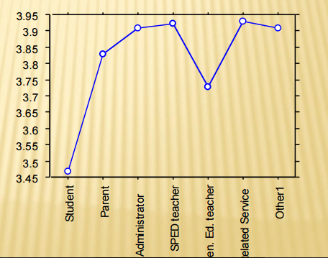
WHY Should Our Students Lead?
Simply put… They know less about what is going on than ANYBODY else.
The Foundation for The Arc Tennessee’s Student-Directed IEP Training: A Self-Advocacy & Self-Determination Approach based on Dr. Martin’s Self-Directed IEP program

Slide 7
ARC Data
Students reported they knew what to do less than anyone else at their IEP meetings
Students spoke less than anyone else at IEP meetings
Students reported that they make decisions less than anyone else
Students felt more uncomfortable than anyone else saying what they felt
Students understood what was being said less than anyone else
Students reported feeling less good than anyone else about the meeting overall
The Foundation for The Arc Tennessee’s Student-Directed IEP Training: A Self-Advocacy & Self-Determination Approach based on Dr. Martin’s Self-Directed IEP program

Slide 8
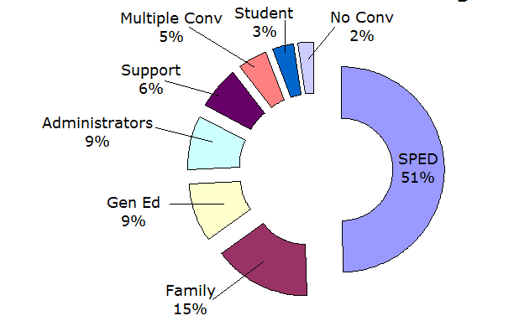
Who Talks at a Typical IEP Meeting?

Slide 9
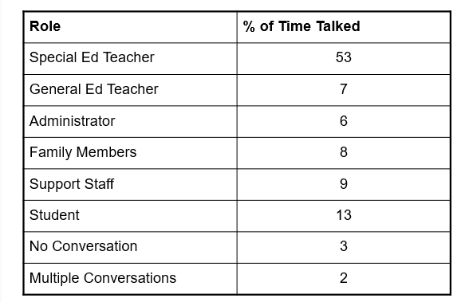
Student Directed?
Say What?!
The Foundation for The Arc Tennessee’s Student-Directed IEP Training: A Self-Advocacy & Self-Determination Approach based on Dr. Martin’s Self-Directed IEP program

Slide 10
If we TRULY want self-advocacy and self-determination...
GOAL: Student developed and led IEPs by senior year

Slide 11
HHS IEP Sample
 | Student | SE | Admin/GE | SSW/GC
Intro and Strengths | 8 | 0.5 |  | 0.5
Future and College | 11 | 2 |  | 2
Past Data | 1 | 5 | 1 | 1
Goals | 4.5 | 2 | 3 | 0.5
Accommodations and Testing | 4 | 1 |  | 1
Timing and End | 1
Total | 29.5 (60%) | 10.5 (21%) | 4 (8%) | 5 (10%)
Notes:
This data is nice, Anna, but really… what did you do??

Slide 12

Houghton High School
Get students into the regular ed classroom
Forced students to talk to their teachers and turn their own work in
Interviewing workshop available
Career Concepts Class
Train the Trainer availability for students
8th/11th/12th
Student IEP event in spring
Notes:
Give a man a fish and he’ll eat for a day, teach a man to fish and he’ll eat for a lifetime

Slide 13
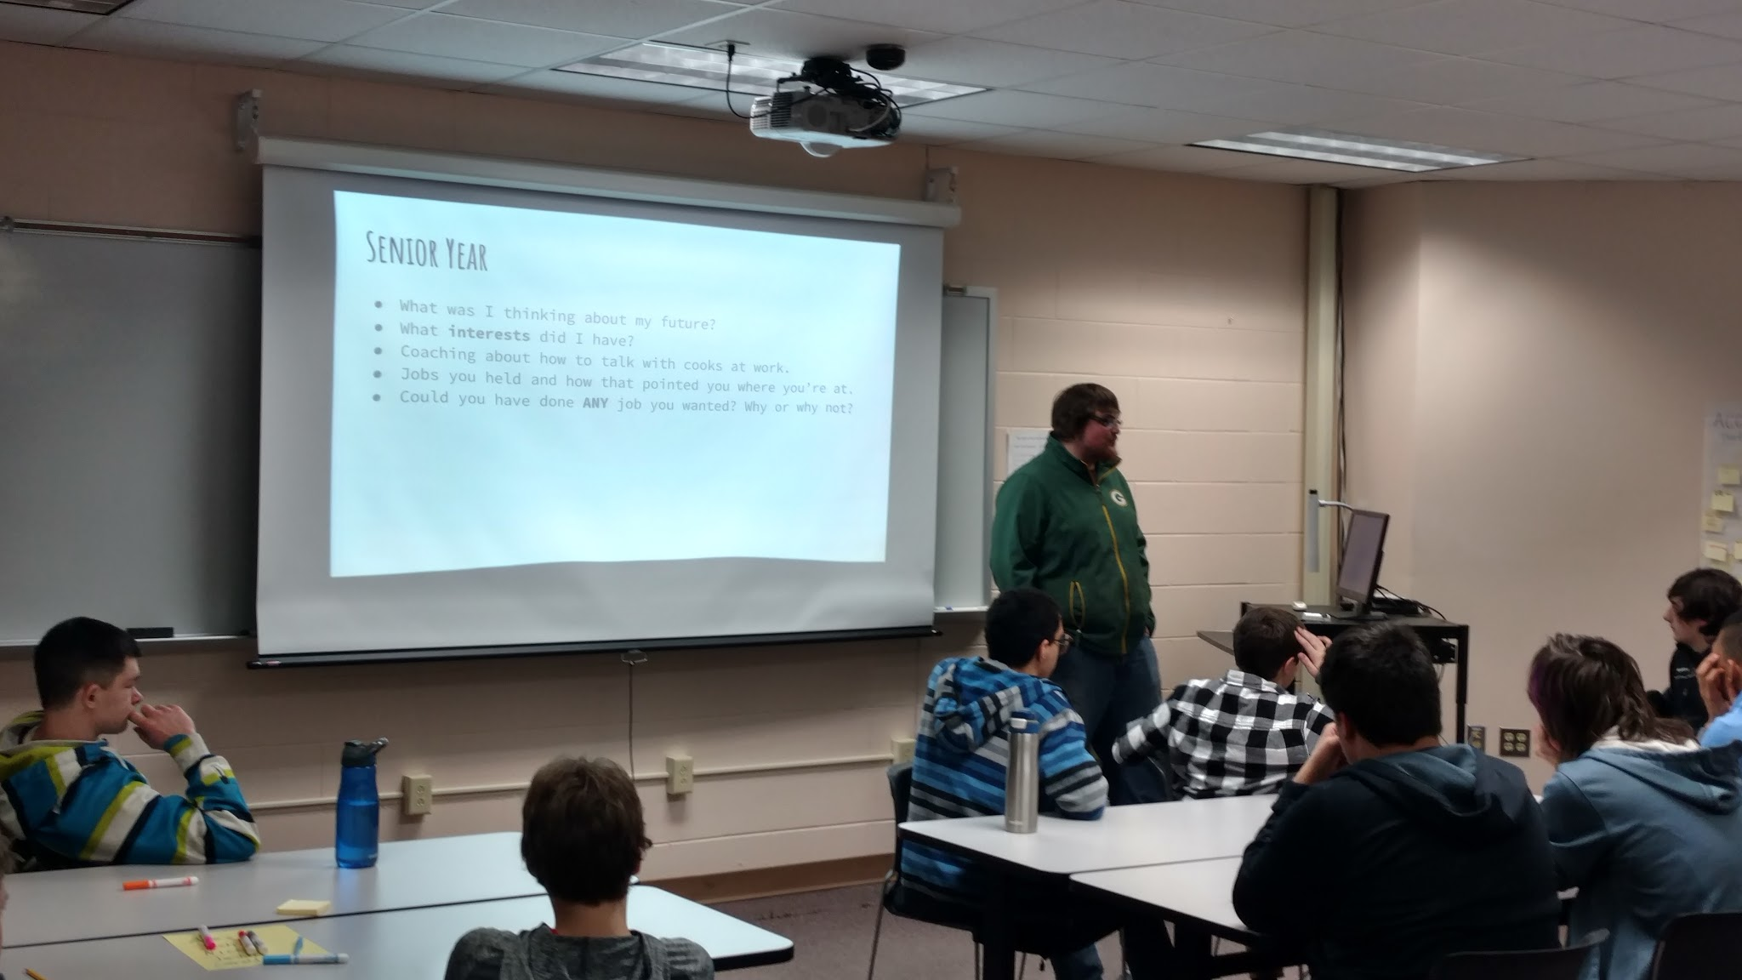

Slide 14
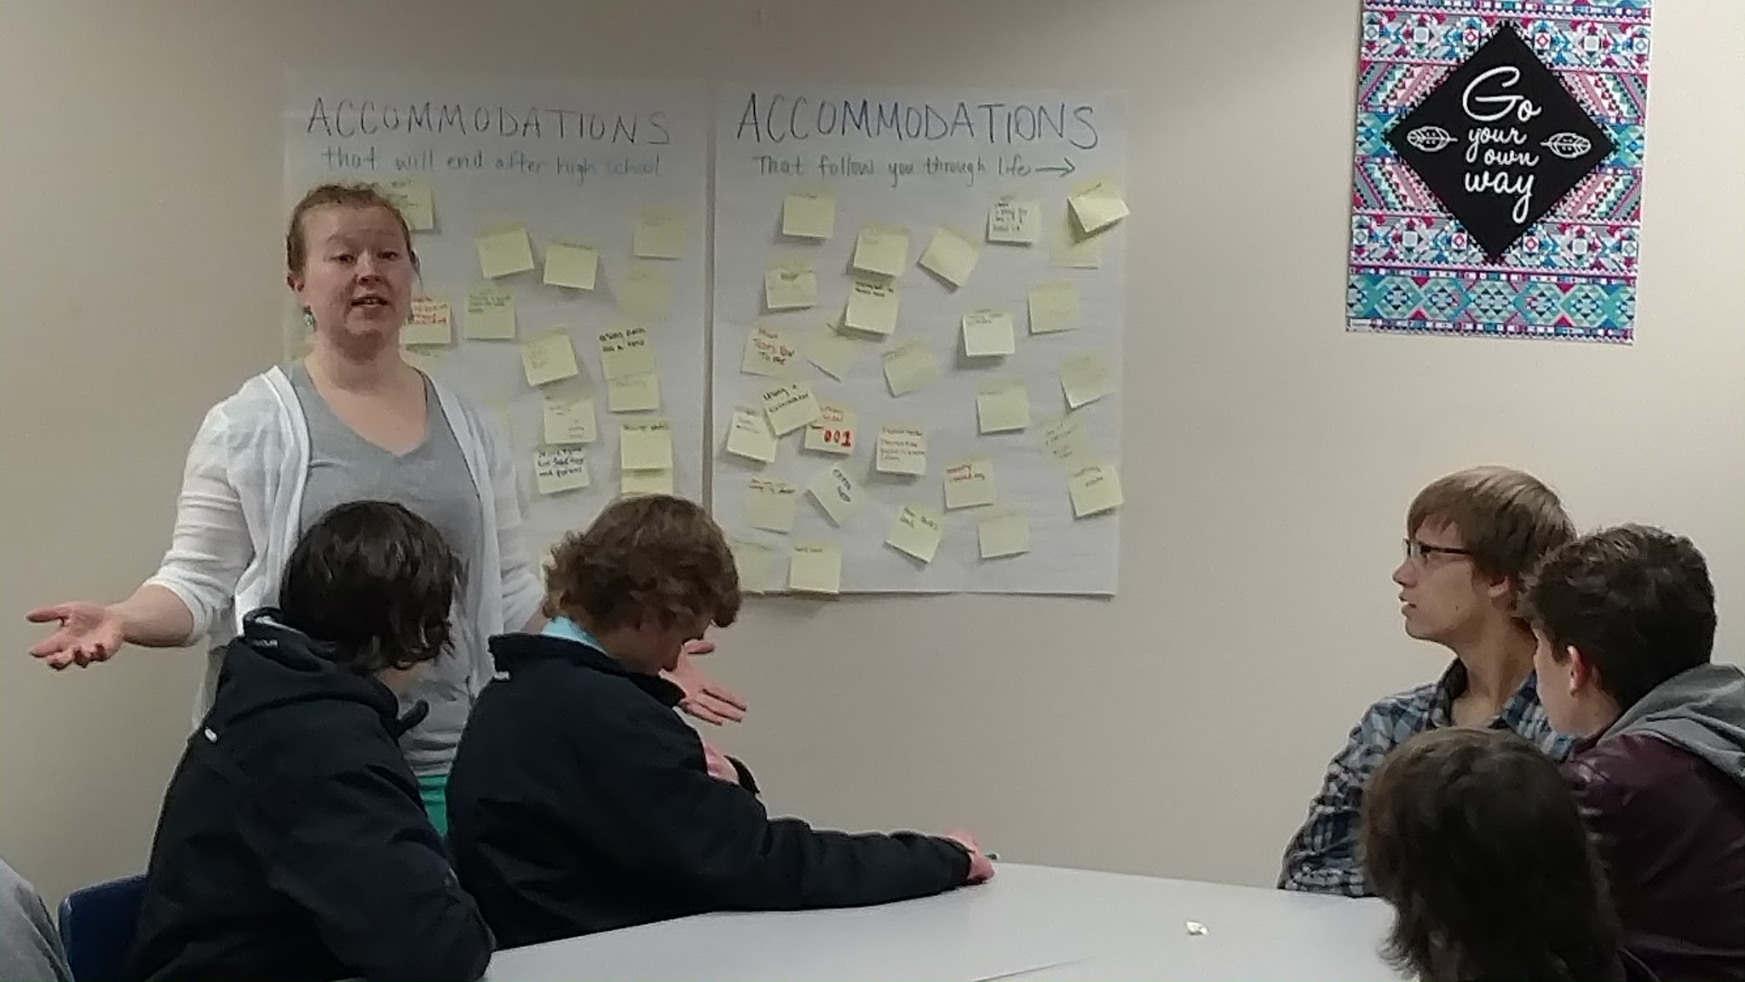

Slide 15
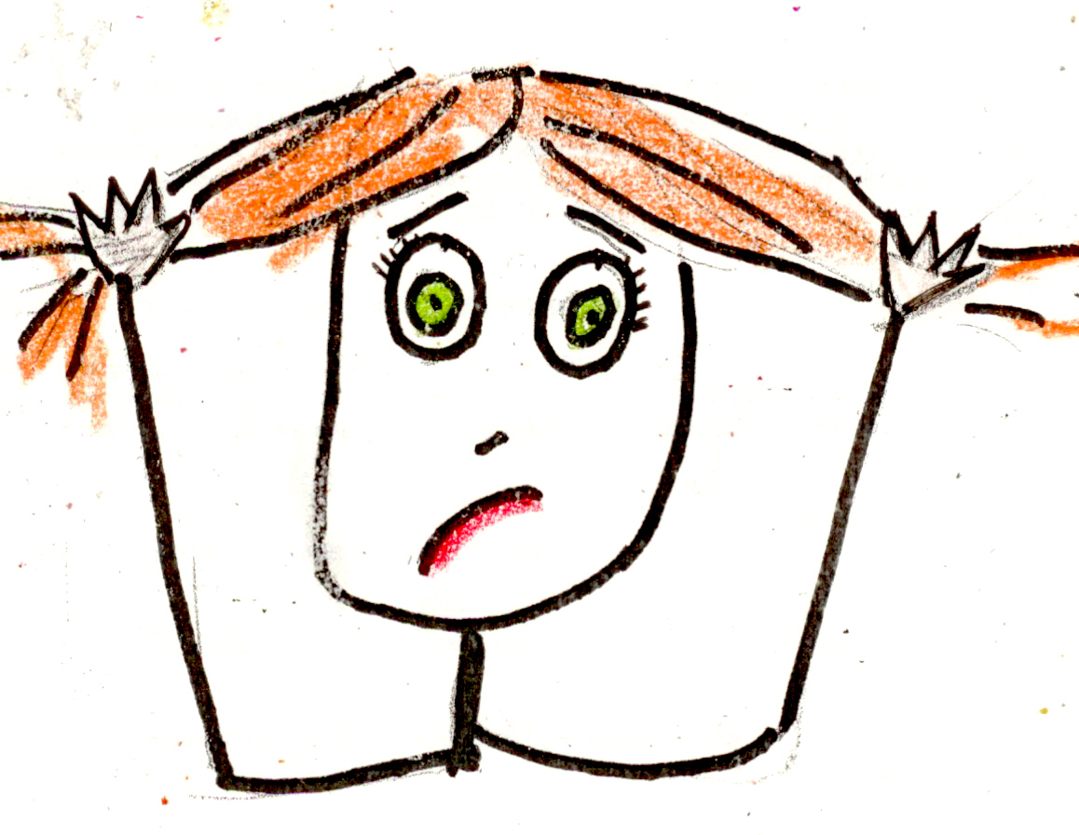
Aaaannndd……. I developed another IEP process

Slide 16
My IEP
Insert your name here

Slide 17
Introductions
Welcome to my IEP! The people here are:

Slide 18
My Disability
I have had an IEP since *
My diagnosed disability is *
This means I sometimes have difficulty with *

Slide 19
Strengths and Things to Build Upon
Things that I am good at include:
*
Things that I should strengthen include:
*

Slide 20
?
Can anyone else add to this list?

Slide 21
The Future
After high school I’d like to have a job in *
In order to do this, I need *
Classes I should probably take in order to be best prepared for my future include*
Currently I am on pace to graduate in *

Slide 22
Things We May Need to Investigate
Instruction
Community Experiences
Development of Employment
Independent Living

Slide 23
For the College Bound
Colleges I’ve investigated:
*
What I know about disability services:
*
Degrees I have looked into:
*
Further steps I need to take:
FAFSA?
Michigan Rehabilitative Services?
Scholarship applications? Loans?
Housing?

Slide 24
?
Does anyone have potential concerns about my transition out of high school?

Slide 25
Teacher Talk
Mrs. Bradfish and Mr/Mrs. General Ed teacher will now talk about how I am doing in school.
Mrs. Rundman may contribute some information about what I need to do to make sure everything is in line for graduation.

Slide 26
How This Next Year Looks
In order to achieve my goals for the future, I’ll need to work on some things in the upcoming year. This can be seen as my “vision” or my “goals”:
*
*

Slide 27
Goal #1
Steps that I need to take to achieve my first goal include:
*
*
*
*

Slide 28
Goal #2
Steps that I need to take to achieve my second goal include:
*
*
*
*

Slide 29
?
Does anyone have potential concerns about my goals for this upcoming year?
Mom/Dad/Guardian: What are your specific concerns for my education this year?

Slide 30
Accommodations and Supports
Accommodations I currently receive are:

Slide 31
Accommodations and Supports for the College Bound
Accommodations I will most likely receive in college are:
*

Slide 32
State Testing
In the upcoming year I will be taking the following required state tests:
*
The accommodations I am likely to receive are:
*

Slide 33
Special Ed Timing
Currently, I am in the resource room * minutes each day. This is used for: *
During this next year, I will be in the resource room for * minutes each day. I’ll use my time for: *

Slide 34
?
Does anyone have potential concerns about my time in the resource room?

Slide 35
Closing Thoughts
This concludes my IEP. This IEP has been an annual/review ** IEP. This is also the formal offer of FAPE, which is a free and appropriate public education. It is offered to all students. If anyone feels like the education I am receiving is not appropriate for my needs, that concern can be brought up now or at any time in the year.
If I am a senior, it also is my graduation IEP as long as I pass all of my required classes and obtain the 48 credits necessary to graduate. When I walk across the stage at graduation, my IEP is officially terminated. However, if I do go to college, I should bring my IEP with me in case I’d like to access further supports there.
Any questions?
Thanks for coming to my IEP!

Slide 36
Self Directed IEP Steps (from ARC)
Begin meeting by stating the purpose
Introduce everyone
Review past goals and performance
Ask for others' feedback
State your school and transition goals
Ask questions if you don't understand
Deal with differences in opinion
State what support you'll need
Summarize your goals
Close meeting by thanking everyone
Work on IEP goals all year

Slide 37
Student Sample

Slide 38

My IEP
Juanita Student

Slide 39
My Disability
I have had an IEP since 5th grade
My diagnosed disability is in
Basic Reading
Math Calculation
Math Reasoning
This means I sometimes have difficulty with math and reading.
I also have difficulty with tracking because of my vision.

Slide 40

Strengths and Things to Build Upon
Things that I am good at include:
Presentations
people skills
athletics
Things that I should strengthen include:
math skills
writing
slowing down while working
Study habits

Slide 41
The Future
After high school I’d like to have a job in the developmental psychology field
In order to do this, I need work hard in all of my classes
Classes I should probably take in order to be best prepared for my future include passing the harder classes
Currently I am on pace to graduate in 2017

Slide 42
How This Next Year Looks
In order to achieve my goals for the future, I’ll need to work on some things in the upcoming year. This can be seen as my “vision” or my “goals”:
passing all my classes with a c or better
(Organize)
Study habits

Slide 43
Goal #1
Steps that I need to take to achieve my first goal (of getting a C or better in all my classes) include:
Better test scores
Improve Study habits
Organize

Slide 44
Goal #2
Steps that I need to take to achieve my second goal (having better study habits) include:
Better attitude towards school work
Keeping on top of homework

Slide 45
How I have changed over the past two years
Using good study habits
Focusing more
Doing homework at home

Slide 46
(Thanks, Juanita!)

Slide 47
How to Get There - Scaffolding Process
Elementary School
Likes and dislikes about school
Middle School
Introduce the meeting, the participants and why they each attend
Identify strengths and things to work on
9th - 10th Grade
All of above PLUS
Accommodations that help me be successful
My goals for after high school (transition section)
11th - 12th Grade
All of above PLUS
Everything else.

Slide 48
Student Benefit
“I think it was better because I had more of a say-so in what was talked about. My mom didn’t go crazy on everybody like a bull because I was talking and she wanted to listen to me. When we got in the car my mom said she liked that way better.”
“It was kind of cool to actually be able to lead something that was about me. It helped me understand things about myself a little bit more. I wasn’t scared at all.”
“It was kind of scary being in charge. It made me feel important though, that I got to lead something.”

Slide 49
Student and District Benefit?
Improved test scores
Students attending higher education
Students have jobs immediately out of high school
(Parents are far more friendly…)

Slide 50

Where Can I Improve?
General Education Teacher involvement
More scaffolding
Training teachers in our district more (including elementary!)
Teaching my students more about the WHY
Having the students report on their last year’s performance
More frequent feedback and thank yous to the people who support my students the most

Slide 51

Questions?

Slide 52


What will YOU do next??
Notes:
BAH! I don’t have time to do this!
You don’t have time NOT to.

