Slide 1
Secondary Transition
Data Trends and Systemic Improvement
January 12, 2023
Michigan Department of Education Office of Special Education

Slide 2
Agenda
Ensure common understanding
Review historic state level data
Review question and consider improvement options

Slide 3
Acronyms
IDEA – Individuals with Disabilities Education Act
IEP – Individualized Education Program
SPP APR – State Performance Plan Annual Performance Report

Slide 4
IDEA Requirements
The IEP to be in effect when a student turns 16, and updated annually thereafter, must include “Appropriate measurable postsecondary goals based upon age-appropriate transition assessments related to training, education, employment, and, where appropriate, independent living skills and the transition services (including courses of study) needed to assist the child in reaching those goals.”
34 CFR §300.320(b)(1)(2)

Slide 5
SPP APR Measurement -part 1
Percent of youth with IEPs aged 16 and above which include appropriate measurable postsecondary goals that are annually updated and based upon an age-appropriate transition assessment, transition services , including courses of study, that will reasonably enable the student to meet those post secondary goals, and annual IEP goals related to the student's transition services needs.

Slide 6
SPP APR Measurement -part 2
There also must be evidence that the student was invited to the IEP Team meeting where transition services are to be discussed and evidence that, if appropriate, are representative of any participating agency that is likely to be responsible for providing or paying for transition services was invited to the IEP Team meeting with the prior consent of the parent or student who has reached the age of majority here.

Slide 7
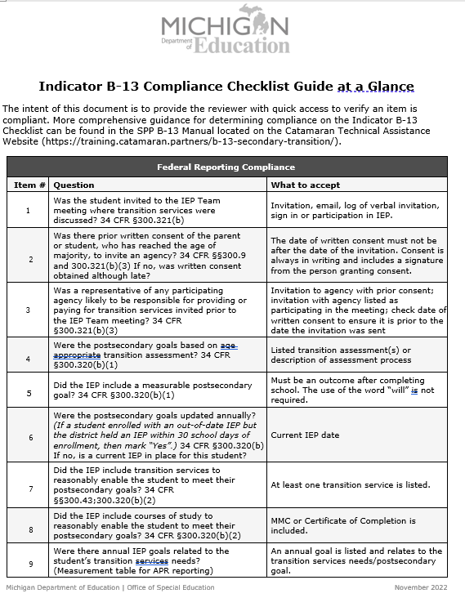
B-13 Checklist
Catamaran TA site
9 questions covering​:
Invitation processes​
Student​
Agency ​
IEP development
Assessment​
Postsecondary goals​
Transition Services​
Annual goal

Slide 8
SPP APR State Data Trend
School Year | 2017-2018 | 2018-2019 | 2019-2020 | 2020-2021 | 2021-2022
Data | 81.00% | 92.34% | 92.94% | 90.66% | 93.68%

Slide 9
Catamaran Data Collection
 | 1 | 2 | 3 | 4 | 5 | 6 | 7 | 8 | 9
2020 | 15 | 85 | 70 | 29 | 27 | 28 | 7 | 14 | 42
2021 | 26 | 95 | 87 | 45 | 43 | 81 | 18 | 12 | 339
2022 | 22 | 84 | 61 | 25 | 25 | 7 | 16 | 7 | 25

Slide 10
Question 1 – Was the student invited?
Historically very little noncompliance
To demonstrate compliance:
Maintain documentation of invitation.
Include student input in not in attendance.

Slide 11
Question 2 – Was written consent obtained?
Historically high level of noncompliance
To demonstrate compliance:
Develop spreadsheet with caseload to map timelines for consent, invitation, IEP Team meeting.
Use colored paper for consent.
Ensure dates are correct on system generated invitations.
Use N/A option on the checklist if no agency is likely to provide or pay for transition services.

Slide 12
Question 3 – Was agency invited?
Historically high level of noncompliance
To demonstrate compliance:
With consent, invite agency representative.
Acceptable to email an invitation to an agency but remember the student’s privacy rights.
Use N/A option on the checklist if no agency is likely to provide or pay for transition services.

Slide 13
Acceptable Forms of Written Consent
Documentation:
Hard copy consent form.
Electronic consent form provided through signature applications such as DocuSign, HelloSign, Adobe Sign.
Consent form emailed which is printed out.
Parent, or student who has reached the age of majority, signs, dates, and returns the form.

Slide 14
Question 4 – Was the postsecondary goal based on transition assessment(s)?
Historically very little noncompliance
To demonstrate compliance:
Many districts’ electronic IEP systems prompt you to list the assessments.
Use a variety of tools to assess the areas of:
Education
Training
Employment
Independent Living

Slide 15
Question 5 – Were there postsecondary goals?
Historically very little noncompliance
To demonstrate compliance:
Identify the student’s desired outcomes.
State the goal in terms of what the student will do after leaving school.

Slide 16
Question 6 – Were they updated annually?
Historically lowest level of noncompliance
Many districts (550+) have some late IEPs each year.
Rarely seen in B-13 checklist.
To demonstrate compliance:
Student information systems can generate automatic reminders of upcoming due dates.

Slide 17
Question 7- IEP includes transition services?
Historically very little noncompliance
To demonstrate compliance, consider:
instruction
related services
community experience
development of employment and other post-school adult living objectives
acquisition of daily living skills and functional vocational evaluation
courses of study

Slide 18
Question 8 – IEP included courses of study?
Historically lowest level of noncompliance
To demonstrate compliance:
Align the courses of study and the postsecondary goals.
If they are not aligned, then include transition services to align the two items.

Slide 19
Question 9 – Were there annual goals?
Historically, medium level of noncompliance but trending down
To demonstrate compliance:
One or more measurable annual goals to meet the transition services needs and progress toward meeting the postsecondary goals.
Measurable Annual Goals and Short-Term Objectives (michigan.gov).
Measurable Annual Goals and Short-Term Objectives: Substantive Compliance (michigan.gov).

Slide 20
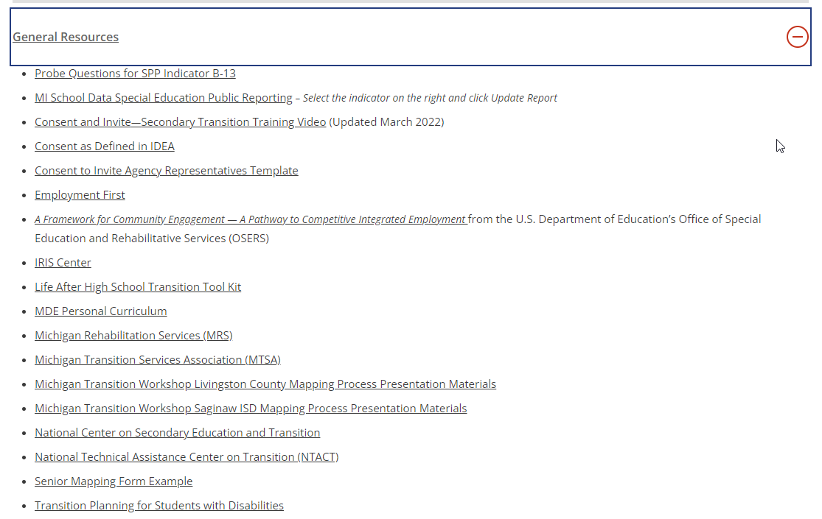
Resources - 1
Secondary Transition Page on the Catamaran TA site

Slide 21
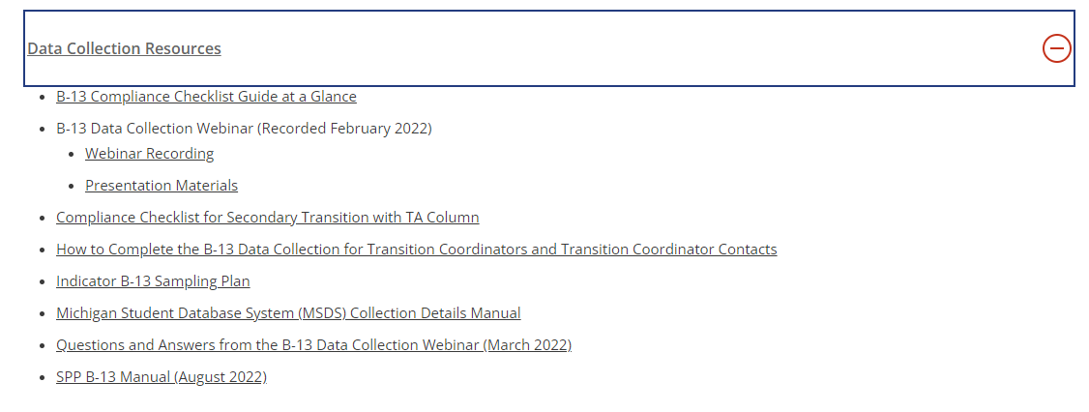
Resources - 2
Secondary Transition Page on the Catamaran TA site

Slide 22
Districts at 100% on the B-13 Checklist

Slide 23
Contact Us
Questions?​
Need Information?​
OSE Information Desk​
888-320-8384​
M-F 9:00 am-4:00 pm​
mde-ose@michigan.gov

