Slide 1

Ableism 102:
Next Steps in Dismantling Ableism
Miranda Grunwell
269-345-1516 x120
grunwellm@dnswm.org
Max Hornick
269-345-1516 x126
hornickm@dnswm.org
Leatrice Fullerton
269-345-1516 x118
fullertonl@dnswm.org

Slide 2
Definition of Disability
A physical/mental impairment that substantially limits one or more major life activities
The ADA also protects people who:
Have a record of such impairment
Are regarded as having such an impairment

Slide 3
Language Review
Words or phrases that show a negative view of people with disabilities | What we say to model language that is neutral and non-judgmental
Handicapped person, Differently abled person | Person with a disability, Disabled person
Handicapped parking, Handicapped bathrooms | Accessible parking, Accessible bathrooms
Abled-bodied person, Normal person | Person without a disability, Non-disabled person
That’s crazy, That’s insane | That’s wild
disABILITY | Disability
Special Accommodations | Accommodations

Slide 4
Person First vs. Identity First
Person First Language:
Puts the person first
Thought to eliminate assumptions by focusing on the person rather than the disability
It indicates a disability as a secondary aspect of a person.
“Person with a disability”

Slide 5
Person First vs. Identity First
Identity First Language:
Emphasizes disability as an identity
Disability is seen as part of a personal identity that can’t be taken away.
It indicates a disability as an inherent aspect of a person’s identity.
“Disabled person”

Slide 6


Person First
Identity First

Slide 7
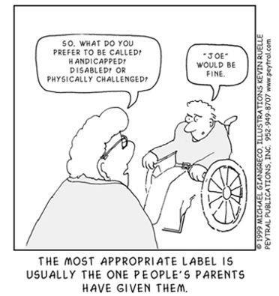
People with Disabilities are People

Slide 8
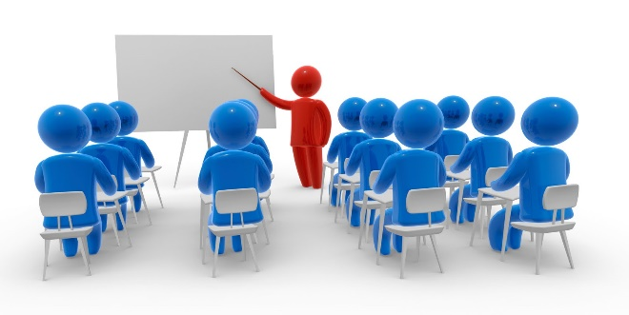
Additional Learning
Chalk Word Lines of Separation by Judy Endow
10 Questions About Why Ableist Language Matters, Answered by Rachel Cohen-Rottenberg
I am Disabled: On Identity-First Versus People-First Language

Slide 9
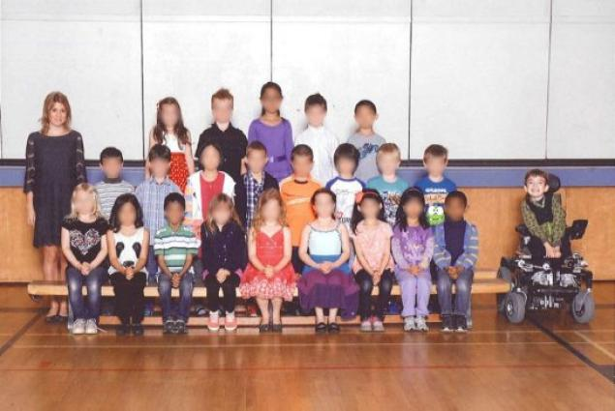
Ableism
The systematic oppression (mistreatment, marginalization, exploitation) of people with disabilities

Slide 10
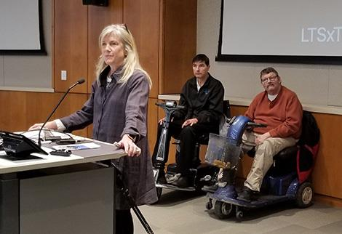
Let’s talk!
What are some examples of why it can be difficult to have a disability?

Slide 11
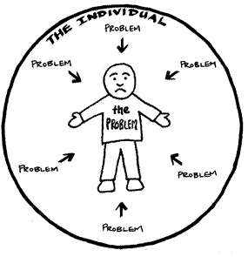
Model of Disability: Medical
Medical Model of Disability:
Disability is caused by a person’s impairment or difference.
Looks at what is wrong with the person
Impairments should be fixed.

Slide 12
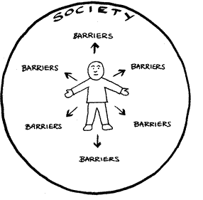
Model of Disability: Social
Social Model of Disability:
Disability is caused by the way society is organized.
Looks at ways to remove barriers
Choice and control over their own lives

Slide 13
Model of Disability: Holistic
Holistic Model of Disability:
Disability is a physical or mental impairment that by itself and/or in interaction with the environment interferes with a person’s full and equal participation in any aspect of life or society.
Looks at treatments/therapies and social/environmental changes that support Disabled people’s needs, wants, and goals
Impairments are inherently disabling and/or disabling due to social and environmental factors.
Source: Introducing the Holistic Model of Disability

Slide 14
Applying Models of Disability
Diabetes
Medical Model: medication, diet, and finding a cure
Social Model: job accommodations, free healthcare, person picks their treatment plan
Holistic Model: person-centered, parts of both models are used

Slide 15
Models of Disability Activity
Migraine
Medical Model:
Social Model:
Holistic Model:

Slide 16


Slide 17
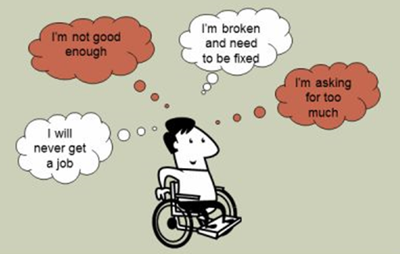
Four Levels of Ableism
Personal
Interpersonal
Organizational
Institutional

Slide 18
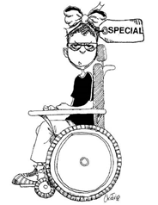
Personal
Your thoughts, values, feelings, and beliefs about disability
“I’m so glad my baby wasn't born with a disability.”
“People with disabilities are so inspirational and nice!”
Action Step: Challenge your own implicit bias and ask, “Why am I thinking or feeling this way?”

Slide 19
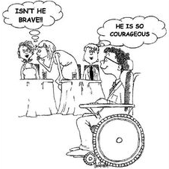
Interpersonal
Actions, behaviors, and language regarding disability
“She can’t be on this committee – she would have too much trouble understanding what’s going on.”
“It’s so cute that he has a girlfriend!”
Action Step: Use neutral language, show respect, and ask!

Slide 20
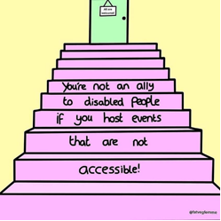
Organizational
The way an organization does things
The organization could make the changes.
“Our public event flyers don't include information on how to request accommodations.”
“You must be able to lift 50 pounds for this job.”
Action Step: Review organizational policies, procedures, programs, and services regularly.

Slide 21
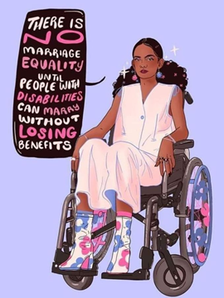
Institutional
Consists of systemic rules, policies, and procedures
Change could be made to policies, but it’s outside of your control or your organization.
Marriage inequality
Guardianship/conservatorship
Action Step: Advocate with legislators for improved laws and policies.

Slide 22
Ableism in Action
Health Care: Play to 3:41
https://youtu.be/RgVKjdheGrQ
Doctors accused of denying care to dying man: Time 3:45 https://youtu.be/2SYjMIX9Lbs
Wrongful Rejection: Time 6:11
https://youtu.be/Z07RzG4mNyY
Florida woman escapes guardianship using secret phone and Facebook to contact media: Time 4:22
https://youtu.be/uILP3yr9ZdM
Restraint and Seclusion Hear Our Stories (Abbreviated Version): Play 2:16-5:25
https://youtu.be/lW3VWlyQU84

Slide 23
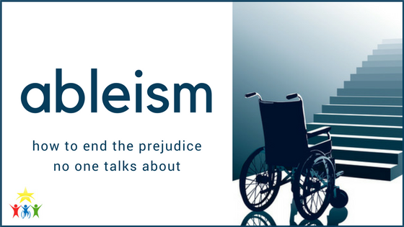
Additional Learning
What You Need to Know About Ableism and Disability Rights by Elizabeth Broadbent

Slide 24
Questions? Comments?
Miranda Grunwell
grunwellm@dnswm.org
Max Hornick
hornickm@dnswm.org
Leatrice Fullerton
fullertonl@dnswm.org

Slide 25
Review from Day 1
Homework review
Questions or thoughts from Day One
Name one thing that stands out from last week

Slide 26
Power & Privilege
Power is having the ability to make decisions that impact others.
Power for people without disabilities:
Selecting where people with disabilities can live
Determining if a person with a disability can work
Deciding if a student will be segregated at school

Slide 27
Power & Privilege
Privilege is what I am able to do.
Privilege for people without disabilities:
Presumed competence
Access to public/private life and spaces
Right to try and fail

Slide 28
Examples of non-disabled privilege
I can open a magazine, watch a TV show, or look at a textbook and see many diverse people of my ability represented.
People will usually not touch me without permission. If they do, it is considered offensive.
I am not expected to be grateful when other people “help” me.

Slide 29
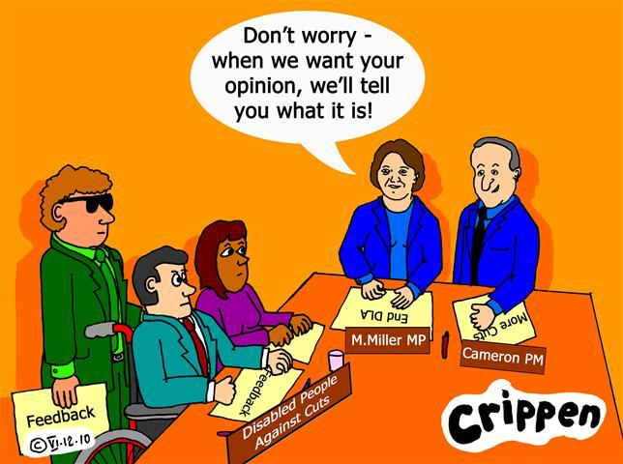
You and I Activity
Need two volunteers who are willing to read in front of the whole group
One person reads statements starting with “You”
One person reads statements starting with “I”

Slide 30
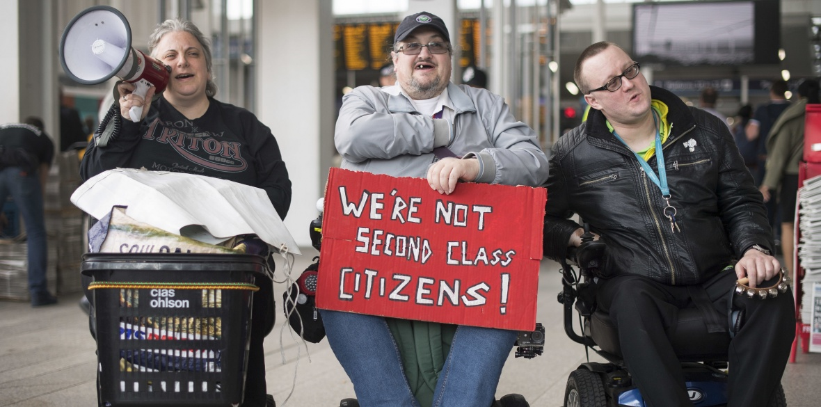
Oppression
Oppression is using our power and privilege against others.
Power + Privilege = Oppression
Oppression is the opposite of inclusion.

Slide 31


Spheres of Influence
Friends
Family
Faith communities
Other board members
Workplaces
Places you volunteer
Park down the street

Slide 32
Full Inclusion
Inclusion is a journey.
Generally, people don’t like having to change the way they do something to accommodate someone else.
Full inclusion will challenge us to do things differently.
Reflect upon systemic ableism in our processes.
What if it means changing how an event is always done?

Slide 33
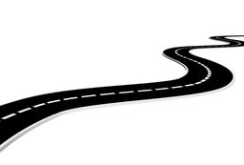
Scale of Inclusion
5. Inclusion
3. Project with Funding
1. Denial – Exclusion
4. Understanding –
Integration
2. Charity

Slide 34
Step 1: Denial – Exclusion
People with disabilities are not included in the planning process.
Effort is made to fit people with disabilities into the current situation, with lots of effort on changing the person with a disability and no effort on transformation of the system.
When inclusion does not happen the explanation is “Well, we just don’t have those people,” or “They have their own program.”
“It’s online, so it’s already accessible!”

Slide 35
Step 2: Charity
Organization pities people with disabilities and sees their lives as tragedies.
Organization is proud of themselves for “helping those people.”
People without disabilities are in control.
People with disabilities are present but not seen as peers or potential friends.
“We don’t need live captioning; we turned on auto-captions.”

Slide 36
Step 3: Project with Funding
Inclusion will happen when a funding source is available.
People with disabilities are included until the group wants to do something the person with a disability “can’t” do.
Accommodations are viewed as expensive.
Organizations praise themselves for reaching out to “those” people.
“We can’t afford an ASL interpreter for this virtual meeting.”

Slide 37
Step 4: Understanding – Integration
People with disabilities are given particular projects and jobs.
People with disabilities are part of the group, and the group says they “do not see difference.”
People with disabilities may be seen as inspirational.
People with disabilities are plugged into an organization with slight adaptations to fit the person into how the business does things.
“We send PowerPoints ahead of time, but we don’t include image descriptions.”

Slide 38
Step 5: Inclusion
Inclusion is a philosophical shift in thinking, not a program or set of procedures.
People with disabilities are found at all levels of the organization and the board.
Organization recognizes that people with disabilities have many identities, so to truly create inclusion, organizations must work on their culture around race, ethnicity, class, gender, sexual orientation, etc.
“We have a policy in place to make all of our virtual meetings accessible – and we follow it!”

Slide 39
Group Activity
Think of your spheres of influence. How can you help them become more inclusive?
How could society set things up differently so that people with disabilities are truly included and have the same opportunities as everyone else?
Make a list of action steps you can start taking to improve inclusion in your personal life or in your spheres of influence.

Slide 40


Slide 41
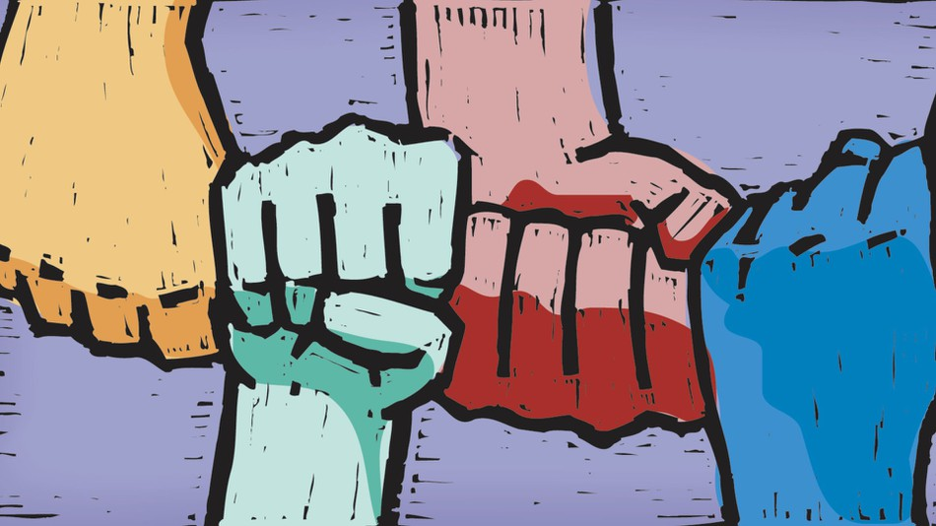
From Ableist to Ally
Ally: A member of a dominant group (people without disabilities) who takes action against oppression out of a belief that eliminating oppression benefits everyone

Slide 42
Tips for Being an Ally
Do:
Listen to people with disabilities.
Presume competence.
Don’t:
Feel sorry for people with disabilities.
Speak for people with disabilities.

Slide 43

How to Be a Better Ally
https://www.youtube.com/watch?v=q7ElX4GFQpI

Slide 44
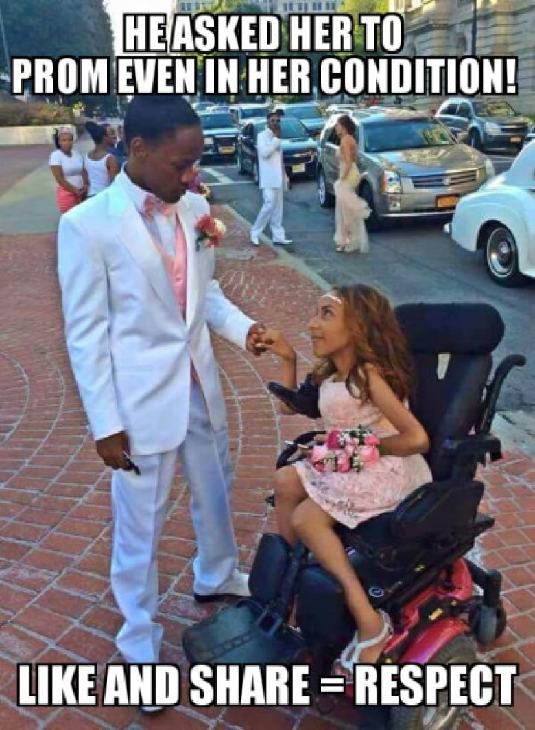
Confronting Ableism
Handout: Confronting Ableism
Small group activity
In your small group, use the information you learned today and say how you would interrupt ableism in each scenario.

Slide 45
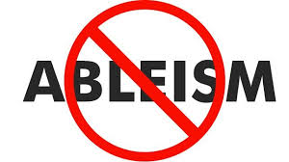
Stopping Ableism
Don’t share or repost.
Ask the person why they are thinking that way.
Model alternative language.
Call people in/out and provide education on why their words or actions are ableist.

Slide 46
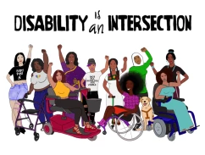
Additional Learning
Who Should be Speaking for the Disability Community by Emily Ladau
10 Principles of Disability Justice by Sins Invalid
Websites, blogs, and other ways to connect online
The Wrong Message by Valeri Brew-Parrish

Slide 47
Questions? Comments?
Miranda Grunwell
grunwellm@dnswm.org
Max Hornick
hornickm@dnswm.org
Leatrice Fullerton
fullertonl@dnswm.org

