Slide 1
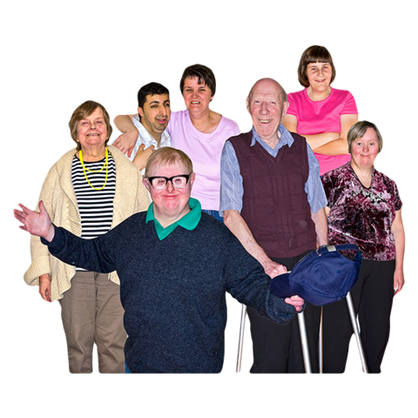
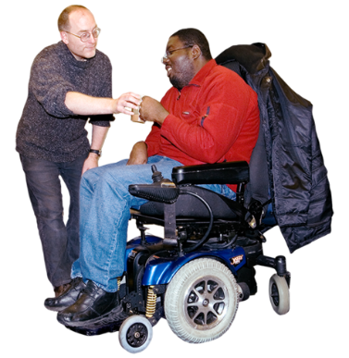
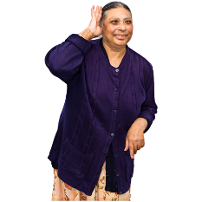


Sexuality and Reproductive Health for People with Disabilities
MTSA Presentation December 1, 2022
Notes:
Frank:
Welcome everyone, thank you for inviting us here today to talk about Sexuality and Reproductive Health for People with Disabilities.
Next slide please

Slide 2
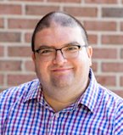
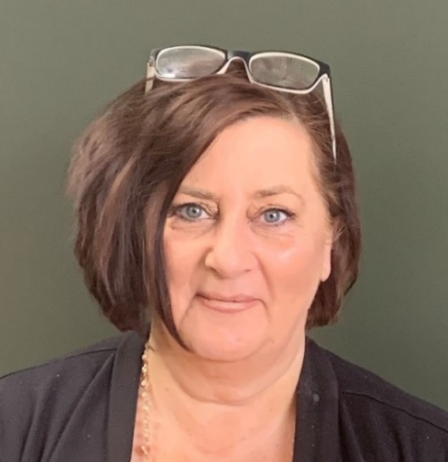
Guest Speakers
Frank Vaca
Michigan Disability Rights Coalition
Mary Shehan
Michigan Developmental Disabilities Council
Notes:
Frank:
Hello, I am Frank Vaca. Introduce yourself with a visual description and pronouns
Mary:
Hi everyone, I am Mary Shehan. Introduce yourself with a visual description and pronouns
Next slide please

Slide 3
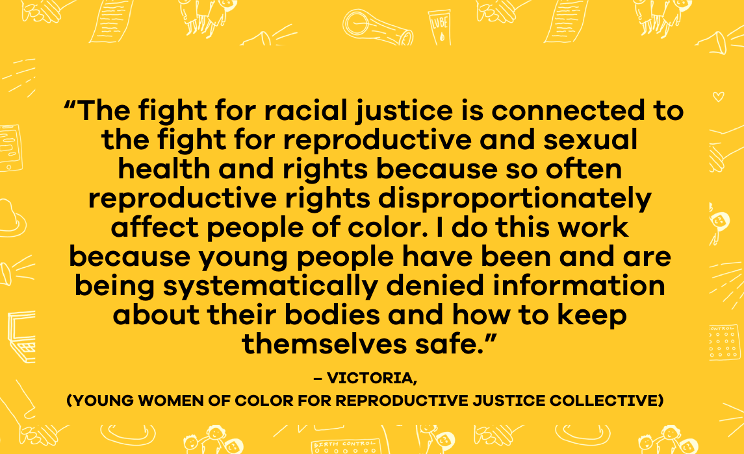
Empowering Students: Sexual Health
Notes:
Mary:
Review information on slide
Next slide please

Slide 4
Empowering Students: Sexual Health
Empowerment involves acquiring skills to become more self-sufficient, obtain resources, solve problems, and make decisions about actions we deem important for ourselves. This includes decisions about our own health, relationships, sexuality, and gender (Moran et al., 2017).
For individuals with autism, parents typically are the initial source of sexual information, and when communication does not include topics related to sexuality, knowledge is often gained from inaccurate and unreliable sources. When parents do discuss sexuality, it typically relates to public and private, body parts, safety, reproduction, and types of touch. What is often lacking are discussions around consent, dating, romantic relationships, love, STDs, birth control, masturbation, and sexual activities (Kahn et al., 2022; Holmes et al., 2016).
There is also a need for increasing training and guidance for educators for students with IEPs...and the importance of educating and supporting autistic young adults in making healthy, safe, and personal choices, based on their own strengths, preferences, and interests, will promote more successful transitions into adulthood pertaining to relationships and sexuality (Kahn et al., 2022)
Notes:
Mary:
Review information on slide
Next slide please

Slide 5

Learning Objectives:
Recognize people with disabilities as sexual human beings
Understanding that sexual messages occur early in life, and therefore education must start young
Understand more about sexual exploitation of people with IDD
Notes:
Frank:
Quickly review the learning objectives express that as a person with a disability, you have experienced some of these issues firsthand
Next slide please

Slide 6

Learning Objectives Continued:
Gain a deeper understanding of communicating with people with IDD about their sexuality
Gain a deeper understanding
of why sexual self-advocacy
is so important
Collaborations that work
toward changing the sexual health picture in
Michigan, for people with IDD
Notes:
Frank:
Some more key points that we want you to gain are … Read and review the learning objectives on the slide.
Next slide please

Slide 7
Why it’s important to teach about sexuality?
Frank-to share thoughts from a self-advocates perspective
Mary-to share thoughts from a family member, educator and psychologist’s perspective
Notes:
Frank:
All humans are born sexual beings and deserve the right to explore their sexuality. For me growing up the only message I got was, “Don’t touch women, and respect you elders.” As a gay man, I was strangely ok with that Idea. In comparison, my sister without a disability got lots of information about menstruation, sexuality, sex, and relationships. I always wondered why there was a difference in the lessons we got.
Mary:
Thank Frank for your insights. I started my career as a psychologist and am also a family member of two different people with IDD, so I have experienced this issue from both perspectives. As a psychologist, I saw that many issues being referred to me as “Behavior Problems.” were in fact people acting in certain ways due to either trauma related to abuse, individuals questioning their sexuality and or, people seeking information in the only way they knew how. I have struggled over the years with family members attempts at communicating being misinterpreted and misunderstood by people paid to support them. That is what motivates me. When I think of the sexual abuse and exploitation rates for people with IDD, I feel compelled to take action to change them.
Next slide please

Slide 8
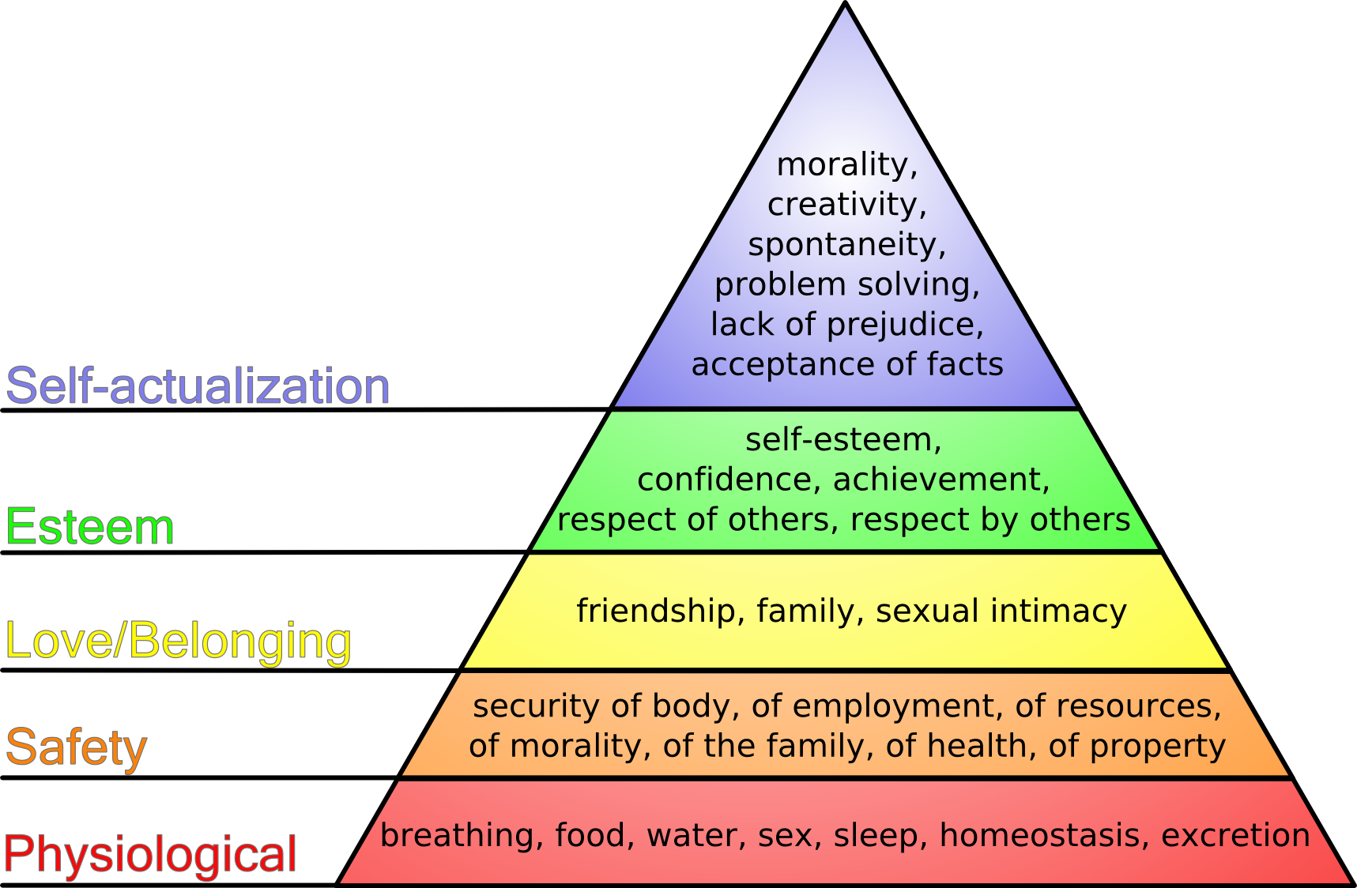
We are all human beings, so we are all sexual beings
Notes:
Mary:
Why is it important to teach this? Pieces of what I refer to as the sixteen dimensions of sexuality appear in each of Maslow’s Hierarchy. All humans are sexual being regardless, of disability type or how profoundly that person’s disability impacts them. We see from the graphic that sexuality appears in each of Maslow’s Hierarchy.
Next slide please

Slide 9
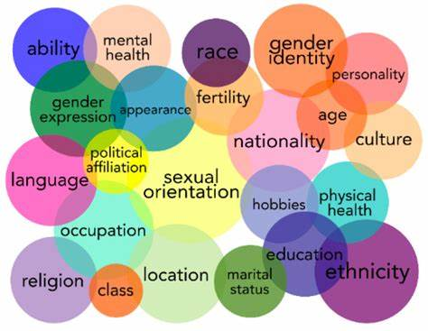
People with Disability’s Sexuality Intersects With Other Life Domains
How we present our sexuality to the world impacts much.
Housing
Employment
Religion
Relationships
Accessibility
employment
Notes:
Frank:
When I think of intersectionality, I think of the word intersection and two roads colliding. Everyone has intersections in their lives. It's what connects us to each other. Businessmen and women are also fathers and daughters. I personally have lots of intersections as a Hispanic, gay man, with a disability, whose gender expression has often been questioned. People with disabilities intersect with every group of people out there. Just as there are people with disabilities in every race, nationality, and religion of people, there are people with disabilities of all sexualities. It is very important to help people with disabilities to express body autonomy at a very early age. Each of us gets to decide what is right for us and our bodies. Each of us though, can also face tremendous backlash from the community if we do not conform to their expectations.
Next slide please

Slide 10

Messages About Sexuality
Start On The Playground
You would be amazed at the diversity in people’s perspectives about how early people should start learning about sexuality.
When did you first learn about sexuality?
What messages were you given?
Notes:
Mary:
Ask one question on the screen at a time, give two or three people a chance to respond. Then say as you can see from the photo, children from a very early age get messages about sexuality. Mary’s son was originally married on the playground in pre-school.
Think of all the messages he got at the ripe old age of three. Messages like:
You must, have a mate
Your mate must be of the opposite gender
There is certain clothing to wear and certain hygiene expectations
There is a religious component to sexuality
Bodily autonomy: “ I have to marry Samantha, because she told me I had to right mommy?” What does that questions say about early teaching about body autonomy. Why do we force youngsters to sit on Santa’s lap, kiss Aunt Agnus goodbye, or tell them to always listen to their elders?
Next slide please

Slide 11
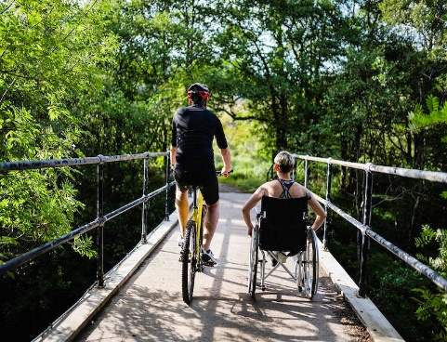
What Do People With IDD Want In Relationships?
The same thing as everyone else!
Happy, fulfilling, relationships
To be honored and respected by another human being
To be free of abuse and have the education to identify when abuse is happening.
To own their own bodies
Notes:
Frank:
We want to touch on individual autonomy and people having the right to both say yes, and say no. Because sexuality and disability are both a natural part of the human experience, education should not only be about sexual abuse prevention, but also be about how to have healthy relationships. We as educators have to promote education about autonomy and sexual self-advocacy in relationships for individuals with IDD as well. We also have to counter the trend of how relationships including relationships for people with disabilities are portrayed in the media.
In Maggie Jones’ article in The New York Time Magazine titled, “What Teenagers are Learning from Online Porn,” one teenager states, “There’s nowhere else to learn about sex and porn stars know what they are doing.”
Next slide please If teens are using pornography, what are the messages they are getting from pornography about sex?
Men and women’s bodies are always perfect
Their breasts are like perfect melons and the penises are very large
Women will moan a lot and act as if everything he is doing is just right
Men should dominate women
Men can flip women over and pull on her hair without asking
Men will last a very long time
Sexual acts are done a certain way and gentle sex is boring
Many young people understand that pornography is over exaggerated and unrealistic, but what happens if someone believes pornography is real. How do these messages impact young people? Young people wonder:
Will I measure up?
Are my body parts the right size and shape?
Will sex be just like sex in pornography?
Do I even need to ask before I do a sexual act?
When do you ask and when don’t you?
One can imagine the consequences of these messages. But, layer on to that, what we know about pornography and people with Developmental Disabilities. (Although, we don’t know actual numbers of user, but we do know that people with developmental disabilities have the same access to pornography and even less access to sexuality education than the general public.) Some people with I/DD are getting in legal trouble for accessing pornography. Given the nature of their disability, they may be less likely to understand that pornography is not real and over-exaggerated.

Slide 12
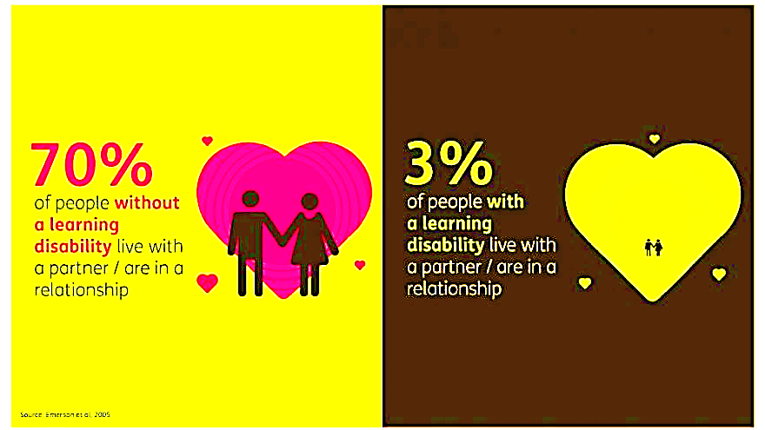
Alarming Statistics
Notes:
Frank: Unfortunately, many people with IDD struggle to achieve these goals. Being in a loving relationship is something that enriches many of our lives. However, research shows that only 3% of people with a learning disability live as a couple, compared to 70% of the general adult population*
You can site the article but only if some ask where this statistic came from.
Emerson, E. B., Davies, I., Spencer, K., & Malam, S. (2005, Jun 1). Adults with Learning Difficulties in England 2003/4.
Next slide please

Slide 13
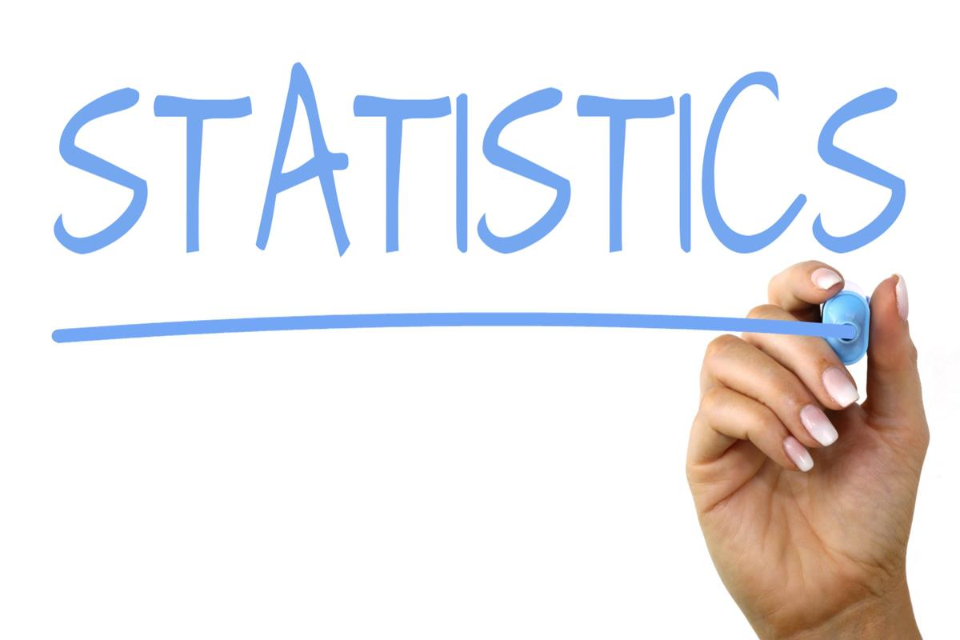
More Alarming Statistics
People with intellectual disabilities are sexually assaulted at a rate more than seven times higher than people without disabilities
(Department of Justice as cited by NPR 2018)
This Photo by Unknown Author is licensed under CC BY-SA
Notes:
Frank:
Negative statistics about people with disabilities get even worse, read slide.
Next slide please

Slide 14
Offenders & Grooming
Offenders
The majority of perpetrators are known and hold positions of power or authority
95-99% of abusers are known to their victims (Petersilia, 2001)
44% of perpetrators have a relationship with the individual because of their disability (Balderian, 1991)
Grooming
Exploiting compliance culture, or trusting nature
Taking advantage of denied sexual knowledge
Becoming a relied upon or primary caregiver before beginning the abuse
Notes:
Mary:
Review slide and discuss the grooming process
Grooming
Exploiting compliance culture, or trusting nature
Taking advantage of denied sexual knowledge
Becoming a relied upon or primary caregiver before beginning the abuse
Next slide please

Slide 15
Scope of the Problem
People with disabilities are 14.2% of the population, and are twice as likely to be a victim of a violent crime (NCVC, 2016)
As many as 83% of women and 32% of men with a developmental or intellectual disability will be sexually victimized within their lifetime (Johnson & Sigler, 2000 )
49% of people with developmental disabilities were assaulted 10 or more times (Sobsey & Doe, 1991)
Generally, if they are given sufficient social support and accessible sexuality and relationships education, many people with a learning disability, are able to engage in safe, healthy and happy personal and sexual relationships (Sinclair et al. 2015; Eastgate 2008).
Notes:
Mary: While the numbers and percentages differ depending on the study and the exact group studied there is one fact the remains the same. All the studies point what would be considered an epidemic of sexual abuse with any other population is not sufficiently addressed with people with IDD.
Next slide please

Slide 16
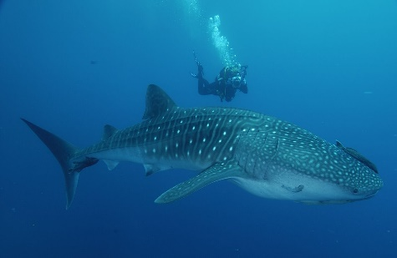
Risk Factors & Barriers
People with I/DD are often denied critical information about human sexuality
Caregivers often teach and reward compliance
Depending on others for care money, medication, and access to resources increases the chance for threats, isolation and manipulation
Depending on assistance with daily living activities (such as bathing, eating, dressing, using the restroom) decreases a person’s expectations for privacy
Mobility and communication challenges may make it difficult to ask for help
Often misperceived myths and stereotypes about people as not being credible, having poor memory recall, or misinterpreting what occurred
Notes:
Mary:
Where does change start? With dialog like what we are having here today. We need to know and understand the risk factors, report when we have concerns, and all work together to provide comprehensive disability specific education everywhere in Michigan.
Next slide please

Slide 17
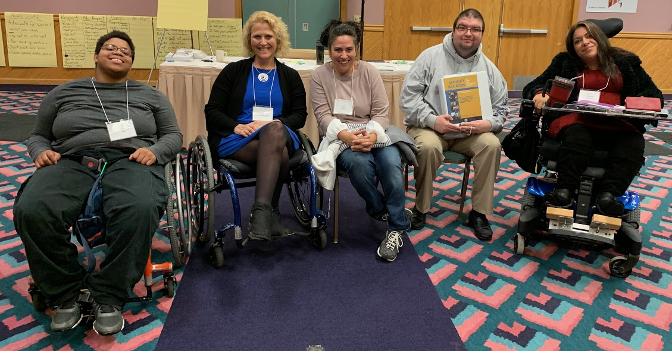
What are we going to do about it?
The big takeaway we hope you gain from today’s presentation is that it is better to be proactive instead of reactive when teaching
Because if not:
People can lose jobs
People can lose housing
People can battle with the legal system
People can struggle to identify healthy relationships
People can be traumatized throughout life
Notes:
Frank:
So, you may be asking yourselves, “What are going to do to change these horrific statistics?” Read slide. You can be part of creating change.
Next slide please

Slide 18
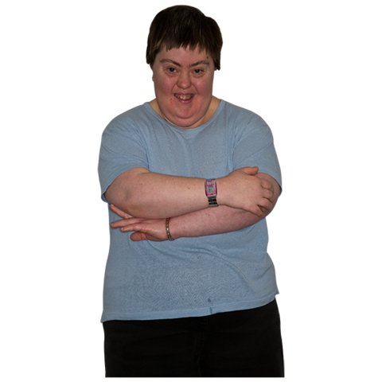
Fundamentals: Don’t Assume!
She is not sexually active
She can’t make decisions about her life including her sexual health
You know her comprehension, literacy or reading level
Don’t assume she is childlike
Notes:
Frank:
You can start with the fundamentals. We need to help the community at large go back to the basics, and not make assumptions about a people with disabilities. It can impair our ability to provide quality support and education. It is important to know people’s abilities and accessibilities.
Don’t assume any of the things listed on the slide
If comfortable, share personal story of when people have made assumptions about you and what the consequences were for you.
Next slide please

Slide 19
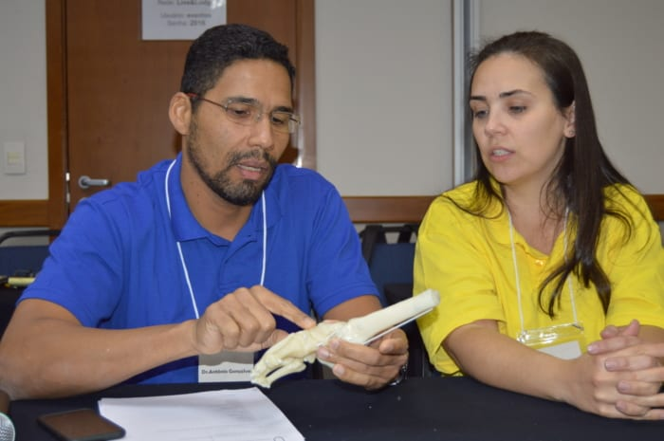
Fundamentals: Communication
Assess Communication Needs/Preferences
Consent forms
Medical Power of Attorney, Patient Advocate
Interpreter
Communication System
Environment
Assess Understanding
Able to consent, or decline the exam
Do your best to explain in primary language,
in terms the person can understand
Notes:
Mary:
Assume that all women, no matter the extent of their disability, are sexual and should be asked about consensual sex. I see signs in every waiting room about this. Do you ask people with IDD about this as well. They have a 7 to 10 percent higher chance of experience sexual abuse and or exploitation than the general population.
Discuss past experiences with pelvic exam. This may provide information on transferring, positioning, speculum use and need for additional assistance.
Communication is fundamental to good health. Communication needs are best determined prior to the exam, and we should make every effort to support the people’s needs.
Interpreters: Language, Sign
Comm. System: TRR, text messaging, TYY, Apps (ie) First, Then. TRS Telecommunications Relay Service - operator service that allows people who are deaf, speech disabled, or deaf blind to place calls to standard telephone users via a keyboard.
Is the environment conducive to effective communication? Is it quiet enough for the hard of hearing, Light enough for visually impaired or for those required to read lips or sign?
Can the people with IDD understand informed consent? Is she able to consent to an exam or able to decline parts of the exam?
Are consents written in Simple Language, Reading consents out loud is an personae, asking peoples to explain what they understand may help to assess understanding.
Do the have a guardian and what type.
Next slide please

Slide 20
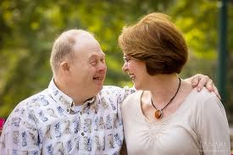
Tips for Working with people who have Guardians
Don’t assume whether someone has or does not have a guardian
Ask for papers
Know your state’s terminology and laws, what authority does the guardian really have?
Be mindful of guardianship type (full or partial)
Notes:
Mary:
Laws: All people (across abilities) are presumed legally competent by law once they turn 18.
A parent of a child with a disability does not remain a guardian of their child when they turn 18 unless the court decides such.
Next slide please

Slide 21
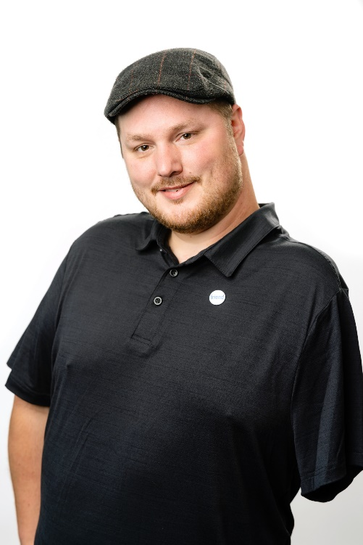
Tips for Working with people who have guardians
Consider asking all adults you serve about guardianship to avoid confusion
Who helps you make decisions? Any community services? Case worker?
Be survivor centered when working with guardians who need to be included
Always speak directly to the person
Notes:
Mary:
We need to get away form thinking about people with disabilities as a separate class of people and the include them in the All. All people need education. All people need to be free of abuse. All people need supporters.
Next slide please

Slide 22
Michigan Mental Health Code
It is the guardian’s responsibility to: provide care, comfort and access to education, medical and psychological services.
This includes a medical forensic exam!
(Michigan Mental Health Code 330.1631)
Notes:
Frank:
If you ever have a guardian who is questioning the need for a Medical Forensic Exam, this is in their job description as indicated in the Mental Health Code, the law that g
governs guardianship for people with IDD.
Next slide please

Slide 23

What is Informed Consent?
Permission granted in the knowledge of the possible consequences, typically that which is given by a person to a doctor for treatment with full knowledge of the possible risks and benefits.
This Photo by Unknown Author is licensed under CC BY-SA
Notes:
Mary:
More about consent and decision-making. It is your role as a healthcare provider to assure you are communicating in a way that makes sense to the person you are seeing. Do your best to do so by adding visual aides and using the methods we have described.
Next slide please

Slide 24

The Importance of Body Autonomy
Notes:
Mary:
Go through FRIES acronym. Many people with IDD too, can learn and understand consent. Talk about this section of the Elevatus Training Curriculum and teacup video as resources.
Click Here: Teacup Consent Video
Next slide please

Slide 25

The Difference Between
Sex and Sexuality
SEXUALITY
WHAT IS SEXUALITY?
?
Notes:
MARY:
Describe and expand on explanation. Request answers from the participants
Next slide please

Slide 26
The Difference Between Sex And Sexuality Continued
Sex refers only to the physical act of sex in all it forms
Sexuality refers to a much bigger set of topics and covers many aspects of humanity and our culture
SIXTEEN DIMENSIONS OF SEXUALITY
EXTERNAL BODY PARTS
INTERNAL BODY PARTS
FUNCTION OF BODY PARTS
GENDERS AND GENDER IDENTITY
PUBLIC AND PRIVATE
PUBERTY AND AGING
EMOTIONS & RELATIONSHIPS
MASTURBATION & SEX
CONTRACEPTION & STI’s
PREGNANCY & INFANCY
LAWS ABOUT SEXUALITY
SEXUAL ABUSE
DISABILITY EFFECTS ON SEXUALITY
SEX AND THE MEDIA
RELIGIOUS VALUES
OWNERSHIP OF YOUR BODY
Notes:
Mary:
Expand on the differences between Sex and Sexuality. Talk about how the many myths and stereotypes about people with IDD and their sexuality have contributed to high numbers of abuse. Bring into the conversation some examples of how people with I/DD have experienced these dimensions of sexuality in ways different from the, population at large.
Next slide please

Slide 27
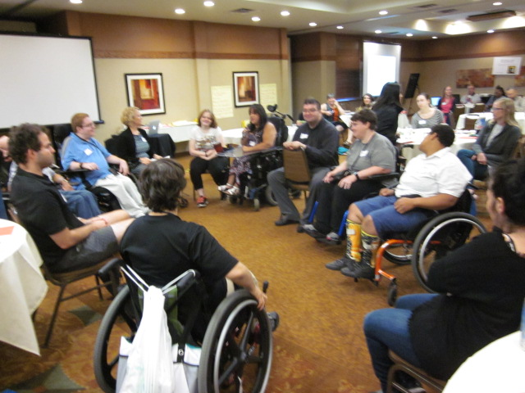
How To Get By-In
Consult students with IDD
Consult parents of students with IDD
Bring in Self-Advocates as guest speakers
Focus on what groups have in common
Recognize where the community is at now, and work toward the next step
Follow MDE rules when in schools
Notes:
Frank:
We often get asked, “How do we get parent on board?” We recommend the following: Read slide
Next slide please

Slide 28

Sexuality Ed. Curriculums In Schools?
Summary of Legal Obligations for
HIV/AIDS Education
Guidelines for Guest Speakers
Regional Health Coordinator List
DD Council
Initiative
https://www.michigan.gov/mde/0,4615,7-140-74638_74639_29233_29803---,00.html
Notes:
Frank:
In case you have never seen them, there are specific rules about what, and how sexuality education can be taught in Michigan public schools. We supplied you with several handouts:
Summary of Legal Obligations: outlining the laws pertaining how each school is to provide HIV/AIDS awareness education
Guidelines for Guest Speakers: outlining the rules pertaining to bringing in quest speakers
A list of Regional Health Coordinators; a list of people who can help support individual districts with Sexuality Education curriculums
The link indicated on the screen will send you to the MDHHS Website with more information
Know that DD Council through Mary’s work is also available to help bring sexuality education to students with IDD as well as adults in your local area
Next slide please

Slide 29
Overarching Principles
live free
The Council’s key principles:
Sexuality is a natural part of the human experience
Safety is a basic human right; everyone has the right to live free of sexual violence
Lack of education for people with IDD is a key factor in the high abuse rates
People with IDD should be autonomous in all aspects of life, including sexual expression
Notes:
Mary:

Slide 30
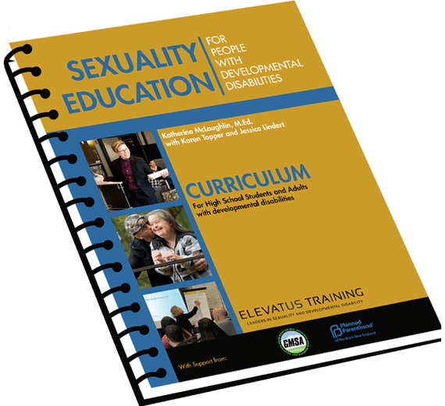
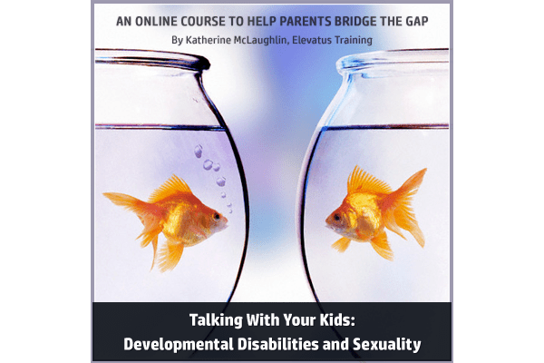
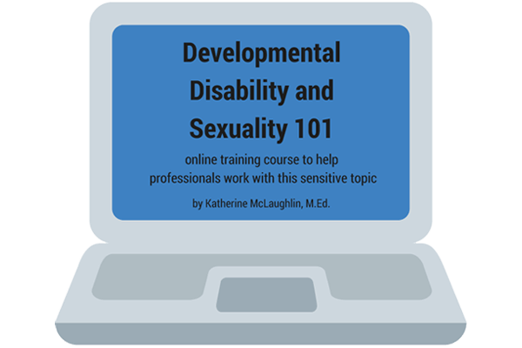
Elevatus Products and Workshops
Becoming a Sexuality Educator
3-day Training
Online workshops and trainings
Trauma informed
Evidences based
Co-lead by Peer Educators
For more information visit: www.elevatustraining.com
Notes:
Frank:
Read slide and expand from your own knowledge of Elevatus
Next slide please

Slide 31
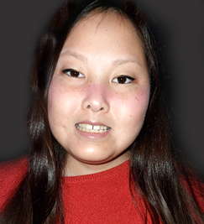
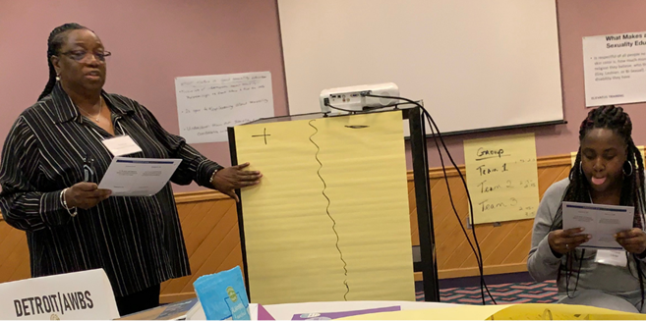
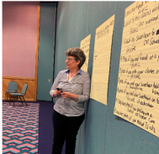
Comprehensive Curriculum
Getting Started
Gender Identity and Gender Expression
Different types of Relationships
Public and Private
Friendship
Communication
Decision-Making
Moving from Friend to Relationship
Internet, Social Media and Communications
Many roads to Relationships
Being in a Relationship
Has Your Relationship Gone Bad?
Body Parts
Caring for Your Body
Sexual feelings, Attraction and Acts
Communicating About Sex
Decision-Making About Sex
Challenges or Things That Can Go Wrong
Do You Want to Have Child?
Avoiding Pregnancy
Getting a Sexually Transmitted Infection
Final Class
Pre-and Post Evaluation Free to participants Participant should attend all 22 weeks
Notes:
Mary:
These are the different lesson taught with the curriculum we use. You can advocate for yourself individually by checking out the Elevatus Training website. Parents can also go on-line and get free worksheet.
There is also a new 12 lesson curriculum called Building Healthy Relationships at Work. This curriculum is also available here in Michigan through the Council’s initiative.
Next slide please

Slide 32






Teams Formed Since 2018
2020/21 Expansion Focus
Support and Enhance existing teams
Continued Team Webinars
Support teams to convert to virtual
Expand into areas not previously reached
Continue to provide presentations
Train new instructors in Michigan
Collaborate w/vocational entities on
education specific to workplace
Collaborate with MRS, BSBP, and other entities working on employment for people with disabilities
Increase a network of employment resources available in Michigan
Work on family engagement Re: this topic
Presentations for families
Creation of family specific tools
TEAMS
Alpena
Ann Arbor CIL
Capitol Area
Cass
Detroit CMH
Detroit AWBS
Detroit CLS
Detroit STEP
Hillsdale
Kalamazoo
LACASA
Livingston +2
Saginaw
Sault Ste Marie
St. Clair
Traverse City
Macomb
Manistee
Marquette
MOASH
Monroe CMH
Muskegon
Mt. Pleasant
Oakland
Osceola
Private Practice
Van Buren CMH
Washtenaw
Notes:
Mary:
Expand and explain chart and graphic
Next slide please

Slide 33
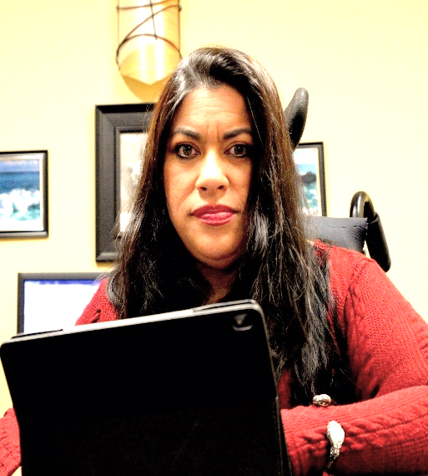
Who Is Being Reached By This Initiative?
Since the first 2018 Team Training:
65 individuals with IDD were trained as sexuality educators
154 professionals and parents were trained as sexuality educators
Since the 2018 Summit
273 family members
481 transition staff
890 other agencies
1,320 individuals with IDD
“I have shared topics from the curriculum with people with disabilities and others without disabilities. The message is universal to all because too often people have not had the opportunity for proper Sexuality Education regardless of disability.”
~Bonnie Gonzalez, Muskegon Team Educator
Notes:
Frank:
I am always excited to do this slide, because we have to update it each time we present. The numbers just keep growing and more and more people are getting a valuable education
Next slide pleas

Slide 34
Resources
Notes:
Mary:
Here are some resources that are also available.
Next slide please

Slide 35
Resources
Notes:
Mary:
Here are some resources that are also available.
Next slide please

Slide 36
Resources
Notes:
Mary:
Here are some resources that are also available.
Next slide please

Slide 37
Resources
Notes:
Mary:
Here are some resources that are also available.
Next slide please

Slide 38
Resources
MOASH https://www.moash.org
YWCA: https://www.ywcawcmi.org
WEAVE
LACASA: https://lacasacenter.org/
DD Council https://www.michigan.gov/ddcouncil
Elevatus Training: https://www.elevatustraining.com
Notes:
Mary:
Here are some resources that are also available.
Next slide please

Slide 39
Questions What questions do you have for the presenters? While we take questions, we will put our contact information on the screen ????
Notes:
Frank:
Read slide (then say next slide)

Slide 40

Speaker Contact Information
Frank Vaca (He, His, Them)
Coordinator For Leaders For Inclusion
Michigan Disability Rights Coalition
fvaca@MYMDRC.org
Mary Shehan (She, Her, Hers)
Community Inclusion Coordinator
Michigan Developmental Disabilities Council
Phone: (517) 284-7288
shehanboogaardm@michigan.gov
Notes:
Frank and Mary:
We will leave this slide up while we field questions, and the moderator closes us out.
Again, thank you for inviting us here today.

