Slide 1


Forward Thinking Transition Options in Michigan Focus on Student Transition from School to Work
Compliments of MTSA Region 1
Voice of: Susan Root
MTSA Region 1 Representative

Slide 2

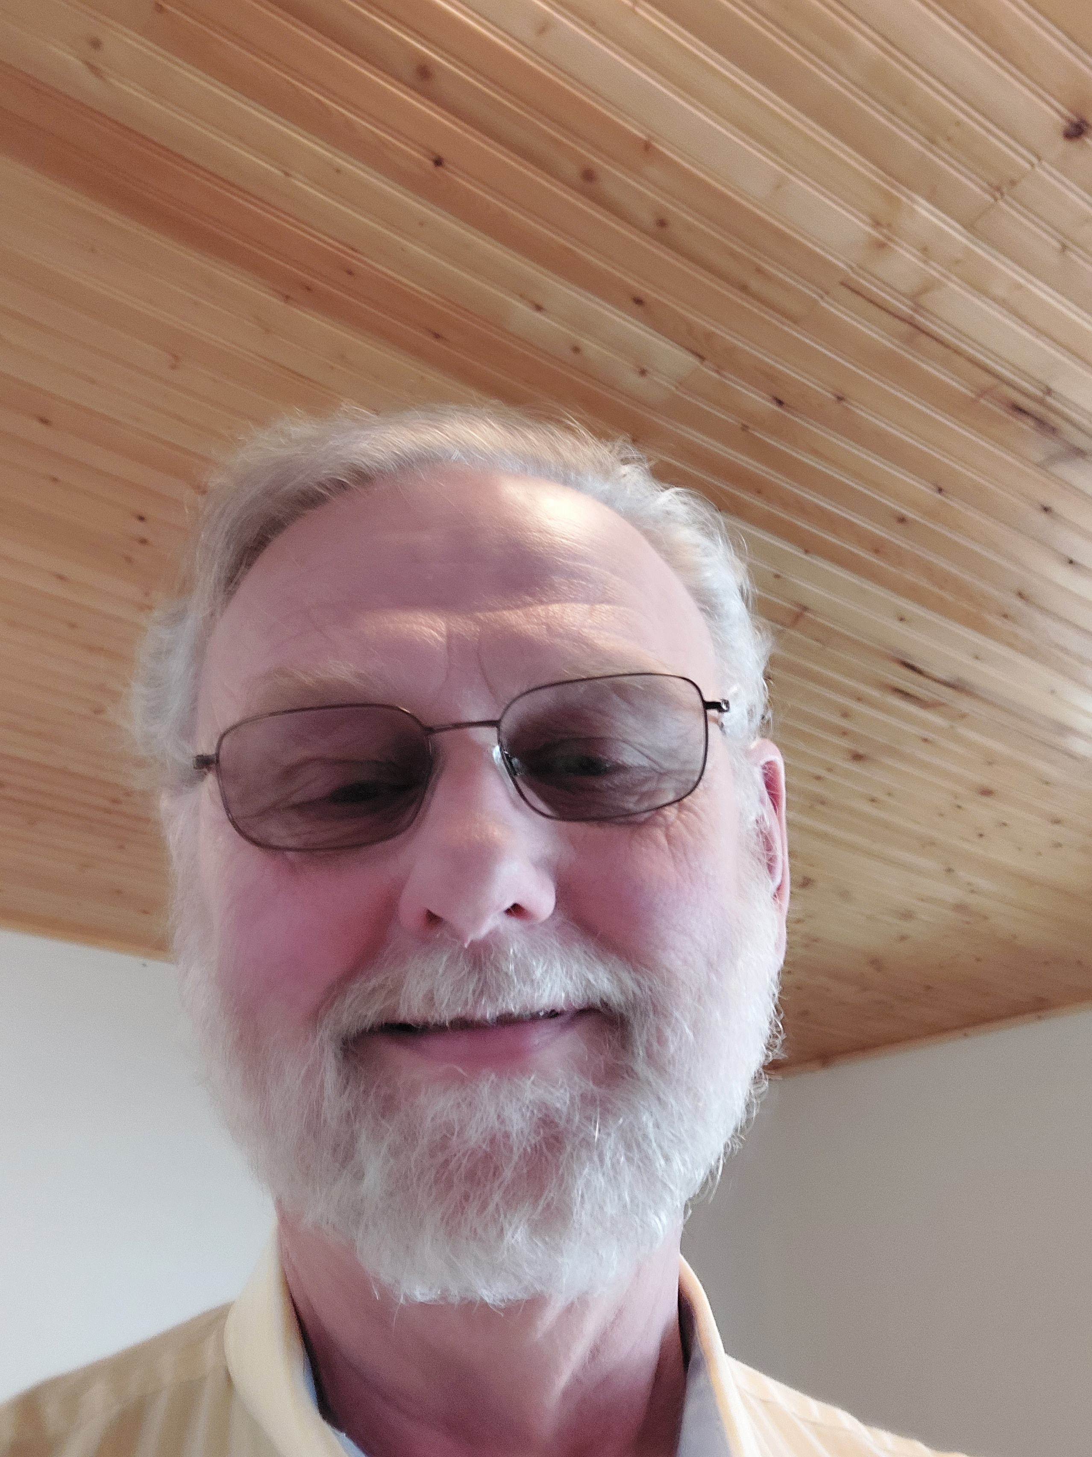
Presenter – Joe Longcor
Joe Longcor is the Supported Employment Specialist at Behavioral and Physical Health and Aging Services Administration (BPHASA). He is focused on all employment services provided through BPHASA contracts for individuals with any disability. In addition, he is the liaison for the evidence-based Individual Placement and Support-IPS (supported employment) project for persons with serious mental illness. He leads the development of BHDDA specific benefits planning initiatives to promote work, the growth of www.mi.db101.org, is a member of the Michigan Project Search Leadership team, and remains involved in expanding Michigan's Freedom to Work/Medicaid Buy-in program. Joe has a BBA in Marketing from Davenport University and has worked in the field of disabilities for 25 years. He was formerly the Coordinator of Employment Development at Allegan Community Mental Health where he facilitated the full transformation of two workshops, initiated the conversion of the day program to full community inclusion, led the Supported Self-employment initiative, and increased the use of Social Security work incentives.
Say Hi to everyone, Joe!
Voice of: Susan Root
MTSA Region 1 Representative

Slide 3

Presenter – Melissa Potter
Melissa Potter is a Rehabilitation Consultant for the Innovation Unit at Michigan Rehabilitation Services (MRS) specializing in increasing Competitive Integrated Employment outcomes for those served with the most significant disabilities. Her specific assignments include strengthening statewide partnerships with Community Mental Health Service Providers (CMHSP), the Behavioral and Physical Health and Aging Services Administration (BPHASA), Michigan Developmental Disabilities Council, and Community Rehabilitation Organizations (CRO). This includes leading and coordinating efforts to support Competitive Integrated Employment, Supported Employment, Customized Employment, Individual Placements and Supports model, Subminimum Wage Section 511, and other programs. She earned a Master’s degree in Rehabilitation Counseling from the University of Wisconsin-Stout and a Bachelor’s degree in Social Work from Michigan State University. She is a Licensed Professional Counselor (LPC) and Certified Rehabilitation Counselor (CRC). She has over 16 years of experience working in the rehabilitation field. She began working for MRS in January 2016 as a Rehabilitation Counselor in the Lansing District Office and then as a Rehabilitation Consultant with the Program Enhancement Division. She previously worked at Peckham as a Services Specialist from 2006-2016.
Say Hi to everyone, Melissa!
Voice of: Susan Root
MTSA Region 1 Representative

Slide 4
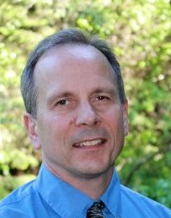
Presenter – Sean O’Brien, CRC
Program Coordinator, VRTAC-QM
San Diego State University (SDSU), Interwork
9332 Stephen Richards Dr., Juneau AK 99801
Work/Cell (907) 321-4071, E-mail: skobrien@sdsu.edu
VRTAC-QM Website: https://www.vrtac-qm.org/
Sean O’Brien has spent the majority of his life and career working in Alaska for about 33 years under the State of Alaska primarily with the Division of Vocational Rehabilitation and their partners to support the field to successfully achieve employment outcomes for their consumers. In 2015 he was promoted to the State of Alaska’s Director of Public Assistance until he retired in 2016. Since that time, he’s been part of the technical assistance team associated with WINTAC (2016-2020) and now with the VRTAC-QM center where he continues to assist VR agencies across the country to develop and implement strategies that result in improving competitive integrated employment outcomes for the consumers they serve. Sean’s subject matter expertise includes Supported Employment, Customized Employment and developing the cross-agency collaboration systems needed to support these programs.
Say Hi to everyone, Sean!
Voice of: Susan Root
MTSA Region 1 Representative

Slide 5
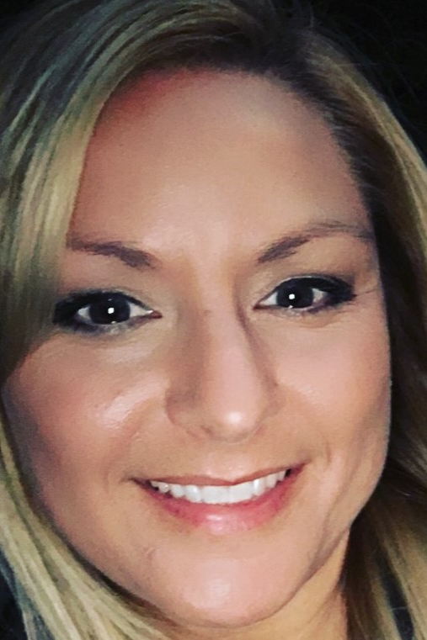
Presenter – Jen Hirst
Jennifer is a Rehabilitation Consultant with Michigan Rehabilitation Services. Her areas of expertise are in Prior to Application (PTA), Pre-ETS delivery, and Transition VR. She is the lead consultant for many statewide programs; Project SEARCH, DNR Summer Youth Work, Jobs for Michigan Grads (JMG), WMU and any additional programs to explore and deliver. She coordinate’s many statewide workgroups with PTA counselors, transition counselors and additional groups to provide feedback. She sits on the Special Education Advisory Council (SEAC), Michigan Transition Services Association (MTSA), Co-Lead for Michigan Interagency Transition Team (MITT) and Wayne State DD Advisory Committee. Prior to being a consultant, she was a Transition VR Counselor with the Southwest District Office.
Say Hi to everyone, Jen!
Voice of: Susan Root
MTSA Region 1 Representative

Slide 6
MTSA TTS Forward Thinking for Transitioning From School Directly to Work
We continue to look at best practices, and quality outcomes with transition from school. For those students that are not college bound there are many agencies that become involved and the approaches or models for transition to work can be overwhelming.
Today we will learn about current and emerging ideas to successfully drive your students to a successful employment outcome. We will explore how WIOA disrupted the "old ways" of transition from the school setting. We will consider specific techniques termed Supported, Customized, or Seamless.
Spot how many times you see CIE or Competitive, Integrated Employment.
Voice of: Susan Root
MTSA Region 1 Representative
Notes:
Sue Root
Welcome
and overview

Slide 7
Transitioning from School to Work
Driven by federal policy, state agency systems are transforming services by increasing their emphasis on preparing youth with disabilities for life after school and connecting them to post-school employment services. For example, the 2014 Workforce Investment and Opportunities Act (WIOA; P.L. 113-128) and Individuals with Disabilities Act (IDEA) of 2004 call for government agencies to intentionally coordinate services and connections for youth with disabilities to facilitate the transition out of the education system and into adult roles. IDEA requires linkages as part of a student’s transition plan, however, there are no formal mechanisms available to measure and ensure such linkages are occurring.
In Michigan, the linkage and collaboration of services
is essential for successful transition outcomes.
-Transition Linkage Tool: A System Approach to Enhance Post-School Employment Outcomes (dol.gov)
Voice of: Susan Root
MTSA Region 1 Representative

Slide 8
Vocational Rehabilitation (VR) in Michigan
Michigan represents one of many states where there are two VR agencies:​
Michigan Rehabilitation Services (MRS) - General ​
Bureau of Services for Blind Persons (BSBP) - Blind ​
Although similar processes are followed and federal regulation guides both agencies equally for the purposes of federal reporting: BSBP specifically serves a unique population representing blindness and low vision as the primary sensory impairment
Voice of: Melissa Potter, MRS

Slide 9
Students and State VR WIOA Rules Apply
First update since 1998 to the National Workforce Development System
Reauthorized access to job seekers to programs/services to succeed in employment and meet employer needs.
Prohibits discrimination in the provision of services under the law as state vocational rehabilitation agencies, American Job Centers, and other service providers. They are held responsible to ensure individuals with disabilities have equal opportunity to participate in services and receive appropriate accommodations.
Amended Section 511 of the Rehab Act of 73 to ENSURE individuals with disabilities have access and information to achieve competitive integrated employment.
Voice of: Susan Root
MTSA Region 1 Representative

Slide 10
Pre-Employment Transition Services
Pre-ETS
Earliest set of services for potentially eligible or eligible SWD
Short term in nature to assist in identifying career interests.
Transition Services
Available for eligible SWD or YWD through Individual Plan for Employment (IPE)
Specific set of 5 required activities provided directly to SWD under pre-ETS.
Assist further to develop and pursue career interests through post-secondary ed, vocational training, job search, job placement, job retention, job follow-up and follow along services.
Voice of: Jen Hirst, MRS

Slide 11
Transition to Post-Secondary Education then Work
Preparing the student to enter and engage in post-secondary training prior to entering work.
Community College
University
Trade/Vocational Tech School
Apprenticeship
Voice of: Susan Root
MTSA Region 1 Representative

Slide 12
Transition to Directly to Work
Preparing the student to enter and engage in competitive integrated employment directly from secondary school.
Employment
Supported Employment
Customized Employment
Employment via IPS
Focus of Today
Voice of: Susan Root
MTSA Region 1 Representative

Slide 13
Transition to ?
Typically, not our intention, but sometimes students are transitioning to the unknown.
May need transition goal changes due to unforeseen circumstances.
Medically unstable
No desire for work or training
Maslow's Hierarchy of Needs
Voice of: Susan Root
MTSA Region 1 Representative

Slide 14
What kind of Work? CIE, of Course!
Competitive
Integrated
Employment
Pay & Benefits
Compensated at or above minimum wage and comparable to the customary rate paid by the employer to employees without disabilities performing similar duties and with similar training and experience.
Receiving the same level of benefits provided to other employees without disabilities in similar positions.
Environment & Opportunity
at a location where the employee interacts with other individuals without disabilities
presented opportunities for advancement similar to other employees without disabilities in similar positions.
Working
Full or Part-time work
Remote or in person
Supported or not supported
Created (new) position
Voice of: Melissa Potter, MRS

Slide 15

Special Education-to-Community Transition Planning Policy
Policy
Document is available to download from chat.
Voice of: Joe Longcor, BPHASA
Notes:
Joe – Sue R. will put the documents into the chat for participants to download.

Slide 16
Mental Health Supports and Services
Noteworthy Information about Mental Health Supports and Services
Document is available to download from chat.
Voice of: Joe Longcor, BPHASA
Notes:
Joe – Sue R. will put the documents into the chat for participants to download.

Slide 17
MH Collaboration with State VR
Collaboration Agreement
Document is available to download from chat.
Voice of: Joe Longcor, BPHASA
Notes:
Joe – Sue R. will put the documents into the chat for participants to download.

Slide 18
Supported Employment (SE)
According to 29 USCS § 705(35)A [Title 29. Labor; Chapter 16. Vocational Rehabilitation and Other Rehabilitation Services; General Provisions]
The term "supported employment" means competitive work in integrated work settings, or employment in integrated work settings in which individuals are working toward competitive work, consistent with the strengths, resources, priorities, concerns, abilities, capabilities, interests, and informed choice of the individuals, for individuals with the most significant disabilities
(i) (I) for whom competitive employment has not traditionally occurred; or
(II) for whom competitive employment has been interrupted or intermittent as a result of a significant disability; and
(ii) who, because of the nature and severity of their disability, need intensive supported employment services for the period, and any extension, described in paragraph (36)(C) and extended services after the transition described in paragraph (13)(C) in order to perform such work.
(B) Certain transitional employment. Such term includes transitional employment for persons who are individuals with the most significant disabilities due to mental illness.
Voices of: Melissa Potter, MRS, Sean O’Brien, VRTAC-QE and Joe Longcor, BPHASA

Slide 19
SE – Individualized Plan for Employment (IPE)
Additional requirements for SE IPE:
Source of extended services or reasonable expectation that source will become available ​
Expected ongoing/extended support services ​
Details for periodic monitoring to ensure the individual is making satisfactory progress toward meeting the weekly work requirement prior to beginning extended services ​
Coordination of services with other agencies; i.e., local school transition plan and/or Community Mental Health Service Provider​
Voices of: Melissa Potter, MRS, Sean O’Brien, VRTAC-QE and Joe Longcor, BPHASA

Slide 20
Customized Employment (CE)
Customized Employment is a process for achieving competitive integrated employment or self-employment through a relationship between employee and employer that is personalized to meet the needs of both. It is a universal strategy that benefits many people, including people with disabilities who might not have found success through other employment strategies. In 2014, customized employment was included in Title IV of the Workforce Innovation and Opportunity Act (WIOA) as a strategy under the definition of supported employment.
Voices of: Melissa Potter, MRS, Sean O’Brien, VRTAC-QE and Joe Longcor, BPHASA

Slide 21
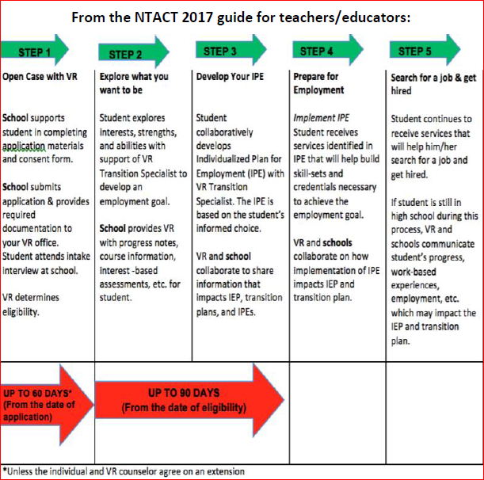
Customized Employment
Voice of: Sean O’Brien, VRTAC-QE
Notes:
Joe – Sue R. will put the documents into the chat for participants to download.

Slide 22
State VR CE Requirements
Current MI VR CE Vendor Requirements
- Griffin-Hammis Associates (GHA)
- ACRE training with an Emphasis on CE
- Performance-based/mentoring standards
- Fidelity Scales for Discovery, Job Development, and Consultative Employment Training and Supports (CETS)
VR CE Credentialing Approval Request Form
*see website below for detailed information
LEO - Information for Current State of Michigan Vendors
Voice of: Melissa Potter, MRS

Slide 23

Seamless Transition
A coordinated process of tasks to be completed each year prior to exit.
Requires multiple insights with collaborative input to match student to CIE.
Consists of a planned set of activities based on exit date.
Strength based and guided by the principles of the Positive Personal Profile for life decisions.
Graded transition to community/work - goal is the last day of school looks like the 1st day of post exit life.
Voice of: Susan Root
MTSA Region 1 Representative

Slide 24
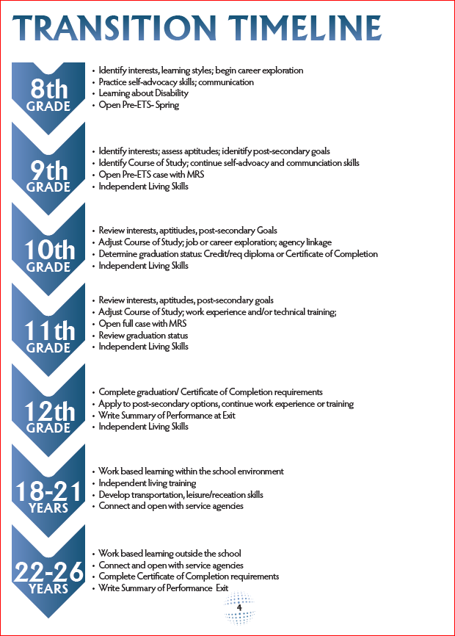
Sample
Seamless Transition Outline
Compliments of Clare-Gladwin RESD
Document is available to download from chat.
Voice of: Susan Root
MTSA Region 1 Representative

Slide 25
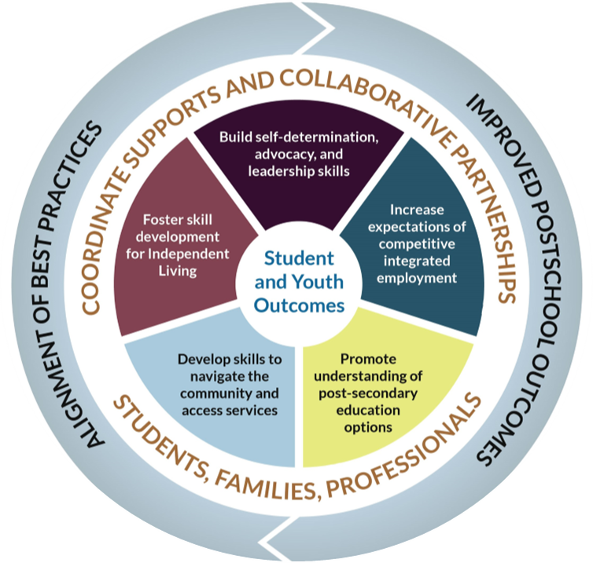
Michigan Interagency Transition Team (MITT) Updates
Designed self-assessment tool targeting 5 Core Student Outcomes
Promotes positive post-school outcomes
Identifies practices to improve skills
Focuses on research-based practices
Supports collaborative approach in self-assessing implementation of practices
Ensures greater consistency across students, teams, buildings, systems
Voice of: Jen Hirst, MRS
Notes:
Have been working with technical assistance to create a statewide framework to assist with:
Consistent definitions of terms and language
Develop and provide cross-agency training and Technical Assistant (TA)
Consensus decision making
Align secondary transition services across the state to maximize resources and avoid duplication
In the next year or so there will be a plan to roll out to a couple pilot sites to review and participate through a pilot.

Slide 26
Open Q&A
What did we miss and what can we clarify?

