Slide 1


Understanding Social Security Disability Benefits While Working
Jeremy Martin & Brenda Pingel
Certified Work Incentives Counselors

Slide 2

A Few Words on MI-UCP…
Vision Statement: People with disabilities living to the best of their abilities and ambitions
Mission Statement: Empowering all people with disabilities throughout Michigan
Guiding Principles:
Ethics: Acting ethically with the highest level of honesty and integrity
Collaboration: Collaborating with others who share our mission and vision
Empower: Empowering people to lead self-determined lives
Supportive Resource: Being a supportive resource for people with disabilities, their families and allies
Accountable: Being accountable to the people we support
Inclusion: Promoting inclusion by working with a diverse population of people with any disability
Innovative Solutions: Creating dynamic solutions through innovation
For additional information please go to our web-site: www.mi-ucp.org

Slide 3
Work Incentives Planning & Assistance (WIPA)
Background:
The Ticket to Work and Work Incentives Improvement Act of 1999 authorized Social Security to award grants, contracts or cooperative agreements to provide community-based Work Incentives expertise to beneficiaries of Social Security or Supplemental Security Income (SSI) benefits based on disability.
Goal:
The goal of the program is to enable beneficiaries with disabilities to receive accurate information and use that information to make a successful transition to work. Each WIPA project has Community Work Incentives Coordinators (CWIC) who will:
provide in-depth counseling about benefits and the effect of work on those benefits;
work in cooperation with federal, state and private agencies and nonprofit organizations that serve SSI and SSDI beneficiaries with disabilities.

Slide 4
SSA Disability Definition
The inability to work:
Cannot do the work that you did before
Cannot adjust to other work because of your medical condition and
Your disability has lasted or is expected to last for at least one year or to result in death

Slide 5

Social Security Disability Insurance (SSDI) Supplemental Security Income (SSI)
SSDI (FICA)
Insurance program based on the individual's work history or on a parent’s work history
No resource limits
Comes with Medicare after 24 months (Parts A, B, C & D)
Must apply for Medicaid through Michigan’s Dept. Health & Human Services
SSI Little or No Work History
Needs based program
Federal Benefit Rate 2022
$ 841.00 for Individual
$1,261.00 for Couple
Resource limits
$2,000 Individual
$3,000 Couple
Comes with Medicaid automatically in Michigan through Michigan’s Dept. Health & Human Services
Some individuals may receive benefits from both programs at the same time.

Slide 6
Social Security Disability Insurance (SSDI)
Insurance Program based on the individual’s Work History – FICA
OR
Disabled Adult Child (DAC)
Child becomes disabled before age 22
&
Parent is collecting SSDI, Retirement Benefits or is Deceased
For Medicaid purposes child must have had SSI for at least one month of SSI prior to becoming a DAC to maintain their Medicaid without a monthly deductible (Spend Down)

Slide 7
Social Security Disability Income (SSDI) Work Incentives (Triggers)
Phase 1 - Trial Work Period (TWP)
$970.00 Gross Wages or MORE = 1 month for 2022
9 months = Trial Work Period
Used within a “rolling window” 60-month period
Extended Medicare (at least 93 months) after completing the Trial Work Period
________________________________________________
Phase 2 - Extended Period of Eligibility (EPE) 36 months after TWP
SGA ($ 1,350.00) for 2022
SGA ($2,260.00 for people w/ blindness in 2022)
** Grace Period – (First time achieving SGA after TWP)
Unincurred Business Expenses – Self Employment Only
Impairment Related Work Expense
Subsidies & Special Conditions
Unsuccessful Work Attempt

Slide 8
Supplemental Security Income (SSI)
Needs Based Program
Comes with Medicaid – Automatically through MI DHHS
Federal Benefit Rate Individual $841.00 / Month
Couple $1,261.00 / Month
Asset Resource Limit Individual $2,000
Couple $3,000
Report monthly on income received during the month
(Unearned & Earned income)

Slide 9
Value of the One-Third Reduction rule for SSI
Social Security Administration (SSA), uses the Value of the One-Third Reduction rule, which lowers the individual’s Federal Benefit Rate (FBR) by one-third ($561.00 of SSI). If the individual are living with their parents and not paying for their share of the rent.
However, if the individual begins to pay rent, then SSA can make them eligible in receiving the Full Benefit Rate of $841.00.

Slide 10
Supplemental Security Income (SSI) & Medicaid ** Managed by MI Dept. Health & Human Services
1619b – Not receiving SSI payment due to earned income and earnings under $44,068 for 2022.
Freedom To Work (BEM 174) – Earning above or have assets greater than $2,000 Ind. / $3,000 Couple.

Slide 11
Working & Receiving SSI
Basic formula when working:
(Gross Wages - $85.00) / 2 = Countable Earned Income
$841.00 - Countable Earned Income = Adjusted SSI Payment
Based on Gross Wages Received within a Calendar Month * $42/quarter State of Michigan’s Supplement Check

Slide 12
SSI Calculation While Working
(Gross Wages - $ 85.00) / 2 = Countable Earned Income
$841.00 - Countable Earned Income = Adjusted SSI Payment
Example: $ 866.00 Gross Wages in June (20hrs/wk * $10/hr *4.33wks/month)
- $85.00
$ 781.00 / 2 = $390.50 Countable Earned Income
$841.00 – $390.50 = $450.50 SSI Check in August
Not taking any Work Incentives into account!
Work in June ➔ Report Pay Stubs in July ➔ SSI Check received in August from June’s wages
 | May | June | July | August
Work | $0.00 | $866.00 | $866.00 | $866.00
SSI | $841.00 | $841.00 | $841.00 | $450.50
Total | $841.00 | $1,707.00 | $1,707.00 | $1,316.50

Slide 13
What if the individual receives both…. SSDI - $500.00 & SSI- $314.00
Wages/Income are looked at in both ways:
SSDI Trial Work Period or
Extended Period Eligibility (SGA)
AND
SSI Calculation
Unearned Income (SSDI) - $20.00 =Countable Unearned Income
Gross Wages - $65.00 / 2= Countable Earned Income
$841.00 – Total Countable Income = Adjusted SSI Payment

Slide 14
SSDI and SSI Expedited Reinstatement of Benefits (EXR)
If SSA closes the SSDI or SSI case, Due to earned income and the individual stops working or reduces Countable Earned Income to less than SGA ($1,350.00, $2,260.00/month for persons with statutory blindness) and it is within 60 months after the case closed
They can request reinstatement of benefits without filing a new disability application.
They will be given temporary benefits for up to six months while Social Security conducts a review.
If it is decided that they are no longer medically disabled by Social Security rules, they will not have to pay the temporary benefits back, unless they knew that they did not qualify for reinstatement.

Slide 15
Reporting to SSA – MONTHLY!!!!
Social Security Disability Insurance (SSDI)
Setup an account online
www.ssa.gov
Bring In Paystubs
Attn: SSDI Unit
Social Security Administration
Local Address
Supplemental Security Income
Setup an account online
www.ssa.gov
Wage Reporting Hotline
866-772-0953
Wages Reporting app
Attn: SSI Unit
Social Security Administration
Local Address

Slide 16
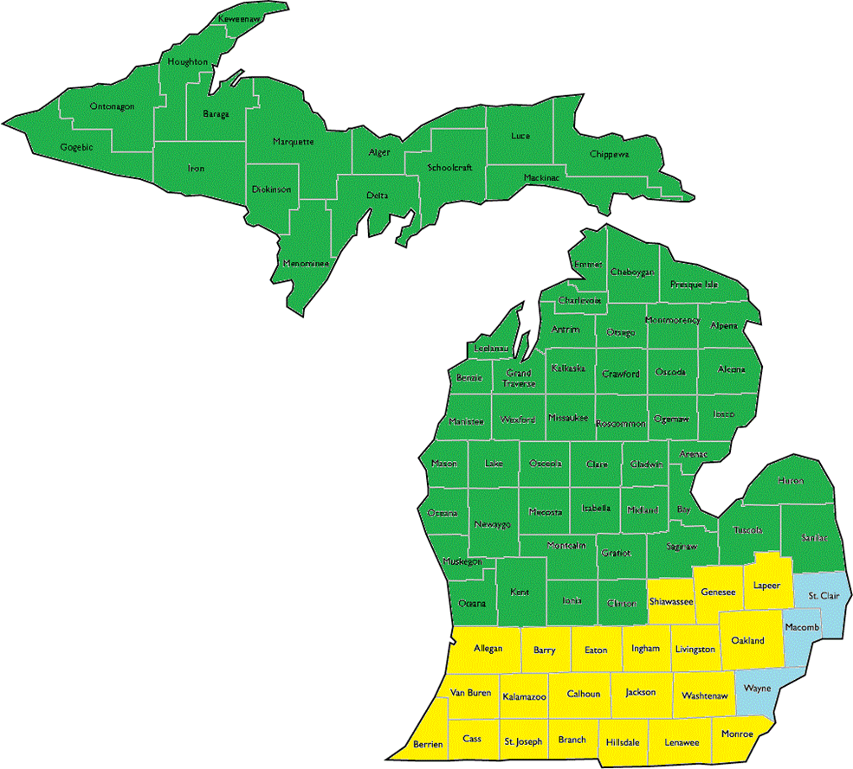

Slide 17
More Resources
Ticket to Work Helpline: 866-968-7842 (V) 866-833-2967 (TTY)
Ticket to Work Online: choosework.ssa.gov
Disability Rights Michigan Protection & Advocacy for Beneficiaries of Social Security (PABSS): 800-288-5923
Disability Benefits 101: mi.db101.org
Social Security My Account: www.ssa.gov/myaccount/
MDHHS MIBridges: newmibridges.michigan
This presentation was developed at U.S. taxpayer expense.

