Slide 1


Michigan Merit Curriculum and Personal Curriculum
Session #1
Oct 13, 2021
Session #2
Oct. 27, 2021
Notes:
Welcome intro

Slide 2

Series Agenda
Introduction and Welcome
Michigan Merit Curriculum (MMC) Overview, History, and Current Legislation
High School Website Tour
Testing Out and Proficiency
Teacher Certification
Personal Curriculum (PC) Overview and Legislation
Educational Development Plan (EDP), connection to PC
Scenarios

Slide 3
Series Overview
Participants will:
Understand the legal framework/requirements of the Michigan Merit Curriculum (MMC) and the Personal Curriculum (PC) including alignment to the student’s EDP IEPs, and transition plan (when applicable).
Apply the legal framework/requirements of the MMC and the PC to general education and special education case studies/scenarios.
The Ultimate Goal: Post HS Readiness upon graduation for ALL students!
Notes:
Reminder, info was in Info session, but there will be team members here that were not in that session.
Reminder of the things they should do to get the most out of the event. Team approach all sessions, 3rd/4th session added team members.
Homework done as a team.
Logistics.

Slide 4
MMC: Brief History
MMC credit requirements began with students who started 8th grade in 2006.
Prior to this legislation, Civics (.5 credits) was the only Michigan requirement.
World Language credit requirement (2 credits) kicked in for the graduating class of 2016 and beyond.
Requirements have been consistent since inception, with few exceptions.

Slide 5
Why did we need the MMC?
Make high schools rigorous academically and better prepare students for an increasingly competitive global economy.
Create consistency across Michigan High Schools.
Reduce remediation rates in college/post-secondary.
Improve graduation rates in higher education.
These graduation requirements were developed through a partnership between school administrators, teacher unions, educational and business organizations, legislators from both parties, and active support from the State Board of Education and state superintendent of public instruction.

Slide 6
Are Your Students Better Off?
Is It Working?
Did it Improve Our/Your System?

Slide 7
Local Control
Districts can have requirements beyond the MMC.
Students must fulfil district and state requirements to get a diploma from any individual district.
State authority ends with adoption of state standards/content and state assessment system components.
Districts make all the decisions around; curriculum, textbooks/materials, local assessment systems, grades/GPA, course design, teacher placement, proficiency, granting diplomas.
Let’s look at where we can find all this information!
Notes:
Go to HS page, assessment page, next slide is HS page

Slide 8
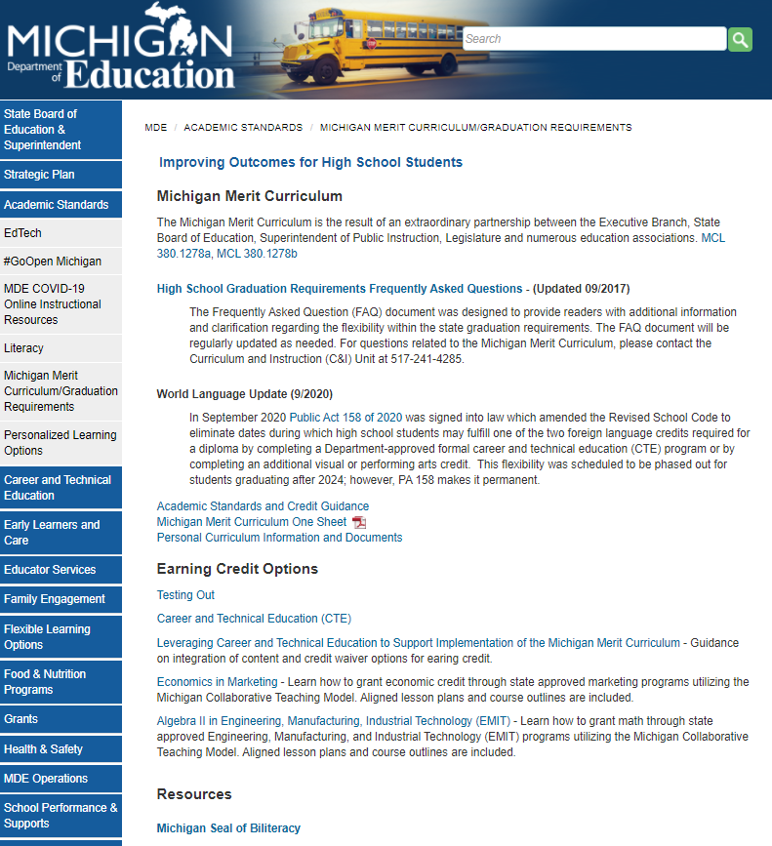
www.Michigan.gov/highschool

Slide 9
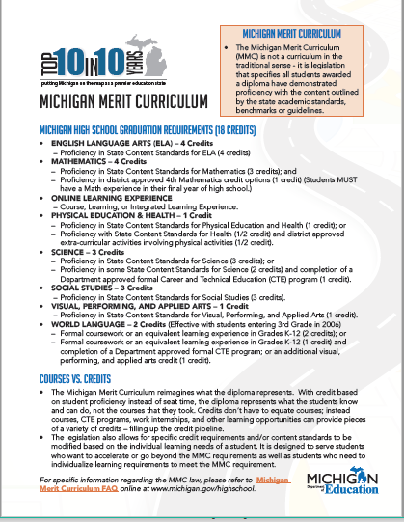
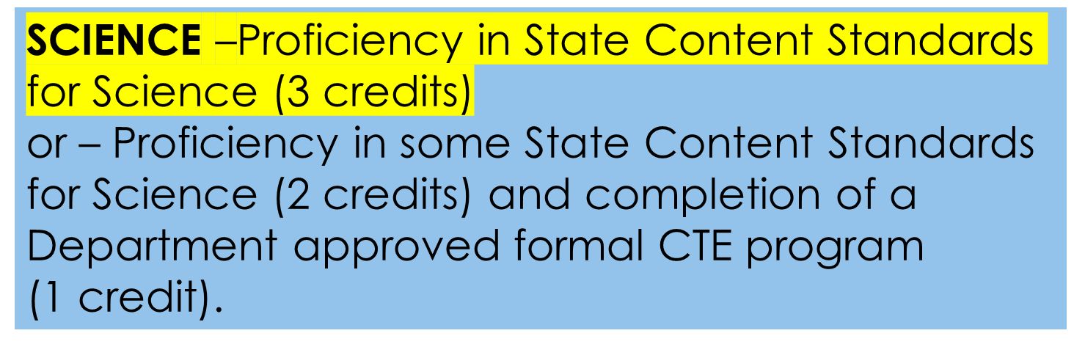

Slide 10
Teacher Certification
Two Different Conversations, different pieces of legislation
  Who is assigned to a course?
  MMC Credit for proficiency
Courses must have qualified teacher assigned
Credit is given by a district for PROFICIENCY
Credit is not dependent on teacher certification

Slide 11
Teacher Certification
Let's look at an example.
Course: Statistical Biology
  What will you call it (in reporting), who will teach it?
    You could code it as a math course, must have certified math teacher tied to it. Or tie 2 teachers to it.
  What standards will be covered?
    Math and science, 1 credit worth of each, 2 total.
  What will students gain proficiency in, get credit for?
    Algebra 2 and Biology
  District grants credit when students demonstrate they know standards.

Slide 12
Teacher Certification
Let's look at another example.
Experience: After school science camp at MSU
  Students learn dozens of science standards, including majority of the standards taught in traditional biology course.
  Students test out of “Biology” after the 8-week program using final exam for district Biology course.
  District, must grant credit if student show proficiency (C+) or better.
  No teacher cert discussion, district grants credit.

Slide 13
No PC
Student earns:
18 MMC credits
6 District credits totaling 24 (district requirement is 24).
Diploma

Slide 14
PC- Removes 6 MMC credits.
Student earns:
12 MMC credits
12 District credits still totaling 24 (district requirement is 24).
Student would need 6 additional electives to meet district total.
Diploma

Slide 15
PC- Removes 6 MMC credits.
Student earns:
12 MMC credits
6 District credits still totaling 18 (district requirement is 24).
Student would not take extra and graduates with 18 total if district approves.
Diploma

Slide 16
PC- Removes 6 MMC credits.
Student earns:
12 MMC credits
0 District credits still totaling 12.
Student would not take any extra and graduates with 12 total.
Diploma

Slide 17
Testing Out
What the MMC Law States:
A school district or PSA shall also grant a student a credit if the student earns a qualifying score, as determined by the school district or PSA, on 1 or more assessments developed or selected by the school district or PSA that measure a student’s understanding of the subject area content expectations or guidelines that apply to the credit.
Notes:
Linked to FAQ

Slide 18
Testing Out
Testing out Windows
  Flexible and not restrictive
Assessments
  Standards based, comprehensive
  Could also includes projects, papers etc.
Do students have to attempt a course before testing out?
  NO
Can students test out of a course they already failed?
  Yes

Slide 19
What Questions
Might you Have?

Slide 20
Personal Curriculum Defined
“The legislative intent of the Personal Curriculum (PC) is to individualize the rigor and relevance of the educational experience and provide a tool to help ALL students succeed with the Michigan Merit Curriculum (MMC).”
Personal Curriculum Guidelines 2009

Slide 21

A PC Can….
  Change the 18 credits required in the MMC.
  Remove an MMC credit/course allowing something that better meets the students needs to be built into their course of study.
  Be used by ALL students though different types of students have different rules.

Slide 22

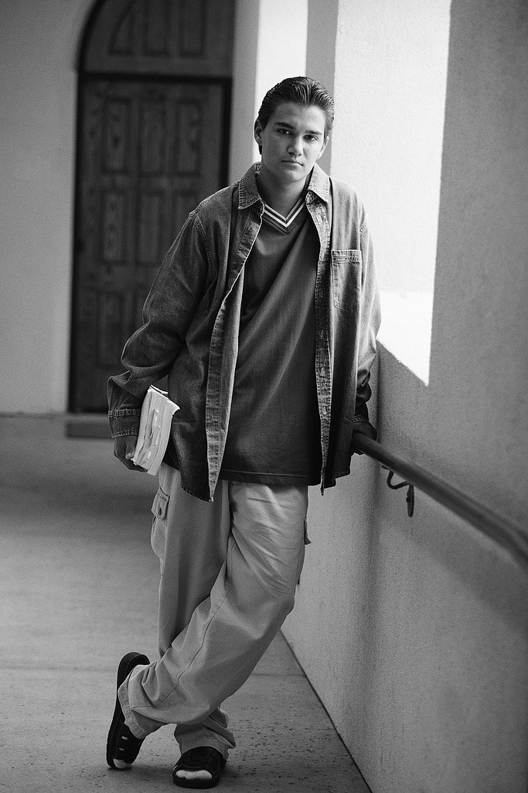
Diploma or Certificate of Completion?
Notes:
Tougher graduation requirements means that some districts will need to think about an “alternative” pathway for exiting HS.
School districts may issue a “certificate of completion” for those students who do not meet all of the requirements of the Michigan Merit Curriculum and have completed the school district’s credit requirements.
Students with a cert of Completion Can….
Enter trade or vocational school
Attend most CC
Enter certain branches of the U.S. armed forces
Apply for certain financial aid and scholarships

Slide 23
To go beyond the academic credit requirements (Enrichment)
To modify the mathematics requirement (General Modified)
To modify the requirements based on the disability of a student with an IEP
To modify credit requirements for a transfer student
PERSONAL CURRICULUM TYPES
Notes:
Let’s go into more detail about when a PC can be used. The use of a PC modification is allowed by state statute for only four reasons:
To go beyond the academic credit requirements by adding more math, science, English language arts, or world language credits.
To modify the mathematics requirement.
To modify the credit requirements based on the disability of a student with an IEP
To modify requirements for a student who transfers from out of state or from a nonpublic school and is unable to meet the MMC requirements.

Slide 24
PC TYPE #1: ENRICHMENT
  To go beyond the academic requirements by substituting 1 credit of the following for additional course work in the core content areas:
    Visual, Performing and Applied Arts credit
    PE/Health
    Social studies credit (excluding Civics)
Notes:
The first option is available to students who are motivated to access advanced or specialized content that cannot be met through electives. For example, a district lacks the resources to provide the course or the schedule does not allow the student to access a district offering. It is also a flexible option for those with the motivation to succeed in accelerated or advanced math, science, English language arts, or world languages. It allows any student to earn additional credit in specific subject areas and count these credits toward the meeting of the state graduation requirements.
A request may be made to substitute up to 1 credit of Visual, Performing and Applied Arts, if the student wants to take more math, science, English language arts or world languages.
In addition to or instead of substituting 1 credit of Visual, Performing and Applied Arts, students may substitute the 3rd social studies credit, excluding Civics, if the student wants to take more math, science, English language arts or world languages. Substituting credit requirement for one social studies credit may be done once a student has successfully completed two required social studies credits (which must include a ½ credit in Civics).
Students who request a PC are expected to meet proficiency requirements for all credits in a content area prior to implementing a Personal Curriculum to go beyond the academic requirements in that content area. For Example, a student must meet expectations for Algebra I, Geometry, Algebra II, and a fourth credit before implementing a PC to take additional mathematics in lieu of 1 social studies credit. The additional courses or credits may be taken concurrently with the final required credit.
If a Personal Curriculum is requested and granted and the student does not achieve proficiency in the required credits, the Personal Curriculum is null and void and the student will have to take the substituted credits to graduate.

Slide 25
type #1: Enrichment using cte
Students may substitute, upon completion (be a COMPLETER), a state approved formal Career and Technical Education (CTE) program for:
1 credit of social studies and/or,
1 credit of health and physical education and/or
1 credit of VPAA
Notes:
Gen ed can already replace 3rd science and 2nd WL

Slide 26
PC TYPE #2: General Modified (Math)
    Remember the MMC math requirement =4 credits
    This type of PC will modify the following component of the math requirement by .5 credits
      “Students must earn at least 3 credits in mathematics that are aligned with subject area standards approved by the State Board”
    With a PC in place, students must earn 3.5 math credits overall and take a math or math-related experience in one of their final two years
    Most typically done by reducing
    Algebra II by .5 credits
Notes:
The second reason for a personal curriculum allows adjustment of the mathematics requirement.
For students challenged with meeting Algebra II expectations, the law requires that a student successfully completes ninth grade before a PC can be implemented to modify the Algebra II requirement. A student earns the Algebra II credit when he or she has demonstrated proficiency in the required content expectations for Algebra II. This option allows a student to demonstrate proficiency in only half of the required content expectations for Algebra II and fulfill the Algebra II requirement by earning one-half credit of Algebra II, statistics, or functions and data analysis.
Modification of Algebra II requires students to complete a minimum of two-and-a-half math credits including Algebra I, Geometry, and one-half credit of Algebra II, or the equivalent of these credit requirements in an integrated math or other program, such as Career and Technical Education (CTE). Once this requirement has been met, a student must still earn one additional math or math-related credit.
Students must earn a total of three and a half math credits and take a math or math-related credit in their senior year.
Any student may take Algebra II over two years for two credits or earn full or partial Algebra II credit for content embedded in a formal career and technical education program or curriculum without requesting a personal curriculum.

Slide 27
Pc type #3: students with iep’s
  To modify based on the needs of a student with an IEP
    Allows modifications to any MMC requirement due to the impact their disability has on accessing or demonstrating proficiency in meeting expectations
  Must align IEP, transition plan, and EDP while keeping the MMC relevant and rigorous
Notes:
The third option applies to students with disabilities and allows specific modifications to the Michigan Merit Curriculum made necessary by the impact the disability has on accessing or demonstrating proficiency in meeting the expectations.
There must be a documented need to make modifications, because the student’s disability prevents access to and/or demonstration of proficiency in the curriculum, and there must be a lack of progress on the MMC despite documented interventions, supports, and accommodations. We’ll cover this more in the next section.

Slide 28
PC TYPE #4: Transfer
  First, let’s define Transfer students
    Completion of the equivalent of 2 years high school content out of state/country or nonpublic school
  Once YOU designate them as a transfer student, modifications are allowed in any MMC content area (similar to students with IEP’s)
  PC must be aligned with EDP (postsecondary and post-school goals)
  Can’t modify Civics

Slide 29
Must Do’s
Create local policy/procedure and communicate system wide because:
  When a PC is requested, one MUST be developed
  Written annual notice and website visibility is mandated
  A team is required which must include a parent, student, counselor or teacher, and special education representative (If IEP)
PC must be approved by Supt or Designee after being developed, before implementation
Parents must approve PC
Notes:
Stress the highlighted

Slide 30
Should Do’s
PC Request Form
  In office, online, easily accessible
PC Forms
  Should include student info, post-school pathway, modifications, and sign-off by parents (more on this to come)
PC Record keeping protocol
Annual Update of PC
  If student has IEP, this would align with transition plan update
  PC should be easily amendable

Slide 31
About the team
A team is required which must include a parent, student, counselor or teacher, and special education representative (If IEP) and have:
  Knowledge about the academic content being modified and behavior records/concerns
  Knowledge around student’s past achievement and true present levels
  Knowledge about student, post-school goals
  Knowledge on district course of study options, course offerings

Slide 32
Communicate to Parents/families
PC’s DO NOT transfer…anywhere
A PC requires district approval and there is no “grievance process” therefore they should be written to include as much of the MMC as possible, not requesting excessive modifications
State testing scores “could” be lower if a student has PC modifications
If students change their mind during HS on post-school goals it could void the PC and could mean extra time in HS to complete MMC
They must agree to any modifications

Slide 33
What Questions
Might you Have?

Slide 34
Educational Development plans
All students are required to have a completed EDP when they enter high school.
EDPs must be started during 7th grade, completed during 8th grade and updated annually through high school.
Must include:
  Personal Information
  Career Goals
  Awareness of career opportunities and job openings
  Education/training goals needed for each career goal
  Assessment Results
  Plan of Action
  Parent endorsement
Notes:
Linked
Importance of EDP in MMC, PC discussion

Slide 35
What does an EDP do?
Develops postsecondary goals in education, training, employment, and, when appropriate, adult living.
Identifies student preferences, interests, strengths, and needs.
Reviews academic performance, learning style, and effective support strategies for students in grades K-8.
Identifies and coordinates courses, experiences, support, and possible consideration of a Personal Curriculum (PC).
Notes:
Linked
Importance of EDP in MMC, PC discussion

Slide 36
That was ALOT of information!!
What QUESTIONS do you have?
Notes:
Linked
Importance of EDP in MMC, PC discussion

Slide 37
Scenarios and Discussion
Let’s look at several scenarios based on typical students.
There will be enough general information, but you will need to know more and ask the right questions to get at the real need for a PC.
There is no right or wrong answers or questions.
You will decide as a team what to modify if there should be a PC implemented.

Slide 38
Scenario: Nicole
Nicole is a 10th grader who receives special education services due to her certification as a student with a disability in math.
Parents requested a PC to modify both Geometry and Algebra II, reducing the math requirement from 4 credits to 2 credits.
She has taken Algebra I with accommodations and support per her IEP, but she has failed once and is currently failing in her 2nd attempt.
According to Nicole’s EDP and transition plan she wants to become a Child Care Provider after high school.
She is barely passing most of her other courses.

Slide 39
Scenario: Ryan
Ryan in starting his 11th grade year in the fall, he has an IEP and qualifies in both reading and math.
He wants to be a chef and own a restaurant one day.
Ryan hopes to enroll in the culinary arts sequence through CTE his last two years of HS.
Ryan hasn’t earned any world language credits due to the extra support needed in ELA and math.
Ryan’s special education case manager has requested a PC to modify the world language requirement to make room in his day for CTE. This request is to modify the 2-credit requirement, changing it to 0 credits.

Slide 40
Scenario: Josh
Josh has a cognitive impairment and is in 12th grade.
He spends half of the day in a CI room for core academics and the other half of the day he attends a CTE employability program, he will not be a “completer”.
  Math functioning- 9th percentile, currently working on single digit multiplication and division.
  ELA functioning- <10th^{th} percentile, currently reading level 3 books with average comprehension.
He has been on a certificate of completion pathway since 6th grade. Focusing on functional learning.
Josh’s parents learned about the PC and want his IEP to be changed to “Diploma”. They have requested all MMC math, ELA,WL, and science removed (13 credits).
He has earned 3 Social studies, 1 PE/Health, and 1 arts credit.
Based on his TP, Josh wants to mow lawns and work at his parent's business.

Slide 41
Scenario: Justin
Beginning 11th Grade year, EDP states he would like to attend a diesel mechanic program in Ohio after graduation.
Missing a few credits (2 math, 1 science, electives) due to attendance and missing work. Grades overall are average, and he is proficient on the PSAT in all areas.
Justin/parents have asked the counselor about a PC to make up some credits.
Main concern is not graduating with class, doesn’t want to come back for a 5th year.

Slide 42
Scenario: Clare
Clare transferred here from Wyoming over the summer, she was going to be a Senior in the fall.
Wyoming only requires Alg. 1, and 2 science credits, plus no world language credits. She was on track in Wyoming.
She would not have room in her schedule for everything to get her to the district required credits in her remaining year.
Clare wants to be a registered nurse but unsure where she will attend.
The counselor wonders if a PC might be helpful for Clare.

Slide 43
Scenario: Tyler
Tyler begins 11th grade next month, though he only has 8 credits and has failed most core academic courses.
He is scheduled to repeat Algebra 1 for the 3rd time.
His EDP states he wants to work in construction and maybe own his own business someday.
PSAT scores form last year show not proficient across the board.
He is meeting with the counselor to discuss options and the possibility of a PC.

Slide 44
Scenario: Olivia
Olivia is new to your school; she will be a 10th grader in the fall.
She did not bring her transcript and her family moved here from Mexico for work in the area.
She speaks fluent Spanish from what you have witnessed, Spanish is the primary language in the home.
It appears the family plans to stay in Michigan until graduation and Olivia wants to attend a 4-year university to become a Veterinarian.
You are meeting with Olivia to discuss her fall schedule and the possibility of a transfer PC.

Slide 45

Additional Questions and comments can be directed to:
Rashell Bowerman
bowermanr1@michigan.gov
517-335-3062

